Slide 1
Introduction To
Engineering Drawing
By Eddie Cody

Slide 2
Paper Sizes
All engineering drawings are printed on paper.
The size depends on the size and scale of the component.
The metric A series of paper is normally used as it is standard throughout Europe and most of the world. The actual sheet sizes (in millimetres) are as follows:
A0 841 x 1189 (1m²)
A1 594 x 841
A2 420 x 594
A3 297 x 420
A4 210 x 296

Slide 3
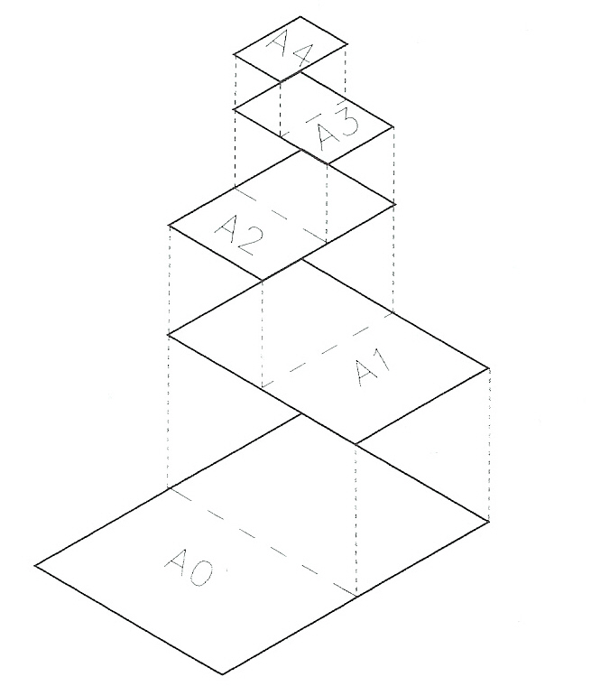
Paper Sizes (cont)
Note that each sheet size is half the previous one

Slide 4
Title block
The paper on which engineering drawing are produced is normally
surrounded by a bold border called a frame.
At the lower right-hand corner of the frame there should be a title block;
the title block must contain a minimum of six items in order to conform to
BS 308 guidelines.
Draughtspersons name or title (DRAWN)
Date of drawing
Projection symbol
Scale ratio
Component title
Drawing number
Further information is nearly always required.

Slide 5
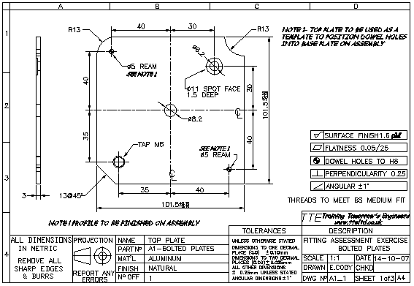
Title block (cont)
A typical drawing-page layout is illustrated below.

Slide 6
Verification of drawings
It is good practice to check that any drawings being used is current.
Engineering drawings are often altered to update specifications, standards and sizes.
It is important to ensure the drawing being used is the most recent issue for all work.
This verification should be carried out if there is any doubt about the correctness of the drawing or its content.

Slide 7
Methods of verifying engineering drawings
Check the date of issue on the drawing.
See if there is an expiry date.
Ask your supervisor if you have any doubts.
Contact the draughtsperson (where possible) if any doubt persists

Slide 8
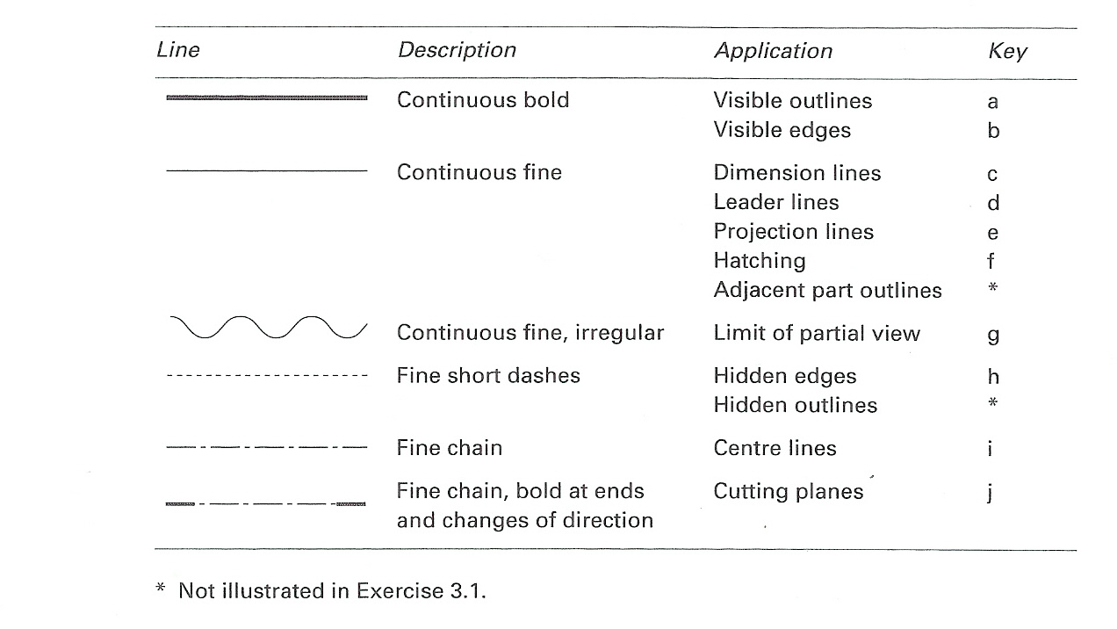
Types of lines
Various features on engineering drawings are represented by particular lines.
The table below shows the correct type of line for several applications as recommended in BS 308.
The correct type of line should always be used.

Slide 9
Orthographic projection
Designers need to represent components clearly on paper in the form of drawings if they are to be manufactured as required.
The preferred methods of drawing components for manufacture is to set two or more views of them on paper in a logical manner using a drawing system called orthographic projection
There are two types of orthographic projection; first-angle orthographic projection (first-angle projection) and third0angle orthographic projection (third-angle projection)

Slide 10
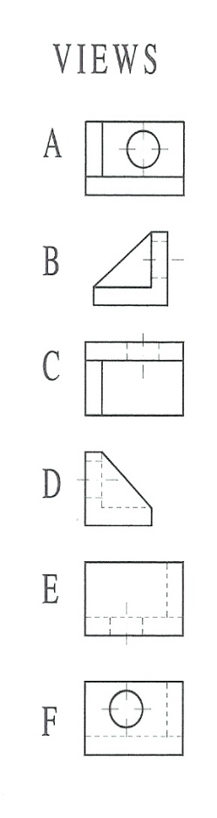
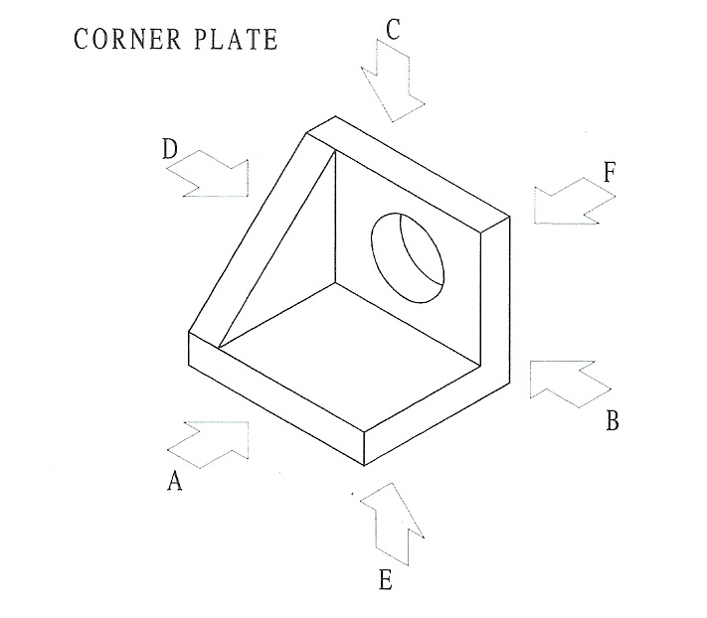
First-angle projection
This is constructed by looking at the component and selecting the faces which reveal the most features. Consider the corner plate shown here. It could be viewed in any of the six planes shown.

Slide 11
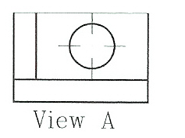
First– angle projection (cont)
Examination reveals that views A, B and C show the greatest number of visible edges whereas views D, E and F leave some of the details obscured.
Three views are generally chosen and the preferred views A, B and C have been selected here as the most appropriate for a first-angle projection of the corner plate.
For the correct layout of the corner plate in first-angle projection, the procedure is as follows:
1. The elevation considered to reveal the most features is drawn. For the purpose of this exercise, view A is chosen

Slide 12
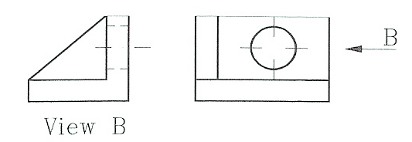
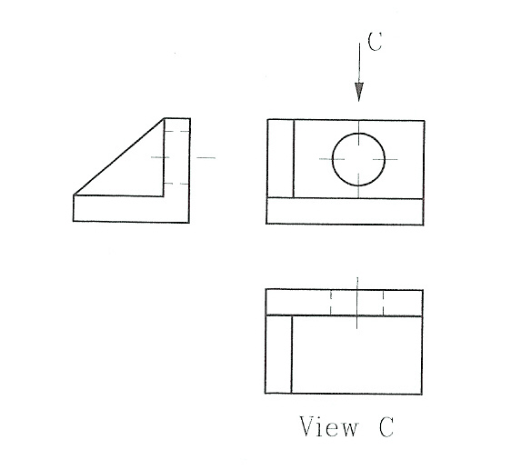
First– angle projection (cont)
2. View B is then drawn to the left of view A. Note that view B is drawn
opposite the side from which it is viewed (arrow B).
3. View C is drawn directly below view A. Not that view C is drawn opposite the side from which it is viewed (arrow C).

Slide 13
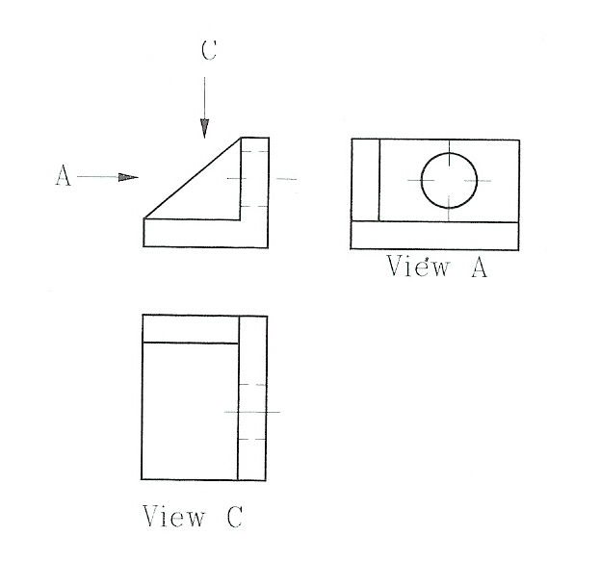
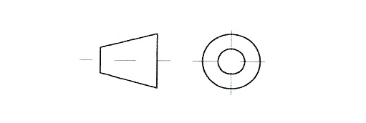
First– angle projection (cont)
If you consider view B to be the face with the most detail, then the first-angle projection would be drawn like this:
The British standard symbol for first-angle projection is shown
below. This symbol must be included in the title block whenever
first-angle projection is used.

Slide 14
Third– angle projection
Third-angle projection (American projection) is an alternative method of laying out the individual views on the page
When using this projection we use the same planes of projection as described for first-angle projection, but the views are not laid out on the same side as they are viewed from.
A drawing of the corner plate in third-angle projection is constructed as follows:

Slide 15
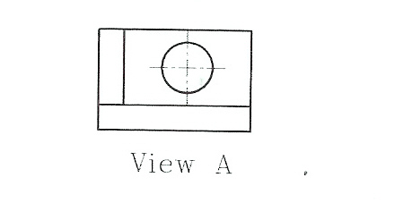
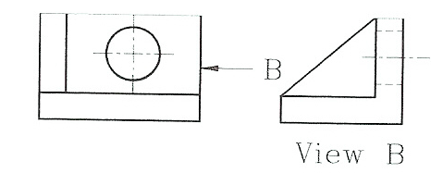
Third– angle projection (cont)
1. The elevation considered to reveal the most features is drawn. For the purpose of this exercise, view A is chosen
2. View B is drawn on the right of view A. Note that view B id drawn on the side from which it is viewed (arrow B)

Slide 16
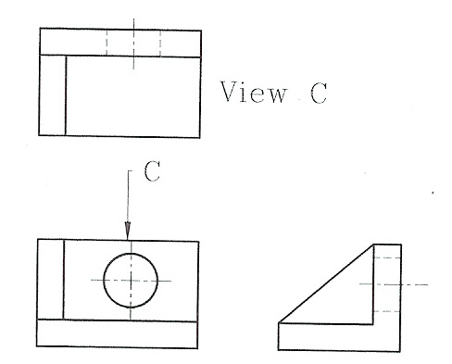
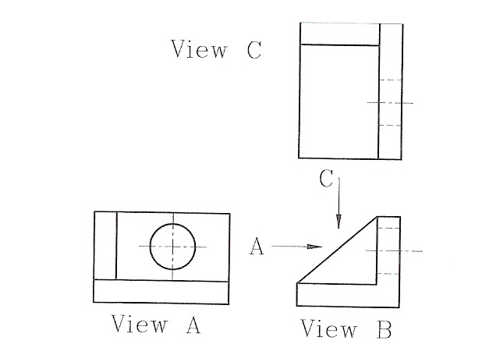
Third– angle projection (cont)
3. View C is drawn directly above view A. Note that view C is drawn on the side from which it is viewed (arrow C)
If you consider view B to have the most detail, then the third-angle projection of the corner plate would be laid out like this:

Slide 17
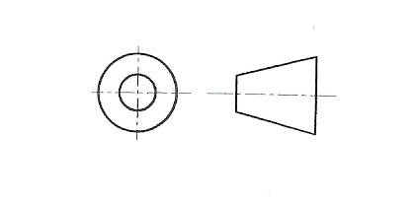
Third– angle projection (cont)
The British Standard symbol for third-angle projection is shown below. This symbol must be included in the title block whenever third-angle projection is used.

Slide 18
Dimensioning drawings
An engineering drawing contains information about the shape of a component.
It also shows dimensions regarding the sizes and the limits to which the component should be manufactured
All dimensions are in millimetres (mm) unless otherwise stated
Information regarding dimensions must be clear and in accordance with BS 308, the fundamental requirements of which are described below:
When applying dimensions to a drawing, use thin continuous dimension lines, projection lines and leaders.
Arrowheads on dimension lines and leaders must be solid and slender.
Dimension lines should not cross each other.
When adding notes to a drawing, the letters, numbers and symbols should be bold and clear, not less than 3mm in height. Capital letters are generally preferred.

Slide 19
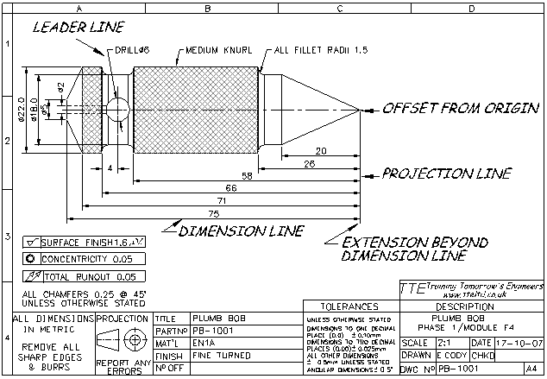
Dimensioning drawings (cont)

Slide 20
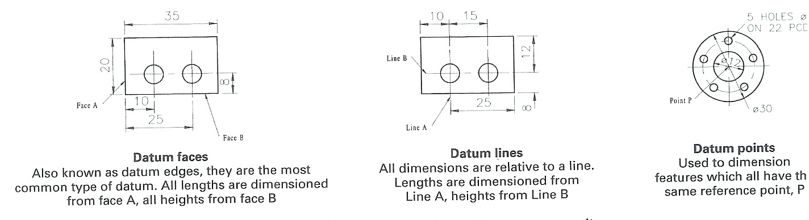
Dimensioning drawings (cont)
When applying dimensions to a drawing, all distances in each direction must be taken from the same face, line or point. This face, line or point is called a datum.
The height, length and width measurements all have separate datum's.
Note: On these three examples only one type of datum is shown for each drawing. In practice a drawing may show more than one type of datum e.g. a datum line and a datum face.

Slide 21
Dimensioning drawings (cont)
The symbol ø preceding a dimension indicates a diameter.
There are several methods of dimensioning circles. Choose according to the size and location of the circle, and whether dimensioning a hole or a shaft.

Slide 22
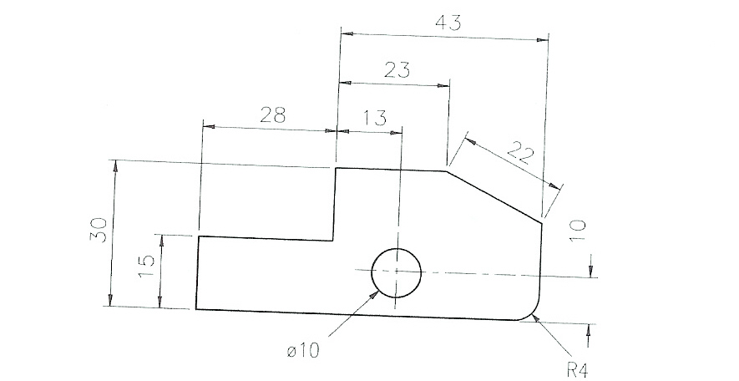
Dimensioning drawings (cont)
Dimensions and text should be placed outside the drawing outline wherever possible

Slide 23
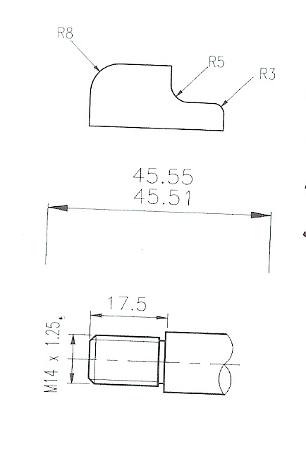
Dimensioning drawings (cont)
The text should be centred above the dimension lines so it can read from the bottom or the right-hand side of the drawing.
When dimensioning a radius (curved surface), use a leader and the abbreviation R to precede the size of the curve’s radius.
Each dimension should be given only once and should be as close as possible to the relevant feature.
The illustrated method is recommended for stating size limits of an individual dimension. Note that both the max and min permissible sizes are shown.
Metric screw threads are specified by the letter M followed by the diameter of the thread (M8), a x sign then the pitch of the thread (1.25), giving M8 x 1.25.

Slide 24
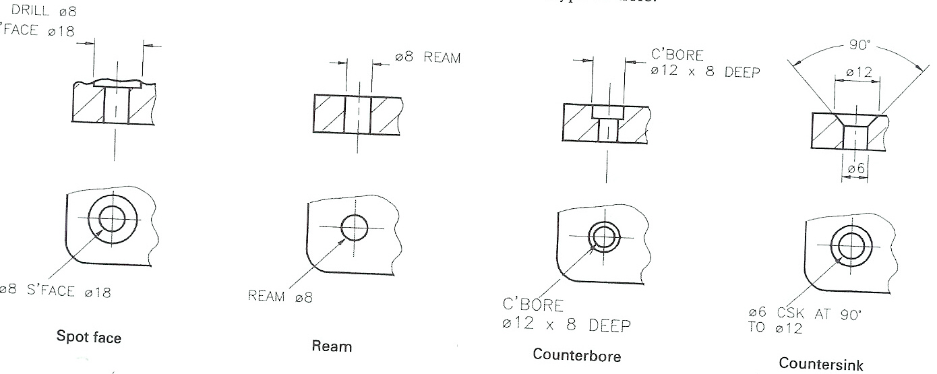
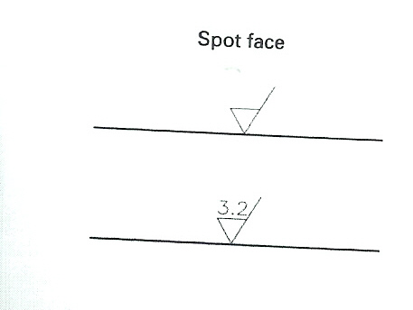
Dimensioning drawings (cont)
Holes for fasteners or for locating devices should be dimensioned by one of the alternative methods shown for each type of hole.
When indicating that a surface is to be machined, the machining symbol is drawn on the surface of its projection.
If a specific surface texture is required, the roughness average (Ra) value is written on top of the machining symbol. The illustrated surface is to be machined to an Ra of 3.2um

Slide 25
Sectioning
A section elevation may be of benefit when a drawing contains so much hidden detail that it has become unclear.
A sectional elevation is a view of part of a component when viewed on a cutting plane.
The cutting plane on engineering drawings is shown as a fine chain line with thick ends; the viewing direction is indicated by two arrows against these ends with identifying letters e.g. A-A.

Slide 26
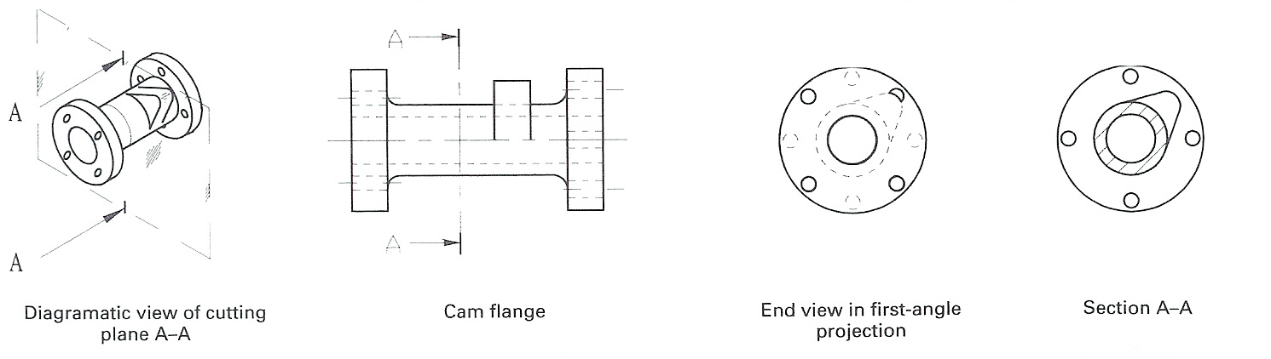
Sectioning (cont)
Consider the cam flange shown above. When the end view is drawn in first-angle projection, the resulting drawing contains much hidden detail.
Compare this with the sectional view A-A, this would be seen if the cam flange were viewed on the cutting plane.
View A-A shows more clearly the wall thickness of the tube, the shape of the cam and the positions of the holes in the right-hand flange
The area through which the cutting plane passes is hatched with fine lines drawn at 45º, usually about 4mm apart

Slide 27
Sectioning (cont)
The layout of a sectional view is always in accordance with the rules for
orthographic projection.
For example, the cam flange shown is in first-angle projection, i.e. it is
viewed in the direction of the arrows A, so the sectional view is drawn
opposite the side from which it is viewed.
Do not hatch these features when cutting plane passes lengthways
through them:
Webs (supporting ribs)
Fasteners (nuts, bolts and washers etc.)
Shafts
Thin sheets

Slide 28
Sectioning (cont)
When a component is sectioned through a hole or other similar
feature, the hatching lines on all the areas of that component
have the same pitch (spacing) and angle.

Slide 29
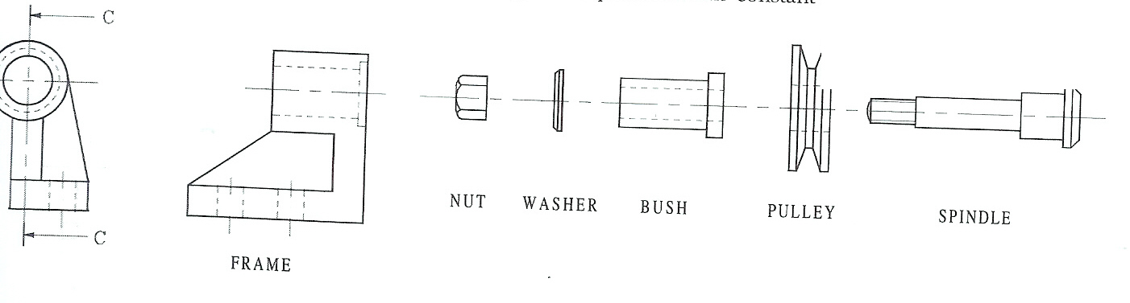
Sectional assembly
When drawing a sectional view through an assembly it is correct
to draw the direction of hatching lines reversed for adjacent parts.
For clarification the pitch of the hatching lines can be adjusted as
long as the pitch remains constant for any single component
These drawings are the component parts of a pulley mounting bracket.

Slide 30
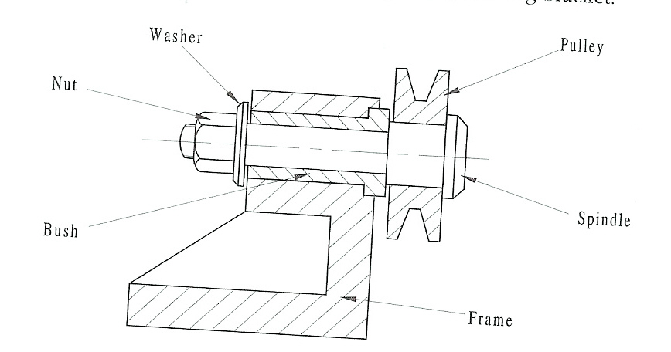
Sectional assembly (cont)
Sectioned assembly looking on cutting plane C-C of the pulley mounting
bracket above. Note that the pin, nut and washer are not hatched

Slide 31
Isometric projection
This is used when a pictorial shape of the finished object is required.
This type of projection shows a 3D like image, which is easier to visualise than an orthographic drawing.
It is used extensively in books and catalogues as it can be understood by non-engineers.
Isometric drawings are not always used for production so dimensions are not always included.

Slide 32
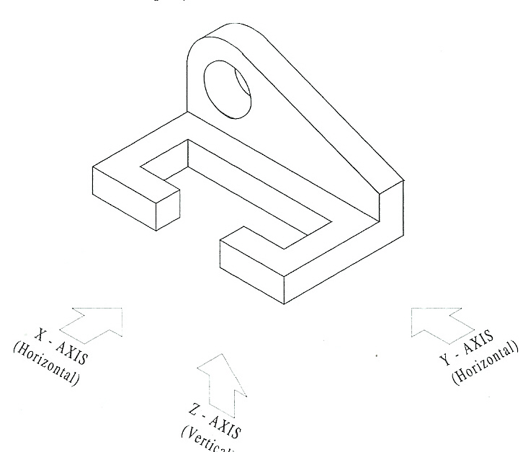
Isometric projection (cont)
On isometric drawings all horizontal lines on the X and Y planes are drawn at 30°.
Vertical lines are drawn vertically
All lines are drawn to a constant scale
An example of a component in isometric projection is shown below.

Slide 33
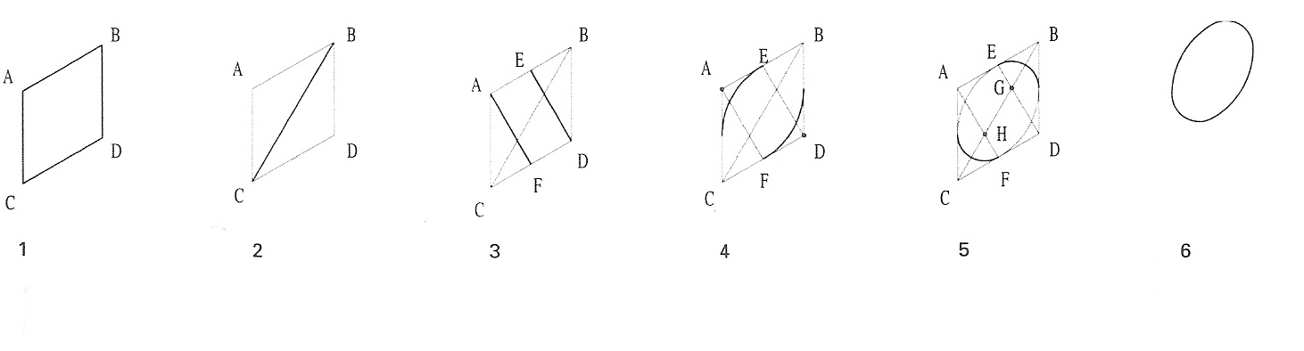
How to sketch isometric circles
Draw an isometric box ABCD which the circle will fit inside.
Insert the longest diagonal BC of the isometric box.
Draw a line AF and DE from each obtuse-angled corner (those with angles greater than 90º) of the isometric box, to the midpoint of the opposite line. These lines pass through the diagonal.
From the obtuse-angled corners (A and D) strike two arcs with a compass. The compass point located at point A for the first arc, at point D for the second.
From the points of intersection (G and H) of the short lines with the long diagonal (BC), strike two arcs. The compass point is located at point G for the first arc, at point H for the second.
Erase all construction lines.

