Slide 1

Centrifugal and Positive Displacement Pumps
Website: www.ttetraining.ltd.uk

Slide 2
Objective of pumping system
Transfer liquid from source to destination
Circulate liquid around a system
2
Notes:
2

Slide 3
Pump Classification
Classified by operating principle
PUMPS
DYNAMIC
POSITIVE DISPLACEMENT
CETRIFUGAL
SPECIAL EFFECT
(JET PUMPS)
ROTARY
RECIPROCATING
GEAR PUMPS
LOBE
SLIDING VANE

Slide 4
Dynamic pumps
  How they work
  Rotating impeller converts kinetic energy into pressure or velocity to pump the fluid
  Two types
  Centrifugal pumps: pumping water in industry it is said they account for 75% of pumps installed
  Special effect pumps: specialized conditions

Slide 5
Centrifugal Pumps
Impeller
Main rotating part that provides centrifugal acceleration to the fluid
Number of impellers = number of pump stages
Impeller classification: direction of flow, suction type and shape/mechanical construction
Shaft
Transfers torque from motor to impeller during pump start up and operation

Slide 6
Centrifugal pump main components
  Prime movers: electric motors, diesel engines, air system
  Piping to carry fluid
  Valves to control flow in system
  Other fittings, control, instrumentation
End-use equipment
  Heat exchangers, tanks, steam boilers, hydraulic machines, etc.
6
Notes:
6

Slide 7
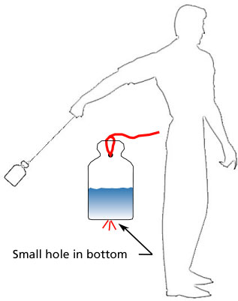
Centrifuge Force

Slide 8
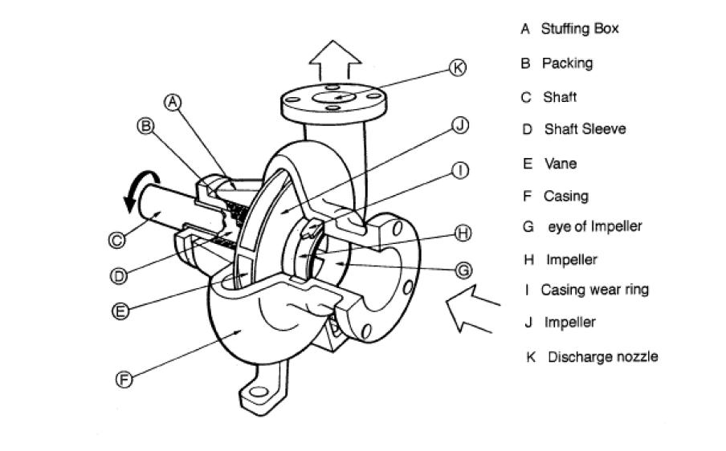
What is a centrifugal pump?
Three basic components:
Volute, casing, body or Diffuser
Impeller or impellers
Driver (motor)

Slide 9
Centrifugal Pumps How do they work?
Liquid forced into impeller
Vanes pass kinetic energy to liquid: liquid rotates and leaves impeller
Volute casing converts kinetic energy into pressure energy

Slide 10
Impeller and volute
Arrows represent the direction of water flow
Discharge
Nozzle
Cutwater
Suction Eye

Slide 11
Pump Impeller
Direction of
rotation

Slide 12
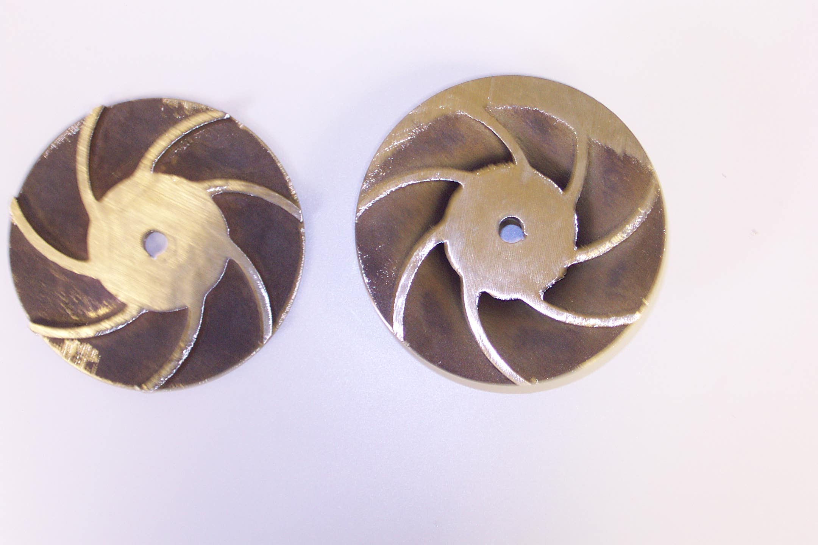
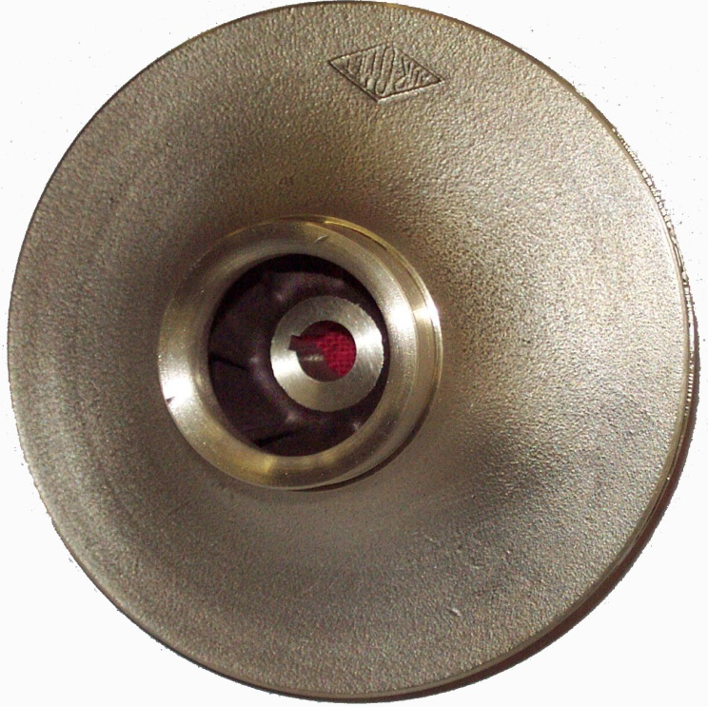
A typical single sectioned suction impeller

Slide 13
Single suction impeller

Slide 14
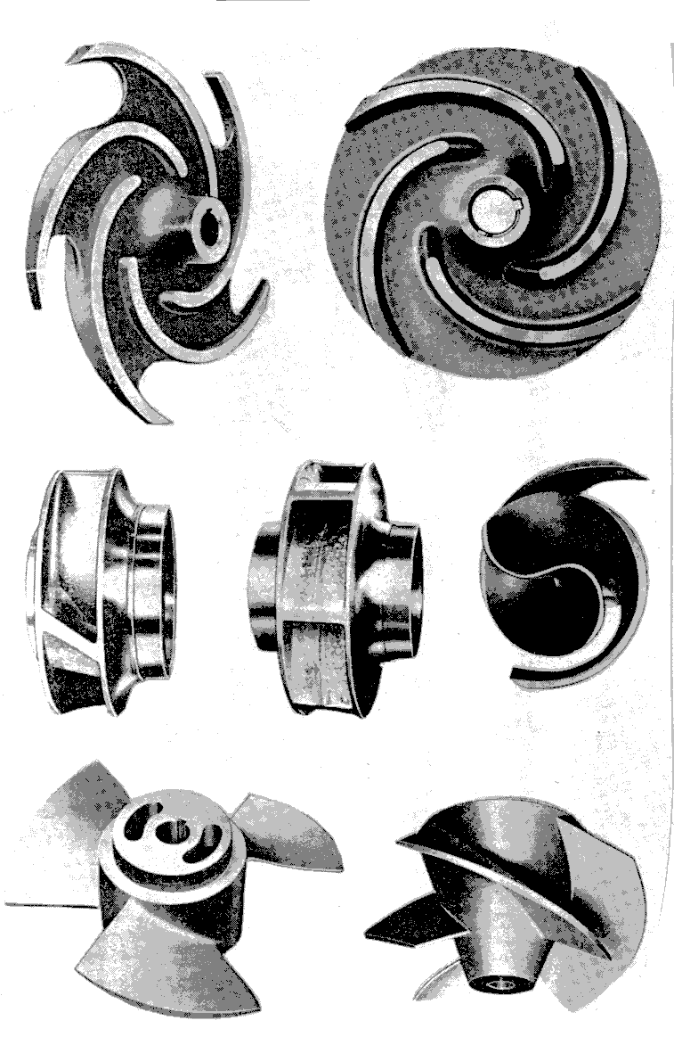
Impeller Types
Open
Semi-open
Closed
  Single suction
  Double suction
Non-clogging
Axial flow
Mixed flow

Slide 15
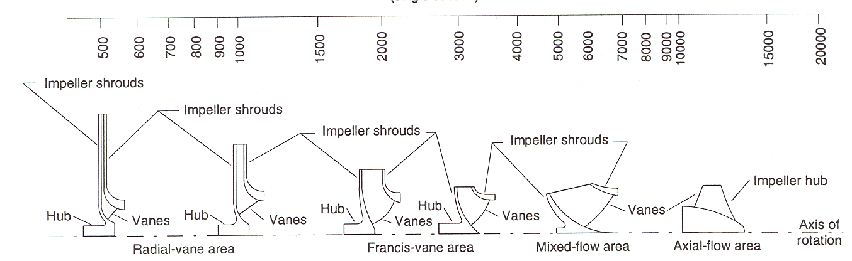
Impeller Profiles
Speed of rotation

Slide 16
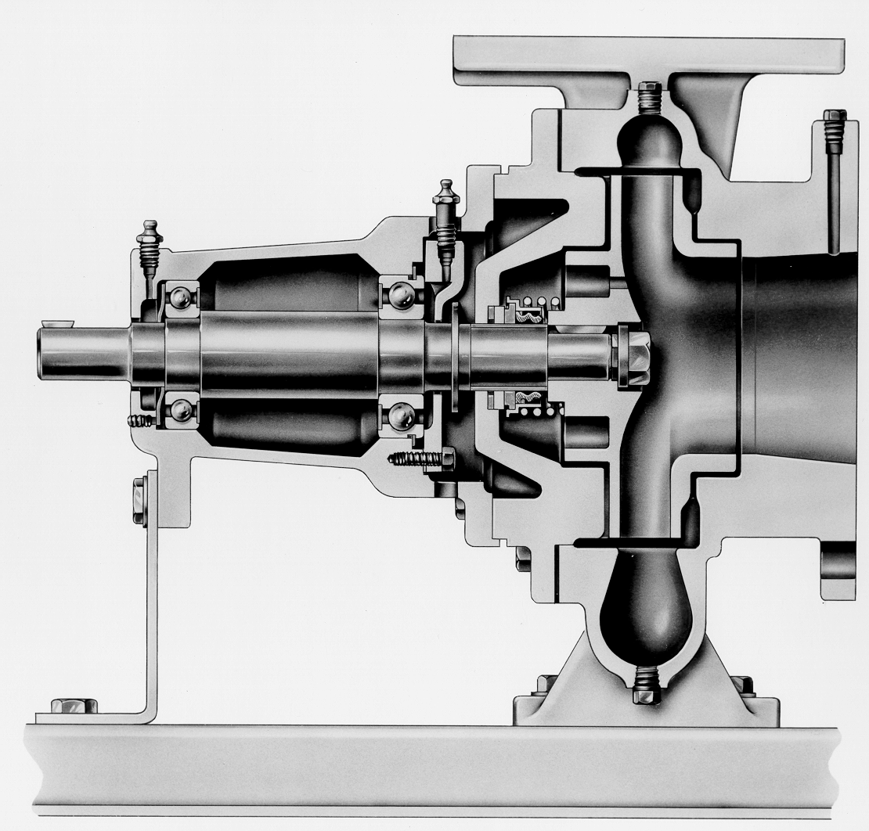
Section view of a typical pump

Slide 17
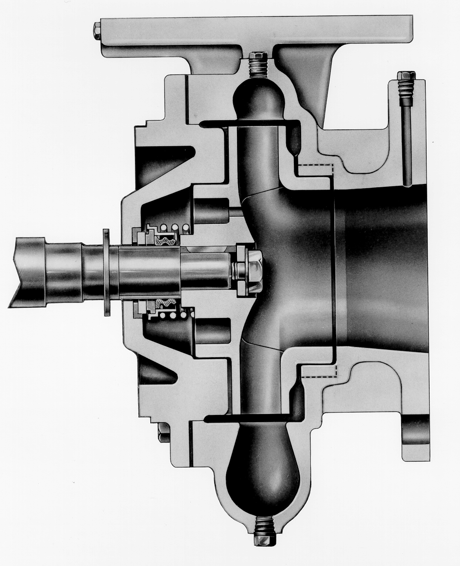
Standard closed impeller with balance holes fitted with a mechanical seal

Slide 18
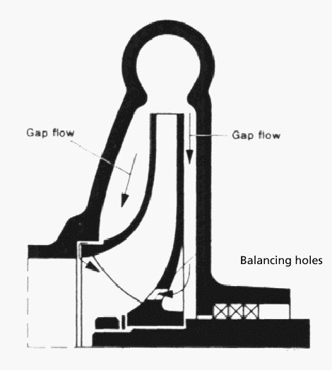
The flow of liquid around a closed impeller to help balance the forward thrust of the rotating element, but without a separate wear-ring system the effect is very ineffective.

Slide 19
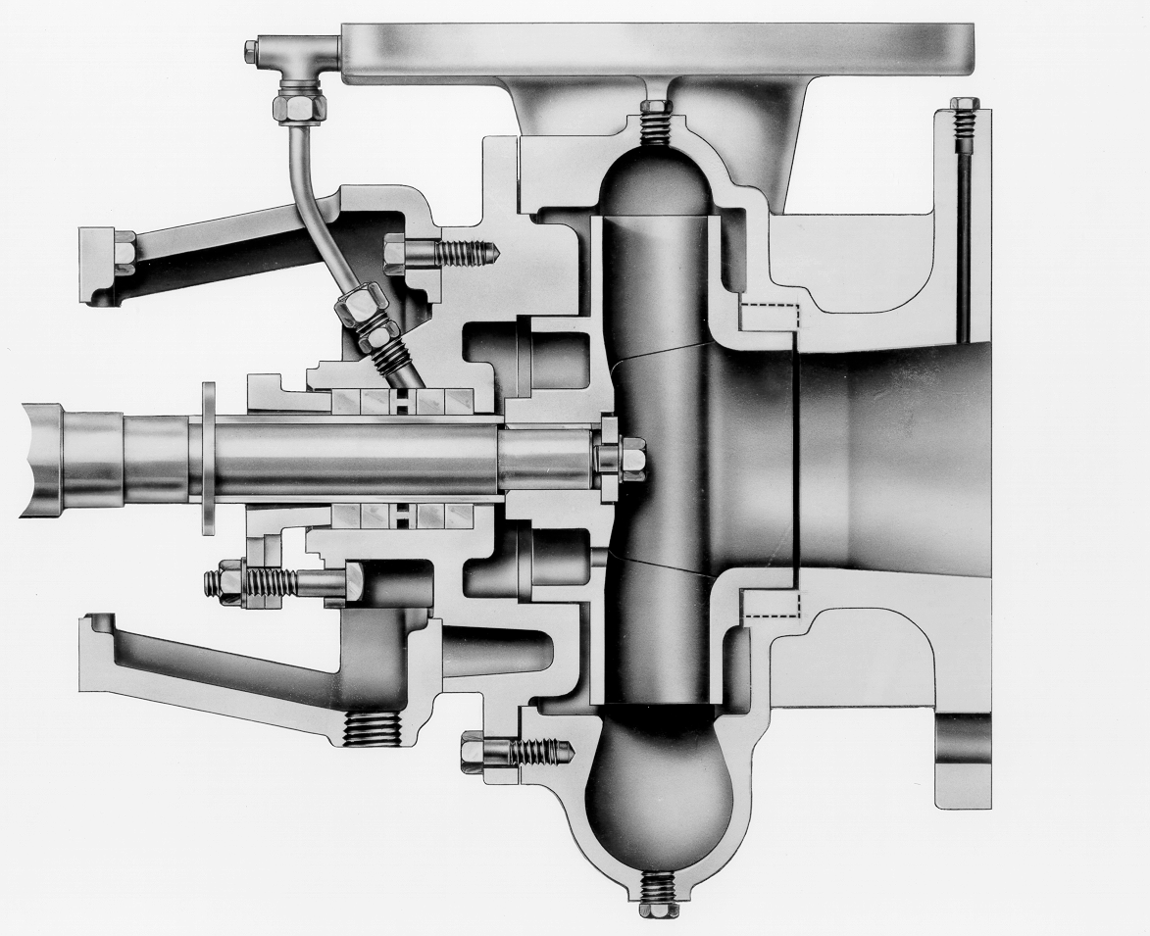
Standard closed impeller with balance holes fitted with a packed gland stuffing box seal

Slide 20
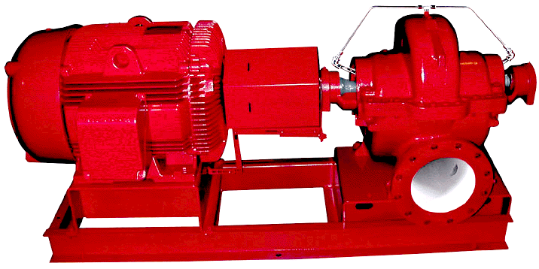
Double Suction Pump

Slide 21
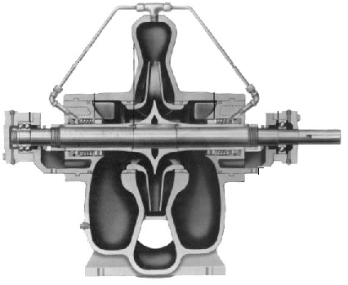
Double Suction Split Case Pump
The design permits removal of upper half for inspection, maintenance without disturbing piping or motor and the pump is radially and axially balanced for long life.

Slide 22
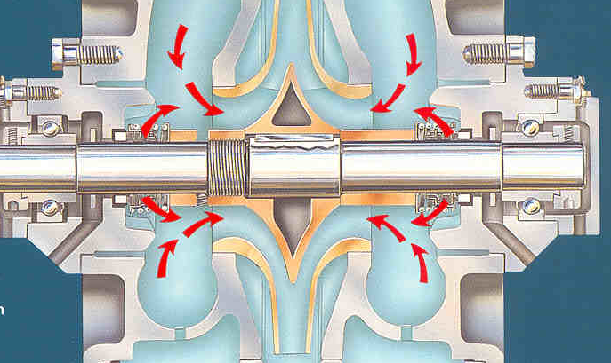
Split case Suction Flow
The inlet area of the fluid to the impeller is larger (each side of the impeller) than single inlet pumps and therefore these pumps can cope with low or negative suction applications.

Slide 23
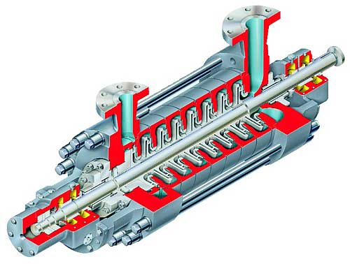
Radially Split Case
Multistage Pump
Mainly used in boiler feed, high pressure process, and some high pressure cleaning applications. The design develops a very high axial thrust that has to be contained by using a shaft mounted thrust piston at the discharge end pump. The pumps are always protected by a minimal flow setup.

Slide 24
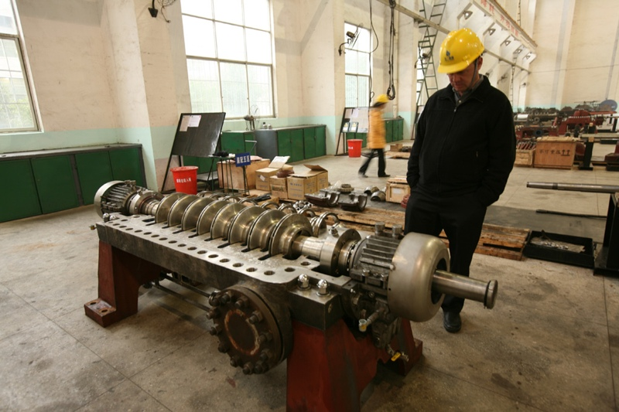
Horizontal Split Case
Multistage Pump

Slide 25
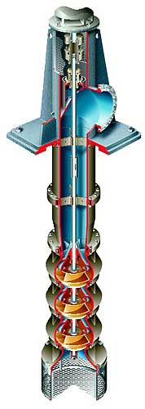
Turbine Vertical Multistage Pump
This type of pump has a large range of capacity and head. It has the advantage that it reduces a negative suction head in difficult site pumping applications. Designed for ease of maintenance and can have stages added quite easily.

Slide 26
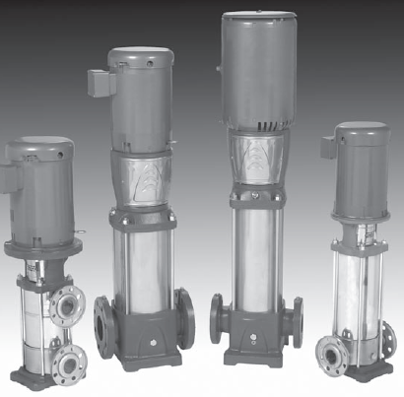
Multi-stage vertical pumps

Slide 27
Multi-stage pump
“Diffusers

Slide 28
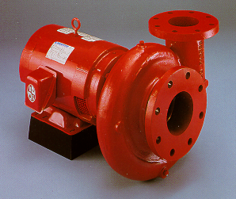
Close-Coupled Pump
General use in commercial or Small industrial type pump cheap and sometimes see as uneconomical to repair. Compact design, motor mounted to pump, no need for additional coupling or base plate.

Slide 29
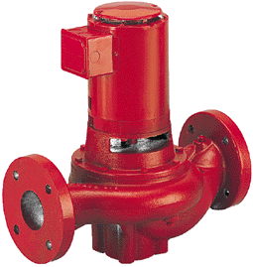
Large, Line Mounted Pump
Mainly used in the petrochemical, chemical and refining industries.
Mounts in and is supported by the piping system. Eliminates the foundation and grouting costs.

Slide 30
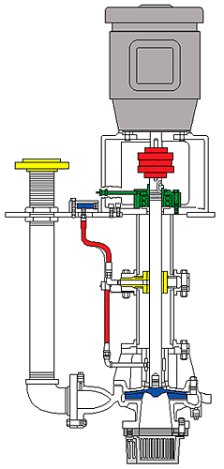
Wet Sump Pump
This pump is designed to be suspended from an tank top by means of a drop pipe and can be used for pumping hazardous or other solids laden liquids. This is also called a cantilever-shaft pump and has the feature that there are no seals or bearings below the liquid level.

Slide 31
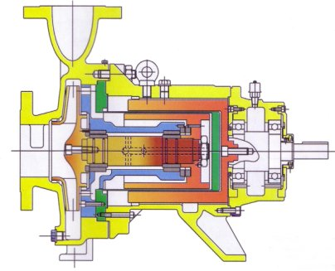
Can or Magnetic Drive Pump
This is a sealless volute type pump and is used for fluids that are corrosive, volatile, high temperature, solids bearings liquids, radioactive and toxic fluids. This type of pump is used where leaks, even the smallest, cannot be tolerated

Slide 32
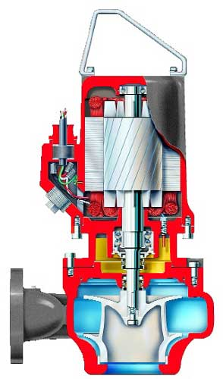
Submersible or Sump Pump
This is the typical submersible sump pump. They resemble a wet-pit volute pump except that the motor also is submerged. They are very popular for controlling water level in sumps in all types of industry. They are usually connected to a flexible hose and are usually easily removed for maintenance.

Slide 33
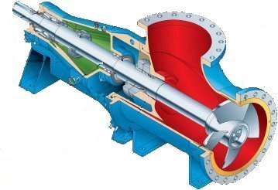
Axial Flow Jet Type Pump
This style of pump is used for high flow, low head purposes. Manly used in very special function
in the chemical, mining, petroleum, pulp & paper and food general applications.

Slide 34
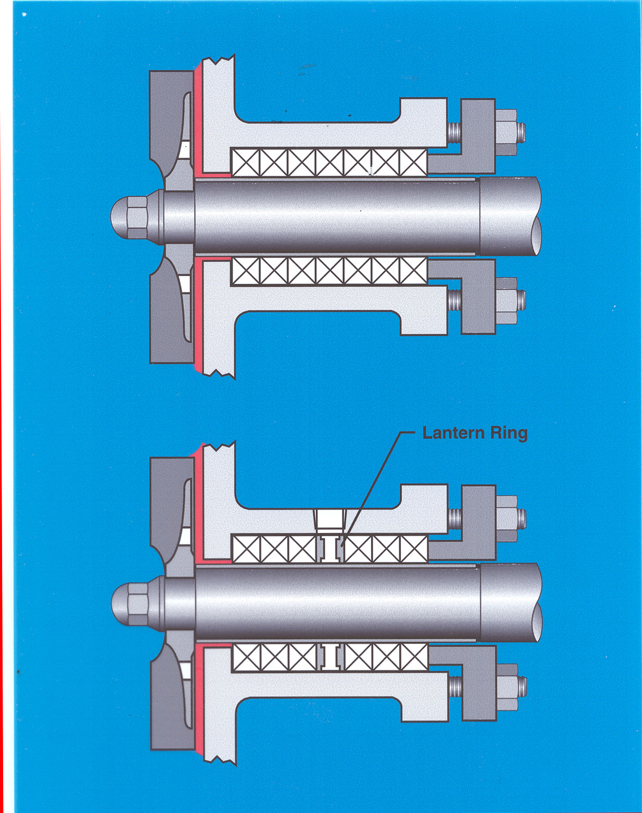
Packing Installation

Slide 35
Liquid-Abrasives Separator

Slide 36
Main Causes pump failure
CAVITATION
LACK OF FLUID
REVERSE ROTATION
CYCLING
COUPLING MIS-ALIGNMENT
IMBALANCE
CLOSED HEAD OPERATION

Slide 37
CAVITATION
Symptoms
1. The pump sounds like it is pumping rocks!
2. High Vacuum reading on suction line
3. Low discharge pressure/High flow
4. Power draw not as per manufacturers curve

Slide 38
CAVITATION
Causes
1. Clogged suction pipe
2. Suction line too long
3. Suction line diameter too small
4. Suction lift too high
5. Valve on Suction Line only partially open
6. Discharge pressure too low

Slide 39
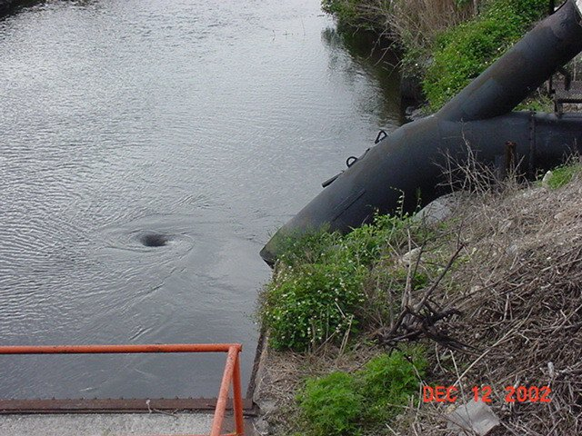
CAVITATION
Beware of suction line problem such as vortex forming around the suction filter

Slide 40
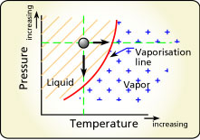
Suction Cavitation occurs when the pump suction is under a low pressure/high vacuum condition where the liquid turns into a vapour at the eye of the pump impeller.

Slide 41
This vapour is carried over to the discharge side of the pump where it no longer sees low pressure and is compressed back into a liquid by the discharge pressure. This imploding action occurs violently and attacks the face of the impeller.

Slide 42
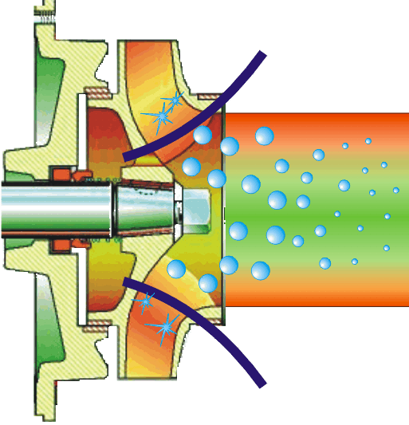
High pressure
Low to high pressure transition
Low Pressure
Cavitation occurs when vapour bubbles form
and then subsequently collapse as they move
along the flow path of the impeller.

Slide 43
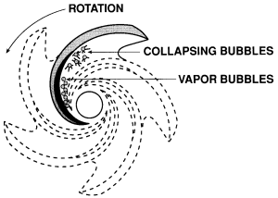
Implosion of gas or vapor bubble
Can be caused by gas or air entrained in the pumped liquid or by a phase change due to pressure fluctuations as the liquid passes through the impeller
.

Slide 44
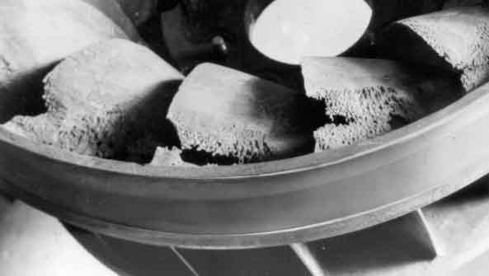
An impeller that has been operating under a suction cavitation condition has lost a lot of material from its impellor this will always lead to premature failure of pump

Slide 45
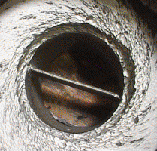
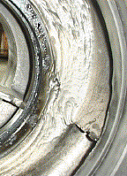
Examples Of Cavitation

Slide 46
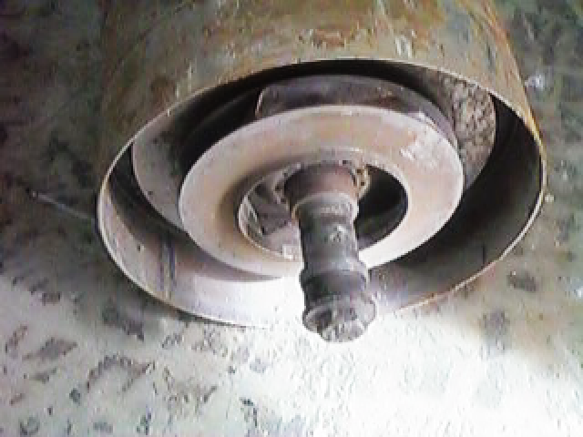
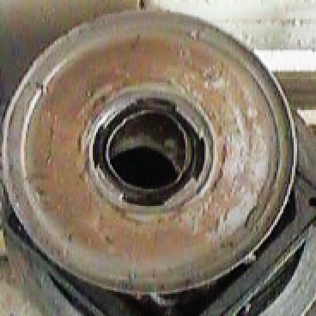
Vertical multistage pumps with pressed impellers do not exhibit the same failure mode as cast components.
Typical failure is bearing and shaft failure

Slide 47
CAVITATION REMEDIES
1. Remove debris from suction line
2. Move pump closer to source tank/sump
3. Increase suction line diameter
4. Decrease suction lift requirement
5. Install larger pump running slower which will decrease the Net Positive Suction Head Required by the pump(NPSHR)
6. Increase discharge pressure
7. Fully open Suction line valve

Slide 48
Centrifuge Pump Commissioning Procedure
1. Ensure the bearing arrangement has an oil supply
2. Check that all auxiliary feeds are working (seal or gland flush, bearing oil heating/cooling feeds)
3. Fully open the suction valve making sure any suction filters are clear.
4. Prime the pump by flooding the volute case and venting any gas.
5. Ensure the discharge valve is throttled in to no more than ¼ open.

Slide 49
Commissioning Procedure Continued
6. Start the pump and ensure it turns in the correct direction (note; - if the electric motor wiring has been changed and the motor is running in the wrong direction, the pump will still pump but with a greatly reduced performance)
7. Slowly open the discharge valve to fully open while monitoring the discharge pressure increase.
8. Check for any leakage, undue noise, vibration and signs of overheating and adjust any shaft glands very carefully as required.

Slide 50
Positive Displacement or Volumetric Pumps

Slide 51
Positive Displacement Reciprocating Pumps
  For each pump revolution a fixed amount of liquid taken from one end and positively discharged at other end
  If pipework is blocked pressure will rises that may damage the pump
  Used on a variety of fluids

Slide 52
  Reciprocating pump displacement by reciprocation of piston plunger.
  Used mainly for viscous fluids and have a precise metering capability.
  They can vary their delivery rate by changing the speed of the drive or altering the crank displacement length.

Slide 53
Volumetric Pumps
  Piston Pumps
  Plunger Pumps
  Diaphragm Pumps
Piston reciprocating pumps may be single or double acting

Slide 54
Alternating Volumetric Pumps
Types :
double or single acting
Plunger or diaphragm
Single
All work on a linear or alternating movement
simple & sturdy
can pump high viscosity liquids at high pressures
Double

Slide 55
Alternating Volumetric Pumps
hydraulic fluid
Disadvantages:
Big & cumbersome compared to centrifugal pumps
They give a pulsed flow
can create dangerously high pressures if the discharge is restricted

Slide 56
The Diaphragm Pump
One-moving-part air valve directs air supply to back side of diaphragm
OUTLET
AIR SUPPLY
PRESSURE
Fluid is pushed out of liquid chamber through pump outlet
Opposite diaphragm is pulled in by connecting shaft
SIDE
AIR
SLURRY SIDE
SLURRY SIDE
Suction draws liquid chamber through pump inlet
SLURRY SIDE
AIR
SIDE
When the diaphragm reaches end of its stroke, air valve shifts air to the opposite diaphragm
IN LET
Liquid is pushed out of the chamber through pump outlet

Slide 57
Positive Displacement Rotary Pumps
  Rotary pump displacement by rotary action of gear, cam or vanes
  Several sub-types
  Used for special services in industry

Slide 58
Rotary Types
        Lobe Pumps
        Gear Pumps
        Sliding Vane Pumps
        Screw Pumps
Lobe Pumps and screw pumps require an external gearbox
to drive the components - they cannot come into contact

Slide 59
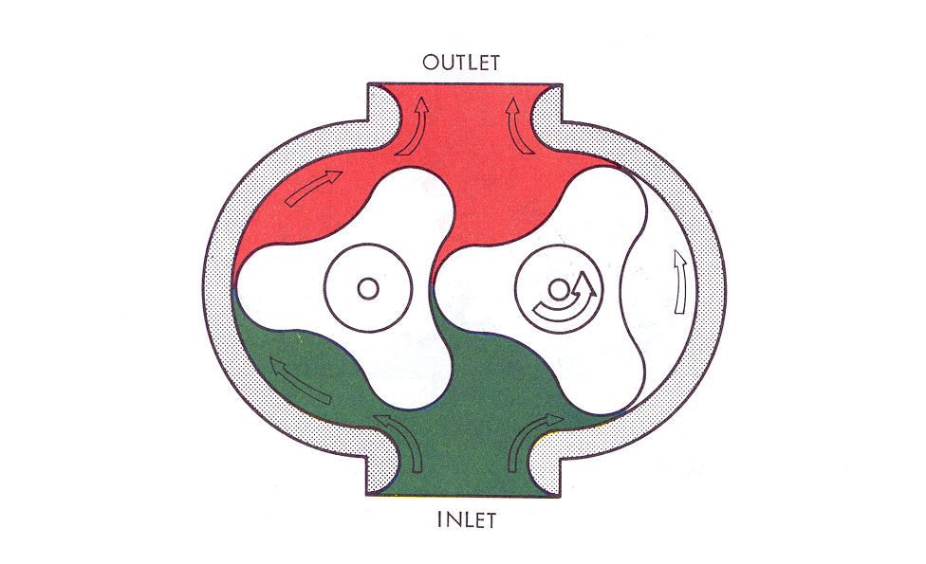
Lobe Pump

Slide 60
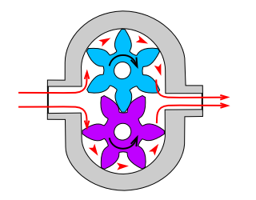
GEAR PUMP

Slide 61
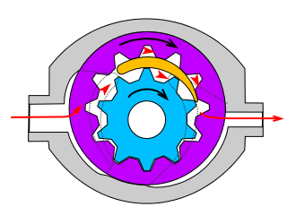
GEAR PUMP

Slide 62
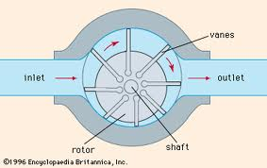
Sliding Vane Pump
A sliding vane pump is a positive-displacement pump that consists of vanes mounted in a rotor that rotates inside of a cavity

Slide 63
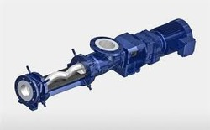
Progressive cavity pump
The progressive cavity pump consists of a helical rotor and a twin helix rubber stator

Slide 64
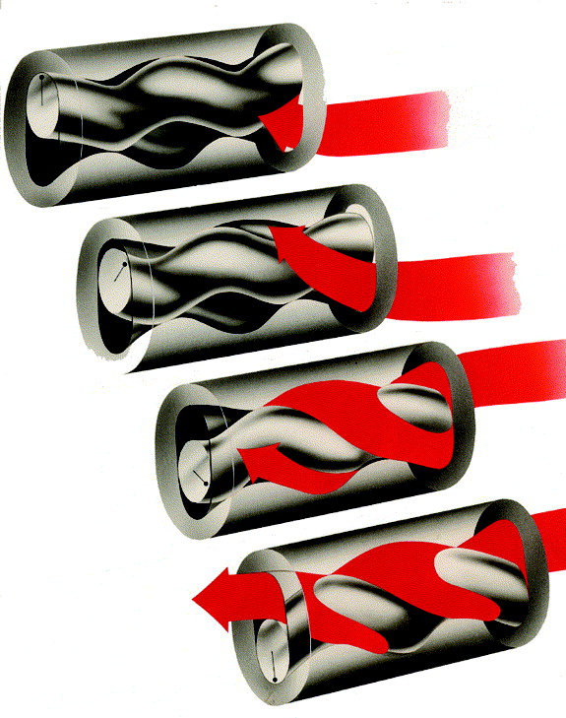
Progressive cavity pump
It is a progression of sealed cavities that pass along the pump flexible stator as the rotor turns

Slide 65
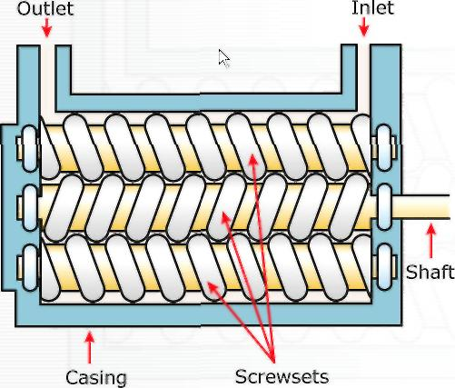
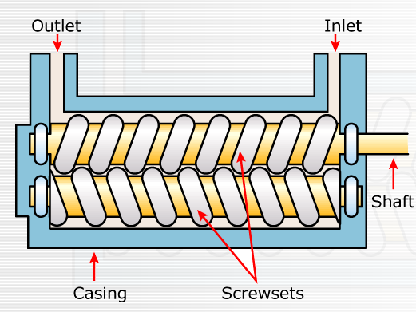
Screw Pumps
The screw pump designs are generally capable of high flow rates for the size of the pump and high discharge pressures, they can two or three screwsets.

Slide 66
Pump Performance Flow and Pressure

Slide 67
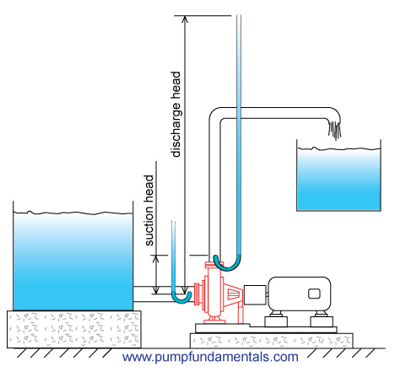
Pump Head
            The height at which a pump can discharge a liquid too.
67
Notes:
67

Slide 68
Head
destination
  Resistance of the system
  Two types: static and friction
Static
head
source
68
Notes:
68

Slide 69
Static head
destination
Static
head
Difference in height between source and destination
Independent of flow
source
Static
head
Flow
69
Notes:
69

Slide 70
Static head consists of
  Static suction head (hS): lifting liquid relative to pump center line
  Static discharge head (hD) vertical distance between centerline and liquid surface in destination tank
Static head at certain pressure
Head (in feet) = Pressure (psi) X 2.31
Specific gravity
70
Notes:
70

Slide 71
Friction head
  Resistance to flow in pipe and fittings
  Depends on size, pipes, pipe fittings, flow rate, nature of liquid
  Proportional to square of flow rate
Friction
head
Flow

Slide 72
In most cases:
Total head = Static head + friction head
System
curve
System
curve
Friction
head
System
head
System head
Friction
head
Static head
Static head
Flow
Flow
72
Notes:
72

Slide 73
Pump performance curve
Relationship between head and flow
  Flow increase
  System resistance increases
  Head increases
  Flow decreases to zero
Zero flow rate: risk of damage to pump
Head
Flow
Performance curve for centrifugal pump

Slide 74
Pump Operating Point
Duty point: rate of flow at certain head
Pump operating point: intersection of pump curve and system curve usually at 75% to 85% of the total pump capacity.
Pump performance curve
Pump operating point
Head
System curve
Static
head
Flow

Slide 75
N.P.S.H.A.
NPSHA means Net Positive Suction Head Available
NPSHA is a measure that corresponds to the level of pressure at the pump suction. The higher the pressure, the higher the NPSHA and the better the pump will operate

Slide 76
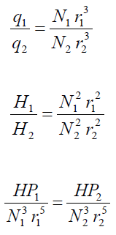
Pump Performance
The Affinity Laws state that (1) flow will change directly when there is a change in speed or diameter, (2) heads will change as the square of a change in speed or diameter, and (3) HP will change as the cube of a change in speed or diameter. As formulae, Affinity Laws are expressed as follows:-
q = Capacity, Gallons per Minute
H = Discharge Head usually in Feet
HP = Horsepower
N = Pump Speed, RPM

Slide 77
Adjusting Pump Performance
Impeller Trimming
Changing diameter = change in velocity
  Changing the impeller diameter is an energy efficient way to control the pump flow rate

Slide 78

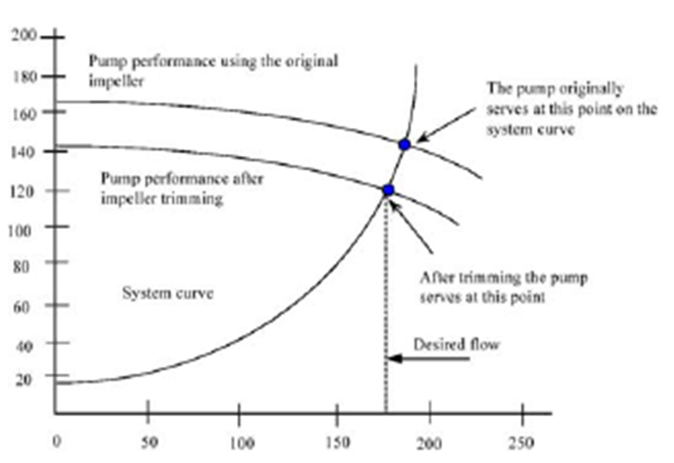
Impeller trimming and centrifugal pump performance
78

Slide 79
The following table compares three options to improve energy efficiency in pumps:
Changing the control valve, trim the impeller and variable frequency drive.
The VFD clearly reduces power most, but a disadvantage is the high costs of VFDs.
Changing the control valves should at all times be avoided because it reduces the flow but not the power consumption and may increase pump maintenance costs.

Slide 80
Comparing Energy Efficiency Options
Parameter | Change control valve | Trim impeller | VFD
Impeller diameter | 430 mm | 375 mm | 430 mm
Pump head | 71.7 m | 42 m | 34.5 m
Pump efficiency | 75.1% | 72.1% | 77%
Rate of flow | 80 m3/hr | 80 m3/hr | 80 m3/hr
Power consumed | 23.1 kW | 14 kW | 11.6 kW
80

Slide 81
Therefore if a change in a centrifugal pump performance is required, this can be achieved by altering the suction head if possible, increasing the impellor speed, or increasing the impellor diameter if the volute case will permit this.

Slide 82
The End
Any Questions?
Website: www.ttetraining.ltd.uk

