Slide 1

SHAFT ALIGNMENT
(1) General Overview
Website: www.ttetraining.ltd.uk

Slide 2
Shaft Alignment
WHY ?
  to allow two shafts to run as one
  to reduce vibration
  to prolong the life of the equipment

Slide 3
Recording Shaft Misalignment
WHY ?
  to allow referral at a later date
  to allow data to be monitored
  to permit readings to be checked

Slide 4
What is the relation between alignment and machinery performance?
Alignment = Performance
Precise alignment between the pump and driver is mandatory for the correct pump system performance.
Incorrect alignment is one of the major causes of rotating equipment failure.

Slide 5
Results of Shaft Misalignment
Excessive vibration(destructive).
Abnormal bearing and coupling wear as both will exposed to additional loads.
As a result equipment reliability life will diminish.

Slide 6
Alignment Methods
Specify Alignment Method:
Initial Alignment.
Face and Rim Alignment.
Reverse Indicator Alignment.
Laser optics Alignment.

Slide 7
Shaft Alignment
There are three methods used in industry to align shafts :
1
2
Taper gauges /
Straight edge feeler gauge
Basic method
Limited accuracy ( +/- 0.002” )
Dial Test Indicators :
Increased accuracy ( +/- 0.001” )
Can be time consuming
training required
3
Lasers
Most accurate ( +/- 0.001 and below )
Quick to use
Initial cost high
Training required

Slide 8
Shaft Alignment

Slide 9
Shaft Alignment
To achieve accurate alignment, the procedure must be carried out in logical stages
The pump should be placed in position with relative pipework installed. This is your Datum
Ensure the pump is secure and under no stresses, i.e. Pipework
You should use DTIs to check for eccentricity of shaft and coupling
You should use DTI to check end float of shafts pump and motor
NB : Always record readings

Slide 10
Every shaft, bent or straight, rotates about an axis that forms a straight line.
Shaft Alignment

Slide 11
Shaft Alignment
Shafts in this same straight line are considered co-linear, or in the same straight line.

Slide 12
Misalignment
There are three types of misalignment :
  Angular (in elevation, in plan)
  Parallel or Offset (in elevation, in plan)
  Axial

Slide 13
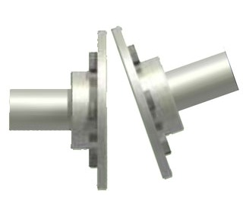
Types of Misalignment
Angular – The shafts are not in the same plane, which causes a difference in measurement between measurements made 180 degrees opposite on the coupling faces. This can be both vertical and horizontal.

Slide 14
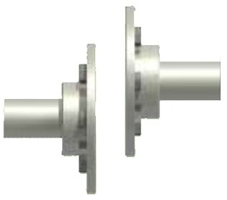
Types of Misalignment
Offset, – The shafts are parallel to each other, but are not in-line, or in the same plane. This can be both vertical and horizontal. Most misalignment issues are a combination of both angular and offset.

Slide 15
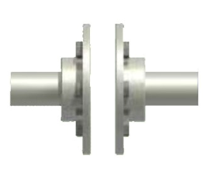
Types of Misalignment
Axial – The shafts are parallel to each and in the same plane but the separation distance can vary.

Slide 16
Alignment
Angular
Elevation
Plan
Parallel
Elevation
Plan

Slide 17
AXIAL
PUMP
MOTOR
THE AXIAL FREEPLAY IS CHECKED FROM ABOVE OR DIRECTLY IN FRONT OF THE MOTOR / PUMP.

Slide 18
AXIAL
PUMP
MOTOR
THE AXIAL FREEPLAY MUST NOT PERMIT THE SHAFT ENDS TO CONNECT!

Slide 19
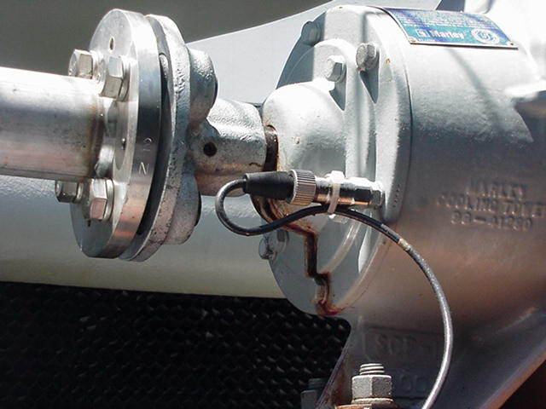
What is coupling alignment?
Coupling alignment is shaft alignment. If the shafts are aligned, the couplings will normally go along for the ride.
Always check that the coupling hubs are running concentrically with the shafts

Slide 20
Alignment Preparation
Prior to starting your alignment process, perform a system survey to major items that are vital to good alignment.

Slide 21
The system survey
Base Plate:
The base plate mounting pads should be level within .002” in/ft.
New Installations:
It is considered good practice on large installations to install the fixed equipment unit on 6 to 10.mm packing strips to increase the adjustment potential at a later date should in be necessary for the driven units.

Slide 22
The system survey
Special Note :
Take great care when drilling and tapping the base plate at the holding down bolt locations. Very accurate hole location is required as the bolts need to sit in the centre of the motor feet holes when the motor is aligned in the horizontal plain. Failure to do this will almost certainly cause problem with bolts binding on the sides of the holes during alignment procedure or if a motor is replaced at a later date.

Slide 23
The system survey
Reference:
The pump and driver are moved into correct relationship per the outline drawing, and the shaft or hub separation is set according the outline drawing and coupling manufacturer.
Location:
Initial alignment is usually done by checking at the coupling hubs.

Slide 24
The system survey
Sequence of Alignment:
Move pump or motor? Determine which piece of equipment is to remain fixed and which is to be moved during alignment.
Setup Marking:
  Some larger electric drive motor armatures are mounted on plain bearings and will align with the windings magnetic centre. This axial position needs to be reference so that coupling hub axial position is maintained when the alignment is adjusted.

Slide 25
Piping Connections
Piping inspection will assure that the piping is installed in apparent agreement with design criteria.
Look for proper placement and adjustment of guides, anchors, and support.
Disconnect suction/discharge piping from the pump.
Correct position of spring hangers.
Complete make-up of flanges with gaskets in place and bolts tightened.

Slide 26
Piping Connections
In short: it must be verified that the system is configured such that post-alignment piping modification will not nullify the alignment effort.

Slide 27
Shim Packs
Shim packs:
Shims should be placed under the driver to provide a solid, adjustable link between the equipment and mounting surface.
A shim stack under each mounting foot provides the ability to remove shims during alignment.
Avoid using lots of thin shims, as this can lead to errors.

Slide 28
SHIMS
These come in various thicknesses and various materials :
Brass } Do not
Plastic } corrode
Steel } Tends to corrode
S/Steel } Probably the Best
You must ensure they are undamaged
Ensure a minimum amount are used, i.e. if you require 0.075” of shim, use one large shim or plate 0.050” then 0.025”.
NB : Failure to do this will cause problems,
i.e. variations when tightening down !

Slide 29
Shim Packs
Physically check shims for :
Rust, improper-cut-shims, voids & wrinkles, hammer marks and dirt.
Replace many thin shims with fewer shims of greater thickness.
Equally important, surface of equipment supports and the base plate are clean and in good condition.

Slide 30
A Quick Comment on Shims…
Try to use a maximum of 4 or less shims under each foot. It’s not always possible, but try to minimize the number of shims per foot.
When you insert shims under the foot, slide them all the way in, then back them out ¼”, so the bolt threads don’t bend them.
Be careful. A 0.003” shim can cut you like a knife. Trust me on this one!
Keep them neat.

Slide 31

Soft Foot
Soft Foot:
Check for “soft feet”, be sure each mounting foot actually rests on its support surface as follow:
Mount a dial indicator on the machine support with the indicator stem resting on the base-plate.
Watch the indicator as the hold-down bolts are loosened.
If the movement of the indicator is more than .001”-.002” , it is an indication of soft feet problem.

Slide 32

Soft Foot
Soft foot further checks:
Remove shim pack underneath machine support.
Use feeler gauges to assure that machine supports are parallel with the soleplate/pedestal.
If supports are not parallel, re-work is required to correct the condition:
Re-grout, re-machine the support as required
Prepare tapered shims.

Slide 33
Indicator Bracket Bar Sag
How to perform a sag check:
Clamp the brackets on a sturdy piece of pipe the same distance they will be when placed on the equipment. Zero both indicators on top, then rotate to the bottom. The difference between the top and bottom reading is the sag.

Slide 34
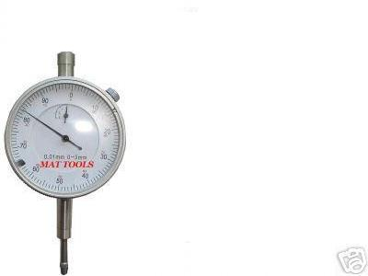
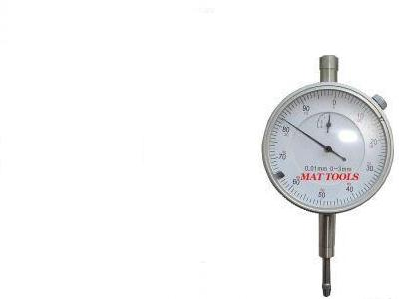
BAR SAG
DOR
MOTOR

Slide 35
BAR SAG
DOR
MOTOR

Slide 36
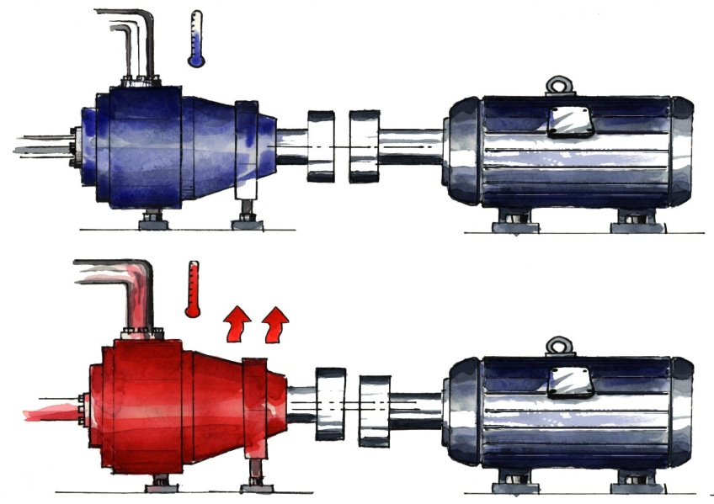
Thermal Growth
Machines that operate at a considerably hotter or colder condition than the ambient room temperature should be thermally compensated.
They will “grow” or “shrink” as they heat up, or cool off

Slide 37

Thermal Growth
The machine manufacturer’s specs are a good place to start but, the machine manufacturer probably does not know:
The exact temperature of the driver and driven machines
Ventilation quality or cooling effects
Piping strain influences
Piping thermal changes

Slide 38
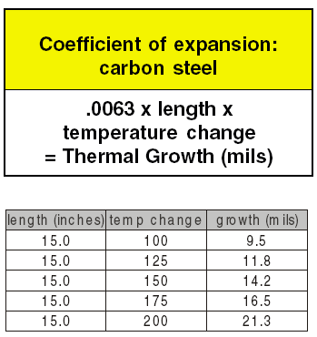
Coefficient of Thermal Expansion
If you can’t remember this chart, remember this:
If one foot of steel get 100 degrees hotter, it grows about ( 0.008”)

Slide 39
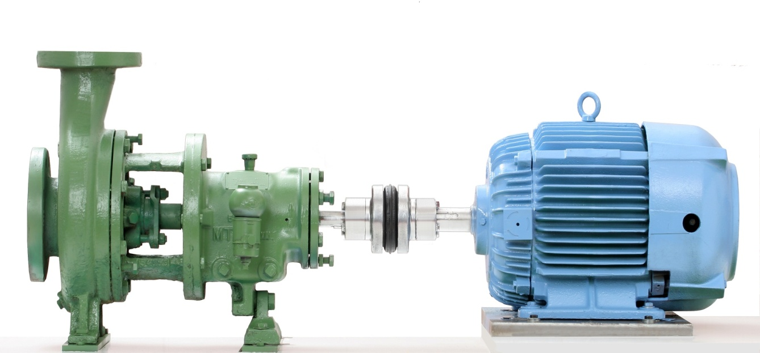
Thermal Growth
However, this is not a magic formula!
Machines do not usually heat or cool at the exact same temperature top to bottom.
You need to find a mean, or average temperature of the machine – from the centerline of the shaft, to the bottom of the foot.

Slide 40
Thermal Growth
The Best Way to Know Thermal Growth Changes
Measure them yourself.
Measure the machine in the cold condition, and pre-set it to the manufacturer’s recommendations.
Re-measure in the hot condition, if possible.
Some lasers can do this calculation for you, or you can simply plot it on paper.
In addition, some laser alignment tool manufacturers sell equipment that allow you to measure the thermal changes.

Slide 41
Assumptions
NEVER ASSUME IT’S LOCKED OFF AND ISOLATED!
Don’t assume it’s aligned correctly, even if you did it the last time.
Can the shafts be rotated together? Can they be rotated individually? You may have to modify your alignment technique.
Is there a soft foot issue? Check and minimize before alignment.
Is there going to be thermal growth? How much? Which direction? Is it going to get hotter, or colder?

Slide 42
Assumptions
Is the coupling insert worn? Does it need replacement?
Is there adequate spacing between the shafts? Between couplings?
Has pipe strain been minimized?
Is the pump assembly sitting on isolators? Are they functioning properly?
Is the pump assembly sitting on an inertia block? Is it properly affixed to the floor?

Slide 43
Assumptions
Do you notice any cracks in the floor around the base?
Can you feel vibration in the floor?
Does the coupling insert have excessive backlash?
Are the coupling flanges tight to the shaft?
Are set screws and bolts tight?
Are keys in place?

Slide 44
Assumptions
Are the hubs concentric? You may be able to align an eccentric hub, but may cause vibration, and make you look bad, if you miss it.
Does the coupling guard clear the coupling?
How clean is the area?
Soft foot is not limited to just under the motor feet. It can happen between a riser and frame, and between a frame and a floor.
Are there jackbolts? Are they screwed tight to the motor?

Slide 45
General Observations
Some alignment systems are sensitive to backlash or “play” in the coupling. Not only lasers, but indicators can be misread due to backlash, especially if there is any eccentricity in the coupling.
Beware of bumping your indicators or laser detectors.
Beware of any binding or tightness in the machines as they are rotated.

Slide 46
General Observations
Always correct vertical misalignment first once the gross horizontal misalignment has been removed.
Once the vertical (top to bottom, up and down) is corrected, you can theoretically move the machine side to side as far as it will go, without changing the vertical alignment.
Then, correct misalignment in the horizontal plane (side to side).

Slide 47
You must make the right moves in sequence !
Regardless of the method you use, alignment needs to be done in four steps
When your ready to align!

Slide 48
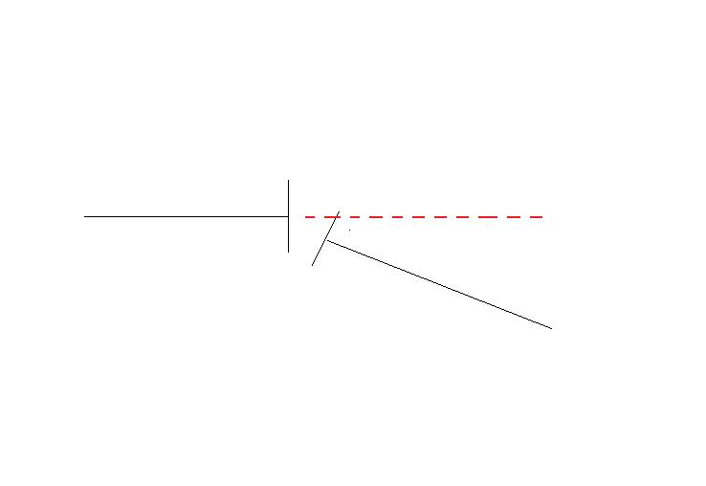
Angular misalignment in the Horizontal Plane
Top View

Slide 49
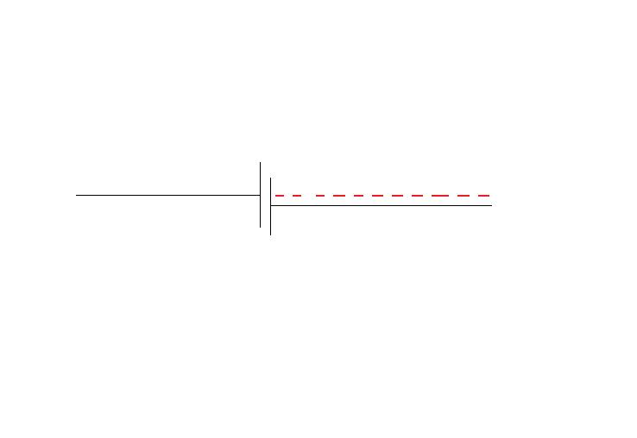
Parallel Offset in the Horizontal Plane
Top View

Slide 50
Angular misalignment in the Vertical Plane
Side View

Slide 51
Parallel Offset in the Vertical Plane
Side View

Slide 52
The End
Any Questions?

