Slide 1

SHAFT ALIGNMENT
(2) Face and Rim Method
Website: www.ttetraining.ltd.uk

Slide 2
Taper gauge/straight edge & feeler gauge or Face & Rim DTI
  This method is mainly used when the coupling components are large in diameter, close together separated by a small gape. The horizontal move is made first to eliminate any accumulative error then the vertical alignment is measured and corrected. This is a two stage process first correction is the angular and then the second correction (move) is to correct parallel miss-alignment .

Slide 3


Angular Alignment with Taper or Feeler Gage
Horizontal
Vertical

Slide 4

Parallel Alignment with Straightedge
Horizontal
Vertical

Slide 5
Initial Alignment
Steps:
Initial alignment is performed prior to precise alignment method.
Be certain the driver has the shaft placed in the axial centred position or magnetic centre.
Use a straightedge and taper gage or set of feeler gages.

Slide 6
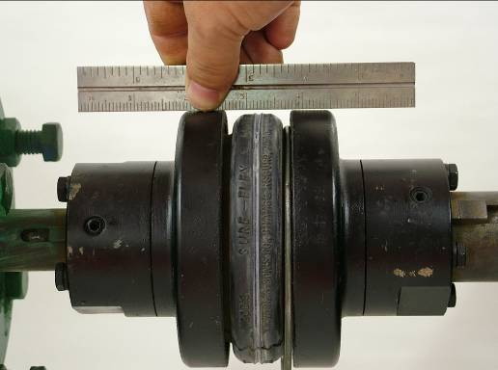
Roughing in
Straightedge, flashlight, feeler gauges, taper gauge, outside caliper, etc…

Slide 7
Shaft Alignment
    After addressing any soft foot issues, the next steps to aligning equipment and are :
        Check angular in elevation
        Check angular in plan
        Check parallel in elevation
        Check parallel in plan

Slide 8
Shaft Alignment - Step 1
Check angular in elevation
(NB : Elevation means side on view)
With motor and pump bolted down,
check with taper gauge and feelers,
the gap at the top of the coupling
and the bottom of the coupling

Slide 9
Shaft Alignment - Step 1
Using the formula S = M L / D
S = thickness of shim required
L = distance between front and rear motor holding down bolts measured in inches.
D = diameter of the coupling
M = The Net misalignment in inches of the couples
This calculation will ensure the
motor is flat in relation to the pump
A
C
L
a
A - a = M
Note difference “m” (net misalignment)

Slide 10
Shaft Alignment - Step 1
A coupling has a diameter of 5” (D)
The distance between motor front & rear holding down bolts is (L) 30”
The Net angular mismatched M = 0.012”
Therefore :
S = ML / D
S = 30 x 0.012 /5
S = 0.072”
D
L
30”

Slide 11
Shaft Alignment - Step 1
A Shim/Shims to the value of 0.072” can be inserted under the front or rear holding down bolts of the motor
How can you tell which end to fit them ?
If gap is greater at top, place under rear feet or remove from front
If gap is greater at bottom, place under front or remove from rear

Slide 12
Shaft Alignment - Step 2
Parallel in Elevation
Place straight edge on top of pump coupling, having first moved the motor in line
Place feeler gauges between straight edge and top of motor coupling
Record reading
Place required shim under all motor feet
Tighten down / check

Slide 13
Shaft Alignment - Step 2
Parallel in Elevation
Note :
Always try to maintain the motor / pump on centre line.
Check after each movement This will put the motor / pump at the same height
All Checks must be done with motor feet bolted down
MOTOR

Slide 14

Face & Rim Alignment Method
Figure below illustrates typical arrangement for Face & Rim alignment.
A bracket is attached to one shaft and extends to the proximity of the coupling hub on the adjacent shaft.
Dial indicators are affixed to this bracket with the stem of one indicator resting on the face of the coupling hub and second resting upon the outside diameter of the same hub.
Coupling Hub
Dial Indicator
Alignment Bracket

Slide 15
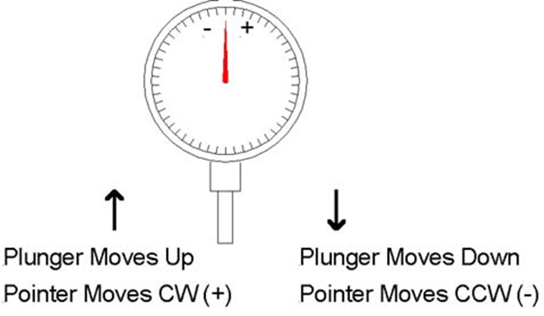
READING THE D.T.I.

Slide 16
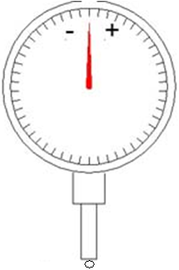
D.T.I. ERROR
10°
20°
30°
10° = 0.985
40°
20° = 0.960
50°
30° = 0.866
60°
40° = 0.766
50° = 0.643
60° = 0.500
DTI READING 1.0 AT VERTICAL
FRONT VIEW

Slide 17
Face & Rim Alignment Method
Example of Tolerances
Maximum TIR (IN) Angular(at 12” radius) | Maximum TIR (IN) Parallel | Operating speed (rpm)
.004 | .006 | 1800 & slower
.002 | .003 | 1800-4000
.001 | .002 | Over 4000
TIR: Total Indicator Reading

Slide 18
Procedure
Procedures:
Use a clocking assembly designed to hold the two dial indicators.
Install the assembly to read the driver hub face and rim.
Take angularity reading at a maximum radius from the shaft centerline.

Slide 19
Procedure cont.
When ever possible both hubs are turned together with the with the clocking assembly.
Take four readings at 90 degree intervals.
Adjust shims as needed to bring angular and parallel misalignment within tolerances.

Slide 20
Considerations
Considerations:
Turning the hubs together eliminates any errors that can be introduced with coupling hubs that are slightly eccentric or not exactly perpendicular to the shaft.
The clocking assembly should maintain the distance between hubs, preventing erroneous reading.
Prevent sag and less accurate readings by using a sturdy dial indicator extensions.(doesn’t deflect under its own weight)

Slide 21
Considerations cont.
Make all measurements with mounting bolts properly tightened.
Make all allowances for driver and gear thermal expansion as recommended by the manufacturer.
The shaft axial position and coupling hub separation should remains constant at all times as reading are taken. (Ensure motor magnetic centre position is maintained)

Slide 22
Method Shortcomings
Note:
When it comes to high speed, high horsepower machines or the requirement for precise alignment accuracy, this method does have shortcoming especially when the coupling separation is quite large. Because of this the Reverse Indicator Method is better suited to give a more accurate result.

Slide 23
Method Shortcomings Example
You will have a reading of .002” on the face of 4” dia. Coupling hub.
This represent an angularity of .006” per foot.
It is an error of .030” at the opposite end of a machine five feet long.
Above an error, that would normally be acceptable.

Slide 24
The End
Any Questions?

