Slide 1

SHAFT ALIGNMENT
(3) Reverse Indicator and Laser
Website: www.ttetraining.ltd.uk

Slide 2
Reverse clock gauge (DTI)
  This method is mainly used when the coupling hubs are smaller in size as in a gear type coupling that are separated with a spool piece thus giving a larger gape. Again the horizontal move is made first to eliminate accumulative error then the vertical alignments are measured in a duel clocking operation and corrected in one move. This is a more efficient process and in the instances where you have heavy large equipment you only want to move it once.

Slide 3
Reverse Clock Method
Features:
It is a graph analysis method. Five measurements are taken that allow the plotting of the vertical or horizontal positions so that a correction can be seen and applied in the correct location.

Slide 4

Reverse Clock Method
Five Measurements
The graph analysis method is based on reverse indicator readings at the two hubs(4 & 5) and the distance from the fixed-unit hub to the movable-unit hub and feet(1,2 & 3).
5
4
1
2
3

Slide 5
Reverse Clock Method
Perform Initial Alignment before proceeding to a precise alignment method.
Vertical alignment analysis and shim correction is done before horizontal alignment analysis and left or right correction.
Vertical alignment then rechecked.

Slide 6
Graph Paper
Graph paper is used to chart the reverse indicator alignment procedure.
It is square grid graph paper.
Square grid. 10 divisions per inch.
A blank 50x90 , 70x100 or 100x150 division graph paper or equivalent can be obtained from a technical paper supplier.

Slide 7
Information Recording Points
5
4
1
2
3

Slide 8
Five Graph Entries
Driver foot
+.010
Driver foot
Driver hub
0.00
5
4
-.010
1
2
3
-.020

Slide 9
Horizontal Scale
With refer to previous figure:
The distance from the fixed-unit hub to the movable-unit hub and feet are entered on the horizontal scale.
For reading accuracy, use as much as possible of the horizontal scale.
The pump hub to outboard driver foot is the largest linear measurement and should be placed as far to the left as possible.
Depending on the measurement, choose a suitable division scale like one division can equal 1”, etc.

Slide 10
Vertical Scale
Each vertical division typically equals .001”.
For greater reading accuracy use as much as possible of the vertical scale.
Enter ½ TIR. (total indicator reading) at the fixed coupling hub and ½ TIR at movable coupling hub on the vertical scale.
The graph analysis is done on the shaft centerline relationship, therefore the total indicator readings are halved before use as graph coordinates.
.

Slide 11
Vertical Scale Coordinate Sign
The positive and or negative sign of the movable-unit hub indicator reading is REVERSED before being used as graph coordinate.
The sign reversal is due to D.T.I indicator orientation.

Slide 12
Vertical Scale Coordinate Sign
The signs of the fixed-unit hub graph coordinate remains the same as the indicator reading at that hub.
The positive coordinates are entered above the mid-point zero line and negative coordinates are entered below the zero line.
Positive Coordinates
+.010
+
.000
Negative Coordinates
-
-.010

Slide 13
Indicator Mounting
If practical, use two rigid fixtures, fastened to the hubs or shafts, to hold two dial indicators.
The indicator tips will be in the contact with the driver and pump hub circumference or bracket contact points.
If any run-out as been detected both hubs are turned together, it is feasibly to use a loosely fastened coupling spacer for this purpose.
Alternatively, use threaded stock piece through both hubs and the fixtures.

Slide 14
Indicator Mounting
Alternatively, use threaded stock piece through both hubs and the fixtures.

Slide 15
Indicator Mounting
Indicator bar sag should be checked and ideally stamped on the bracket.
Indicator readings are adjusted for the indicator bar sag.
After mounting the indicators, rotate shafts several times and make indicator mounting adjustment before taking reading.
Take several sets of readings to verify accuracy and repeatability.

Slide 16
Vertical Alignment Measurements
Enter the following measurements on the horizontal scale:
(1) INDICATOR TIPS. Measure the distance between the two indicator tips.
1

Slide 17
Vertical Alignment Measurements
(2) INBOARD DRIVER FOOT. Measure the horizontal distance between the pump hub indicator tip and the centre of the inboard mounting foot.
2

Slide 18
Vertical Alignment Measurements
(3) OUTBOARD DRIVER FOOT. Measure the horizontal distance between the pump hub indicator tip and the centre of the outboard mounting foot.
3

Slide 19
Vertical Alignment Indicator Readings
Rotate the shafts to move the indicator tips to the top, 0 degree, position.
Set the dial indicator to zero.
Rotate shafts clockwise (facing the pump, at hub end) to move the indicator tips to the bottom, 180 degree, position.
Record TIR and positive or negative sign at each hub. A positive reading is produced when the indicator tip moves into the body.

Slide 20
Indicator Readings
(4) PUMP HUB
The pump is the fixed unit the positive or negative sign of the graph coordinate remains the same as the indicator reading at the pump hub.
The graph coordinate is one-half of the total indicator reading(TIR) at the pump hub.
Record TIR and positive or negative sign at the hub.
4

Slide 21
Indicator Readings
(5) DRIVER HUB
The driver is the moveable unit the positive or negative sign of the moveable-unit hub indicator is reversed before being used as the graph coordinate.
The graph coordinate is one-half of the total indicator reading(TIR) at the driver hub.
Record TIR and positive or negative sign at the hub.
5

Slide 22
Plotting the Graph Entries
Alignment Line:
The alignment line is drawn and then the two hubs and two motor feet locations are placed on it to a scale that represents their separation distances on the chart.
Draw a vertical line through each hub at the coordinate point, and then on that line transfer ½ the TIR recorded measurement readings noting the + or – sign’s.
Don’t forget to REVERSE the sign of the movable-unit hub indicator reading.

Slide 23
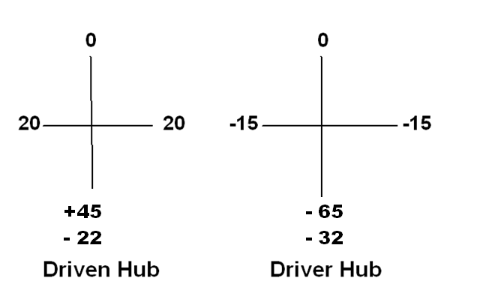
Recording the D.T.I readings at both hubs remembering to halve the total reading and reverse the sign for the movable hub.

Slide 24
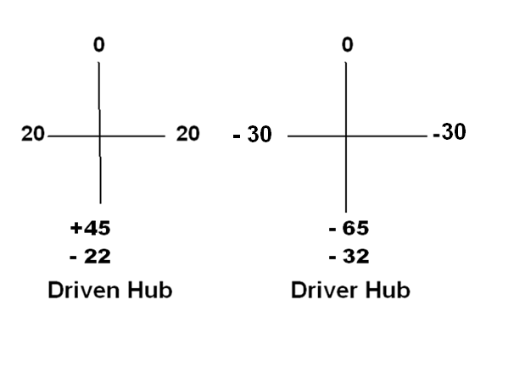
Recording the D.T.I readings at both hubs remembering to halve the total reading and reverse the sign for the movable hub.

Slide 25
Plotting the Graph Entries
Drawn the second line through the two point plotted at each hub on the chart and past both motor feet.
Draw a vertical line through each motor foot coordinate points
The coordinates of the alignment line and the driver feet vertical lines indicate the amount of shims required to bring the driver and pump into vertical alignment.
Read the vertical scale for the amount of shims to be added or subtracted from the inboard and outboard driver feet.

Slide 26
Plotting the Graph Entries
Note:
Coordinate points above the midpoint zero line(the ideal alignment line) means that shims will be removed.
Coordinate point below zero line means that shims will be added.

Slide 27
Plotting the Graph Entries
Reminder:
Shims:
Ideally the Shim should be non-rusting material such as stainless steel or brass and be the same size of the foot.
Use care to prevent folds,etc, that affect the shims thickness.
The equipment feet must be clean, free from grout, etc.

Slide 28
Alignment Graph Features
Reverse the Indicator reading sign
Pump Hub
Outboard driver foot
Inboard driver foot
Driver Hub
+.020
.000
Alignment line
½ TIR
-.020
Read coordinate points for alignment correction
Hub to Hub
-.040
Hub to 1st foot
Hub to 2nd
foot

Slide 29
Horizontal Alignment
Horizontal alignment indicator readings:
This procedure is almost identical to the vertical method just covered and can be set out as covered following slides.
But in a purely practical sense because there is no lifting and shimming involved it is a lot easier to reduce this misalignment. As you take the vertical readings the inline side to side readings should be equal half that of total indicator readings (TIR). This adjustment can be made to reduce the misalignment a just before you take the vertical readings

Slide 30
Horizontal Alignment
Horizontal alignment indicator readings:
Rotate shafts to move the indicator tips to the right, 90 degree, position.
Set the dial indicator to zero.
Rotate the shafts clockwise(facing the pump, at hub end) to move the indicator tips to the left, 270 degree, position.
Record TIR and positive or negative sign at each hub. A positive reading is produced when the indicator tip moves into the body.

Slide 31
Horizontal Alignment
Note:
PUMP HUB
The pump is the fixed unit the positive or negative sign of the graph coordinate remains the same as the indicator reading at the pump hub.
The graph coordinate is one-half of the total indicator reading(TIR) at the pump hub.
Enter the coordinate on the pump hub vertical line.

Slide 32
Horizontal Alignment
Note:
DRIVER HUB
The driver is the moveable unit the positive or negative sign of the moveable-unit hub indicator is reversed before being used as the graph coordinate.
The graph coordinate is one-half of the total indicator reading(TIR) at the driver hub.
Enter the coordinate on the driver hub vertical line.

Slide 33
Horizontal Alignment
Alignment Line:
The alignment line is drawn after the three hubs and foot measurements and two hubs coordinates are entered into the chart.
Draw a line from the pump hub coordinate point, through the driver hub coordinate point and extending the line through the driver feet vertical lines.

Slide 34
Horizontal Alignment
Continued
The coordinates of the alignment line and the driver feet vertical lines indicate the amount of driver horizontal movement required to bring the driver and pump into horizontal alignment.
Read the vertical scale for the amount of left or right movement(viewed from pump hub end) required at the inboard and outboard driver feet.

Slide 35
Laser optics Alignment.

Slide 36
Things to Consider as you Gain Experience
Carrying out and understanding the requirements of the axial alignment process will always improve as you gain experience. The following slides are a helpful pointer and a general recap of the main point you need to become familiar with.

Slide 37
Indicator Bracket Bar Sag
How to perform a sag check:
Clamp the brackets on a sturdy piece of pipe the same distance they will be when placed on the equipment. Zero both indicators on top, then rotate to the bottom. The difference between the top and bottom reading is the sag.

Slide 38
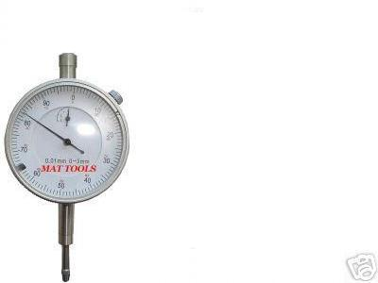
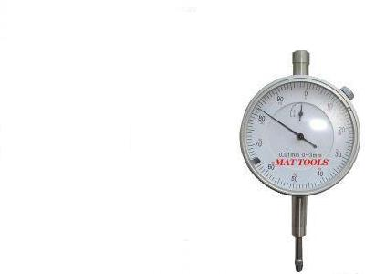
BAR SAG
DOR
MOTOR

Slide 39
BAR SAG
DOR
MOTOR

Slide 40
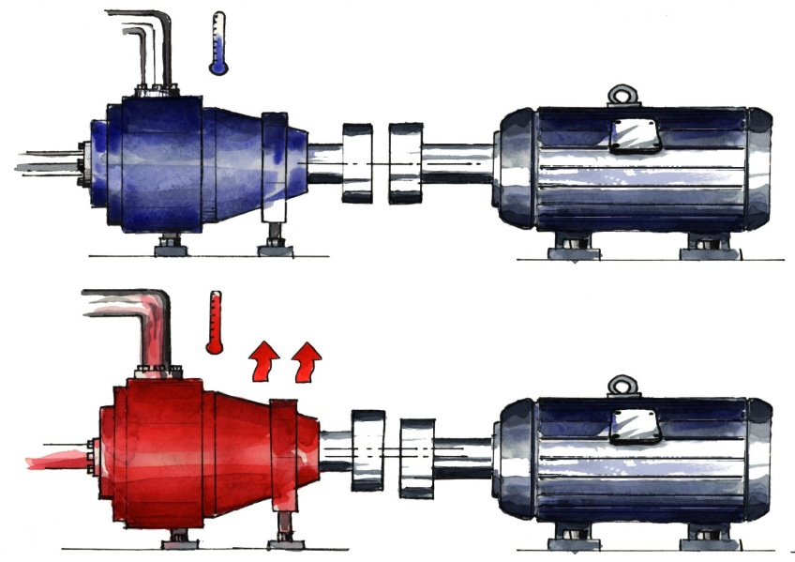
Thermal Growth
Machines that operate at a considerably hotter or colder condition than the ambient room temperature should be thermally compensated.
They will “grow” or “shrink” as they heat up, or cool off

Slide 41

Thermal Growth
The machine manufacturer’s specs are a good place to start but, the machine manufacturer probably does not know:
The exact temperature of the driver and driven machines
Ventilation quality or cooling effects
Piping strain influences
Piping thermal changes

Slide 42
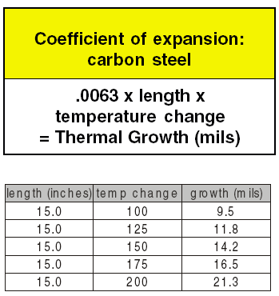
Coefficient of Thermal Expansion
If you can’t remember this chart, remember this:
If one foot of steel get 100 degrees hotter, it grows about ( 0.008”)

Slide 43
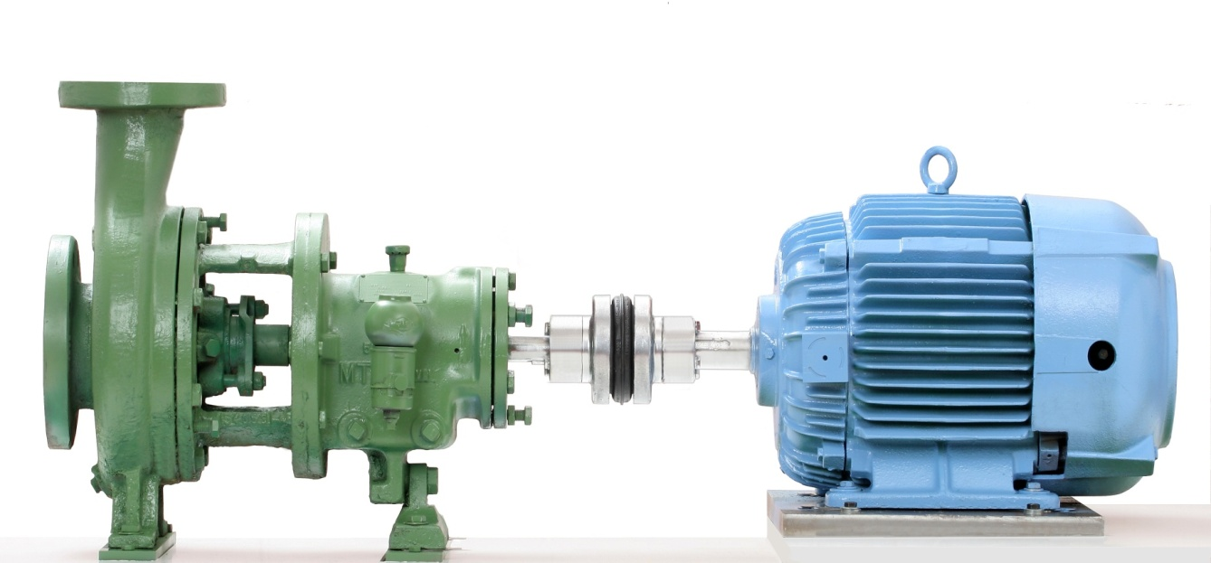
Thermal Growth
However, this is not a magic formula!
Machines do not usually heat or cool at the exact same temperature top to bottom.
You need to find a mean, or average temperature of the machine – from the centerline of the shaft, to the bottom of the foot.

Slide 44
Thermal Growth
The Best Way to Know Thermal Growth Changes
Measure them yourself.
Measure the machine in the cold condition, and pre-set it to the manufacturer’s recommendations.
Re-measure in the hot condition, if possible.
Some lasers can do this calculation for you, or you can simply plot it on paper.
In addition, some laser alignment tool manufacturers sell equipment that allow you to measure the thermal changes.

Slide 45
Assumptions
NEVER ASSUME IT’S LOCKED OFF AND ISOLATED!
Don’t assume it’s aligned correctly, even if you did it the last time.
Can the shafts be rotated together? Can they be rotated individually? You may have to modify your alignment technique.
Is there a soft foot issue? Check and minimize before alignment.
Is there going to be thermal growth? How much? Which direction? Is it going to get hotter, or colder?

Slide 46
Assumptions
Is the coupling insert worn? Does it need replacement?
Is there adequate spacing between the shafts? Between couplings?
Has pipe strain been minimized?
Is the pump assembly sitting on isolators? Are they functioning properly?
Is the pump assembly sitting on an inertia block? Is it properly affixed to the floor?

Slide 47
Assumptions
Do you notice any cracks in the floor around the base?
Can you feel vibration in the floor?
Does the coupling insert have excessive backlash?
Are the coupling flanges tight to the shaft?
Are set screws and bolts tight?
Are keys in place?

Slide 48
Assumptions
Are the hubs concentric? You may be able to align an eccentric hub, but may cause vibration, and make you look bad, if you miss it.
Does the coupling guard clear the coupling?
How clean is the area?
Soft foot is not limited to just under the motor feet. It can happen between a riser and frame, and between a frame and a floor.
Are there jackbolts? Are they screwed tight to the motor?

Slide 49
General Observations
Some alignment systems are sensitive to backlash or “play” in the coupling. Not only lasers, but indicators can be misread due to backlash, especially if there is any eccentricity in the coupling.
Beware of bumping your indicators or laser detectors.
Beware of any binding or tightness in the machines as they are rotated.

Slide 50
General Observations
Always correct vertical misalignment first.
Once the vertical (top to bottom, up and down) is corrected, you can theoretically move the machine side to side as far as it will go, without changing the vertical alignment.
Then, correct misalignment in the horizontal plane (side to side).

Slide 51
You must make the right moves in sequence !
Regardless of the method you use, alignment needs to be done in four steps
When your ready to align!

Slide 52
Not knowing when to say when
When the machine is aligned to within your alignment tolerance, you are done.
Don’t try to get it all the way to zero.
You may cause more problems than you correct.
AND, you will certainly waste time.

Slide 53
THAT’S THE WAY IT’S SUPPOSED TO HAPPEN!

Slide 54
So what do we do if it doesn’t?
Check for soft foot.
Check for bolt or base bound condition.
Check to make sure you haven’t bumped or moved your alignment tools
Check for coupling backlash.
Check for excessive vibration in the area
Re-measure, and see if your results are repeatable.

Slide 55
The End
Any Questions?

