Slide 1

Vee Belt Drives &
Coupling Types
Website: www.ttetraining.ltd.uk

Slide 2
Vee Belt Drives
Belt fitting, belt wear, belt material and belt alignment need to be set-up correctly to ensure the dive is reliable and long lasting.

Slide 3
Ensure the following when fitting Vee Belts
All belt used in zoned areas need to be F.R.A.S. belts. (Fire Resistant Anti Static)
Always ensure that you change out a full set of belts, never replace one or two.
Also check that the set of belts you are fitting have the same batch number as this is the only way of ensuring each belt has the same length.

Slide 4
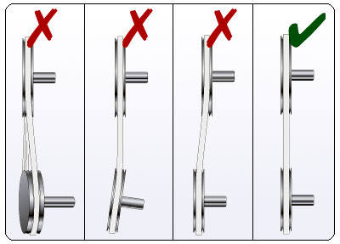
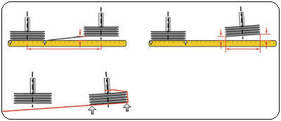
The maximum allowable pulley miss-alignment is < 0.5mm per 100 mm of pulley separation. Always ensure that you have good alignment of the pulley's as shown.

Slide 5
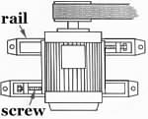
Pulley alignment is crucial when driving through belts.
The plan view of the motor and pulley arrangement shows a slide rail system the stops the motor from slewing as the belts are tensioned thus maintaining parallel pulley alignment. (Note that the orientation of the rails)

Slide 6
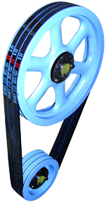
Advantages of a Belt Drive System
Easy and economical installation.
No lubrication required.
Clean & low maintenance.
Elasticity of belts helps shock load dampening.
Quiet, smooth operation.
Long life expectancy when well designed.
Good mechanical efficiency.

Slide 7
Important Facts about V-Belt systems
Ability to slip upon overload, resulting in a fail-safe drive.
Generally 5% slippage.
Multiple belt systems never slip against each other and therefore belt should never be wound on under tension.
A belt drive system should never be lubricated as it depends on friction to transmit power, in contrast with chain or gear systems.

Slide 8
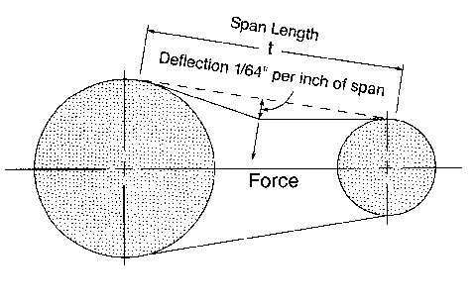
Too much tension can cause excessive wear on belts & bearings.
Too little tension allows slippage, loss of power & additional wear.
Wherever possible a Vee Belt Tension Tester should be used

Slide 9
Installation Procedure
  Clean all surfaces (grooves, taper hub, shafts, etc.
Verify alignment
Proper Belt tension
Check tension after 48 hours

Slide 10
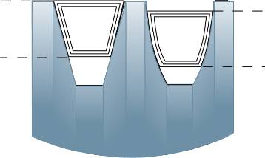
Checking Pulley Vee for wear
Worn grooves cause one or more belts to ride lower than the others, resulting in premature wear of belts & reduced performance levels (see Figure below)
If wear is premature, could be caused by misalignment.
Signs of wear:
One or more belts are slack
while others are tight?
Bottom of the groove is shiny?
Belts wear out quickly?
MASKA 2009-M1

Slide 11
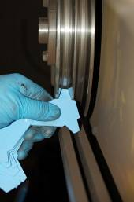
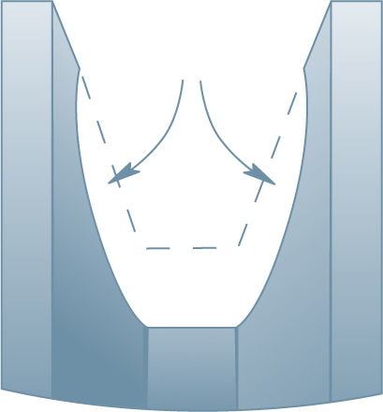
How to check for wear quickly?
Using a suitable belt gage is an inexpensive tool that can be inserted in the groove until the rim touches the flange. If more than 1/32" wear, replace the sheave (see Figure opposite ).
The cost of replacing the part is soon offset by the number of belts that will be quickly ruined by rounded sidewalls.
Resulting belt problems – touching bottom and slipping, reduced wedging action & less gripping power.
MASKA 2009-M1

Slide 12
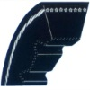
Cogged Vee Belts
Cogged Belts
These are used were a tight radius is required in the drive system. It allows the belt to maintain its Vee section profile as it passes over a small Vee drive pulley, thus improving contact and reducing surface embrittlement on the sides of the belt caused by slippage.
MASKA 2009-M1

Slide 13
Belt Drives
Uses friction to transmit power
2
D₂
ω₂
D₁
ω₁
1
C
Speed = D1 / D2 X R.P.M. of driver = R.P.M. of driven

Slide 14
Belt Drive Basics
Speed Ratio = 2.5
4”
Speed-Down
10”
1750 rpm
700 rpm
10”
Speed-Up
4”
1750 rpm
4375 rpm

Slide 15
Main Advantages
No lubrication required
Clean & low maintenance
Low-stretch tensile cord nearly eliminating the need for re-tensioning
Eliminate noise problems of chain drives
Long life expectancy when well designed
Smooth engagement of belt with pulley allows high speeds
Less weight compared to chain and gear drives for same horsepower requirements
Can operate in wet environments

Slide 16
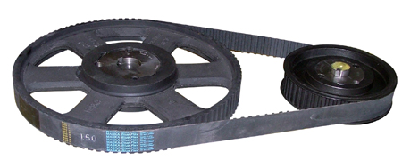
SYNCHRONOUS BELT DRIVES

Slide 17
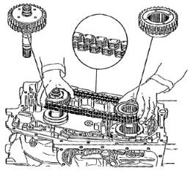
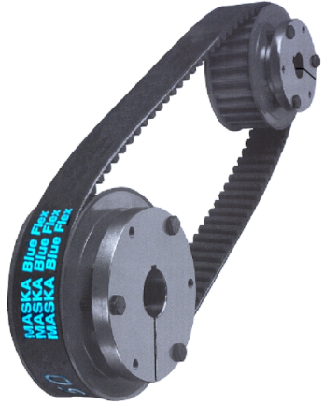
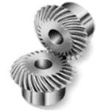
THREE CATEGORIES OF SYNCHRONOUS DRIVES:
A) Synchronous Belt Drive
B) Gear drive
C) Chain drive
A
B
C

Slide 18
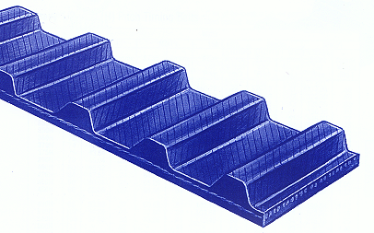
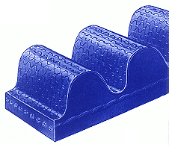
Toothed Timing Belt Drives
Standard/Trapezoidal Synchronous belt
H.T.B. High Torque Belt/ Curvilinear Synchronous Belt

Slide 19
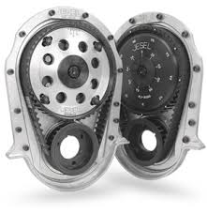
Installation of Timing Belts
Prior to installation, the drive centre distance should be reduced so that the timing belt can be installed without force.
If this is not possible, the timing belt must be installed together with one or both of the timing belt pulleys.
Installation with the use of the force is NOT permissible at any time.

Slide 20
Main Advantages
No need for expensive drive enclosures
No need for lubrication systems
No need for tensioning devices
No adjustment needed due to stretch or wear
No worn sprocket replacement
No ongoing maintenance costs for roller chain

Slide 22
COUPLINGS

Slide 23
Drive Couplings
A coupling is used to connect two in-line shafts to allow one shaft (driver) to drive the second shaft (driven) at the same speed.
A coupling can be rigid or, more normally, it can be flexible allowing relative radial, axial or angular movement of the two shafts. (Note: Flexible couplings are not an excuse to accept poor alignment)
Unlike the clutch the coupling transmission is not designed to engage-disengage as a normal operation

Slide 24
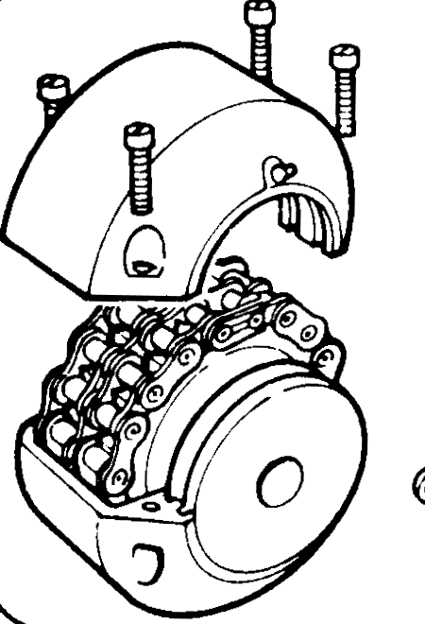
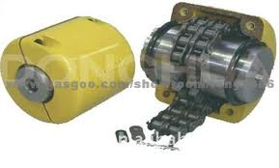
Chain Coupling

Slide 25
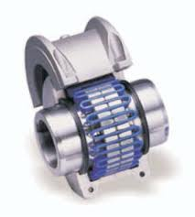
Bibby Coupling

Slide 26
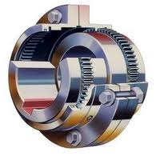
Gear Coupling

Slide 27
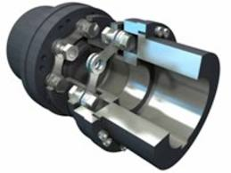
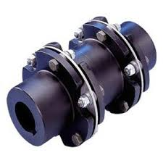
Metastream Flexible Coupling

Slide 28
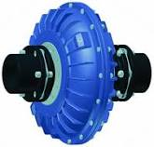
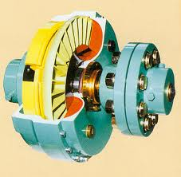
Fluid Coupling

Slide 29
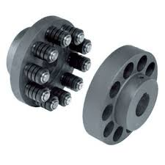
Pin and Bush Coupling

Slide 30
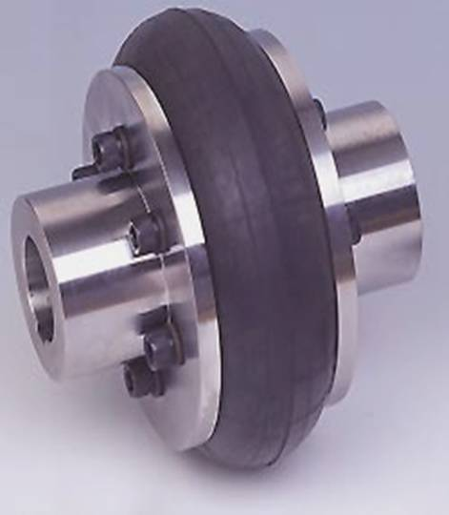
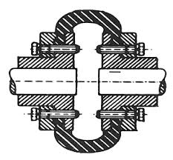
Tyre Coupling - External

Slide 31
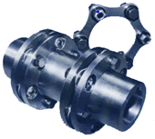
Disc or Flexible Membrane Coupling

Slide 32
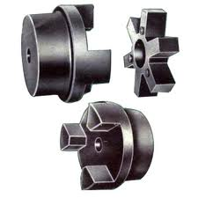
Spider Coupling

Slide 33
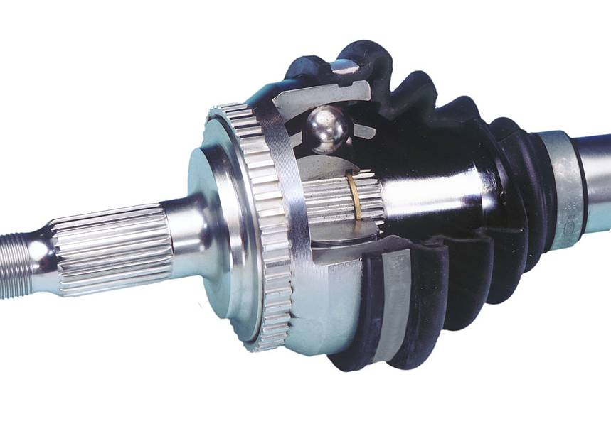
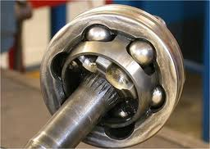
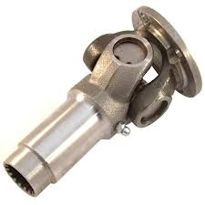
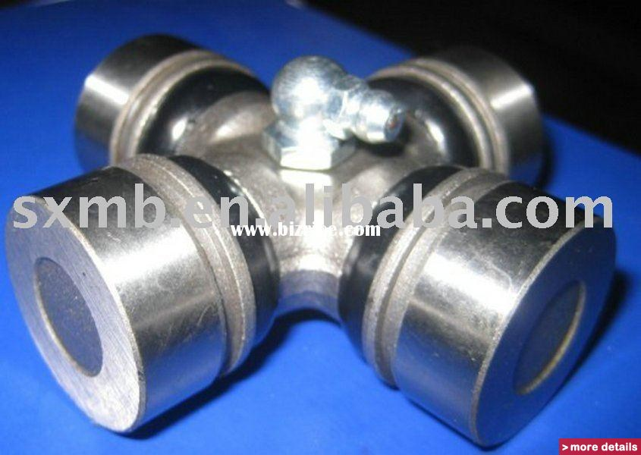
Universal Coupling and Constant Velocity

Slide 34
ANY QUESTIONS?

