Slide 1
CONDITION MONITORING
This module is designed to develop your awareness and competence in condition monitoring according to your current training objectives which are set out in your ROA.
Upon completion of all input, whether practical or theoretical, you will be asked to complete a written test that will verify your level of understanding.

Slide 2
WHAT IS CONDITION MONITORING
Is the process of monitoring all parameters of condition in machinery, such that a significant change is indicative of a developing failure. It is a major component of:-
PREDICTIVE MAINTENANCE
The use of conditional monitoring allows maintenance to be scheduled, or other actions to be taken to avoid the consequences of failure, before the failure occurs. Nevertheless, a deviation from a reference value (e.g. temperature or vibration behaviour) must occur to identify impeding damages.

Slide 3
PREDICTIVE MAINTENANCE
DOES
NOT
PREDICT FAILURE

Slide 4
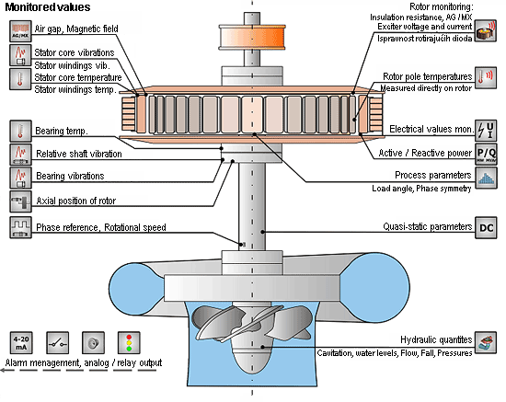

Slide 5
WHAT IS CONDITION MONITORING (CM)
In the 21st Century CM includes, but is not limited to, technologies such as:-
Vibration Measurement and Analysis
Infrared Thermography
Oil Analysis and Tribology
Ultrasonics - Covered Previously
Motor Current Analysis - Electrics

Slide 6
RECAP OF PREVIOUS LESSONS
You should recall that some areas of CM have been taught in previous lessons.
DYE PENETRANT DETECTION
MAGNETIC PARTICLE DETECTION
ULTRASONIC DETECTION
X-RAY (RADIOGRAPHIC) DETECTION

Slide 7
Vibration Measurement and Analysis
Ninety percent of all machine failures are signalled months, even years, in advance by changes in machine vibrations. Some future failures are even predictable upon initial start-up.
By understanding a machine's vibration "signature," you can diagnose, solve, and prevent problems, as well as reduce the cost of maintenance.

Slide 8
Vibration Measurement and Analysis
We monitor the condition of machinery for the following reasons:-
Less Downtime
Less Spare Parts Inventory
Better Management Time Allocation
Less Overhaul-Overkill
Longer Production Runs
Better Quality

Slide 9
How to monitor
Although the recording of vibration data can be performed with equipment as basic as a meter and a pencil and paper, advances in technology enable computer assisted data collection which provides much more detail in a fraction of the time .

Slide 10
Vibration Analysis
Using a vibration analyser, and some skill, personnel can pinpoint the causes of rough machinery condition. Such problems as rotor imbalance and misalignment make up a great proportion of mechanical deficiencies and can be identified and rectified. Other problems such as bearing wear are not only detected, but also qualified as to the severity of wear. In many instances, a historical case study can prognose the remaining life of bearings so that scheduled repairs can be prioritised.

Slide 11
Corrective Measures
By far, the most predominant utilisation of vibration corrective measures are that of balancing. More than a trial and error method of achieving dynamic trueness, balancing with an analyser is a stepped process. It is one of very few techniques where machinery which is deemed "rough" can be corrected in place, without disassembly and where the results can meet any level of precision in almost all cases. This is especially helpful when one considers that the same analyser pinpoints imbalance conditions so that the cause and cure are achieved with the same instrument.

Slide 12
Corrective Measures
Vibration analysers can be used for running alignment. We have seen cases where an analyser is used throughout the alignment procedure to detect the source of high vibration or to detect the effects of fastening. Also, soft-foot conditions can be detected and corrected while the machine is operational. This creates a fast diagnosis-correction situation without having to stop and start the machinery.

Slide 13
Myths
"We don't have a vibration problem"
That is because "vibration" is not a problem - it is a physical manifestation of machinery imperfection. It is used to help find obvious and subtle deviations in machines. No machine runs perfect.

Slide 14
Myths
“Balance that machine“
This is a request that is made before a condition of imbalance is established. It is not just a matter of semantics either. If in fact, the machine is imbalanced, corrective action can be taken and the machine can operate within tolerances. If it is not imbalanced, the vibration analyst will advise the corrective action but cannot use the analyser to fix the problem directly. It is a matter of expectations and in some cases, disillusionment.

Slide 15
Myths
“That machine is fine - we've just changed the bearings"
This is stated as a reason for not analysing a machine. Bearings do fail as a matter of fact. After a certain amount of time, maybe a month, maybe a decade, bearings will finally succumb to slight or severe wear criteria and will fail. Assuming however, that bearing replacement is the final solution is a folly.

Slide 16
Myths
The bearing replacement trap occurs when the old bearings are noisy or fail. The engineers are charged with replacing them and the new ones are now quiet - problem solved -
WRONG

Slide 17
Myths
“That machine always runs like that"
And it always will until you fix it! Vibration analysis can tell you how.

Slide 18
Myths
“When it fails, we repair it"
The fact is, the machine will fail at its discretion (if it had any) and not to your schedule. When it fails, it will cause secondary damage. The parts for many machines must be kept on hand ahead of time to minimise the time it takes to repair.

Slide 19
Infrared Thermography
Infrared Thermography is the technique for producing an image of invisible (to our eyes) infrared light emitted by objects due to their thermal condition.

Slide 20

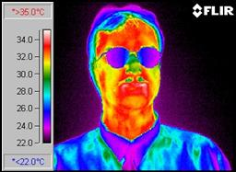
Infrared Thermography
An image produced by an infrared camera is called a thermogram or sometimes a thermograph.

Slide 21
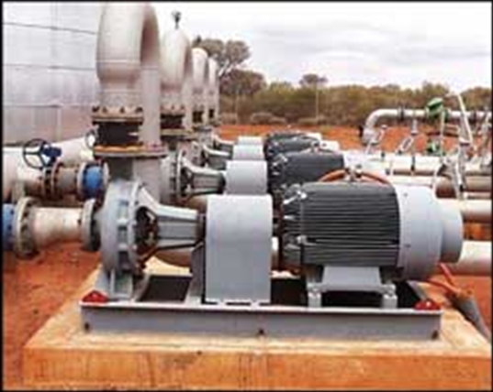
PUMP THERMOGRAPHY

Slide 22
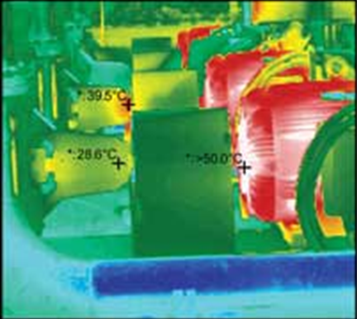
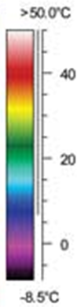
PUMP THERMOGRAPHY

Slide 23


WHICH HEATER IS LIT?

Slide 24
WHY USE THERMOGRAPHY
Thermography can be applied in any situation where a problem or condition can reveal itself by means of a thermal difference.
This is why it is very quick and simple to use in CM, giving accurate results.

Slide 25
ADVANTAGES
Boiler Applications
  Inspect burners for flame impingement and burner management
  Look at combustion patterns of fuel
  Detect thermal patterns on boiler tubes and measure tube skin temperature during normal operation or when boiler is on standby
  Scan and record temperatures in areas of boiler not monitored
  Scan the exterior of boiler for refectory damage or locate warmer areas where potential refectory damage may occur

Slide 26
ADVANTAGES
Detect coke buildup in crude oil furnaces
Power Plant boiler flue gas leak detection
Mechanical bearing inspections
Heat ventilation air conditioning equipment evaluation
Cold Storage cooling losses.
Detect insulation leaks in refrigeration equipment

Slide 27
ADVANTAGES
Petrochemical Applications
Refinery process line insulation loss or leak detection
Refinery process evaluation
Heat exchanger Quality and efficiency evaluation
Furnace refractory (insulation) inspections
Furnace Internal flame evaluation and tube inspections
Flame propagation explosion analysis.

Slide 28
ADVANTAGES
Electronic Equipment Applications
Printed circuit board evaluation and troubleshooting.
Thermal mapping of semiconductor device services
Circuit board component evaluation
Production-type inspection of bonded structures
Inspection of hybrid microcircuits
Inspection of solder joints

Slide 29
ADVANTAGES
Environmental Applications
Locate old waste disposal sites
Locate old buried tanks on industrial sites
Locate and monitor oil spills

Slide 30
Oil Analysis and Tribology
Oil condition monitoring is all about gaining an insight into what is happening inside your machine, be it the engine, gearbox or hydraulic system.
Taking a sample of oil is like taking a sample of blood and analysing it for illness.

Slide 31
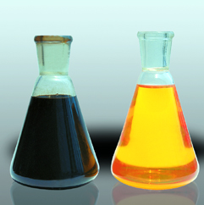

For example a sample of motor oil can provide you with a glimpse into the future and allow you to take a proactive approach, and prevent extra costs associated with equipment failure.

Slide 32
What is Tribology?
Tribology refers to the study of friction, wear, lubrication and contact mechanics, particularly in an engineering and mechanical context. The definition of Tribology is: 'interacting surfaces in relative motion.

Slide 33
TRIBOLOGY DEFINITION
INTERACTIVE
SURFACES
IN
RELATIVE
MOTION

Slide 34
WHAT’S NEXT
You will now require to go in to workshop number 05 (Alan’s) and carry out CM data collection on the fan and bearing heater.
The data will be collect and recorded, from which you will produce a graph to prove your findings.

Slide 35
THERMOGRAPHY / VIBRATION
Choose a suitable axis and plot the results incrementally for EACH case.

Slide 36
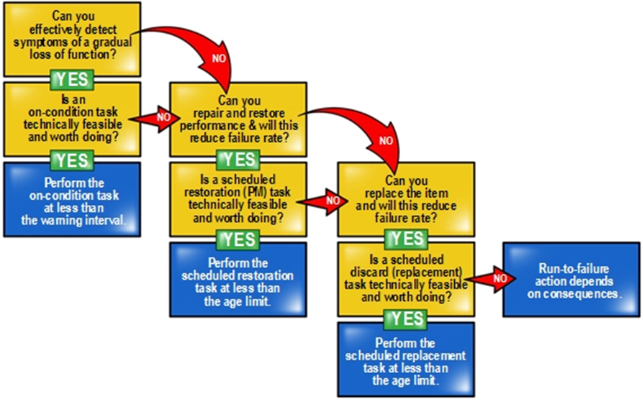
SUMMARY

