Slide 1

Pressure Relief Streams
Part Three Relief Valve Faults
Website: www.ttetraining.ltd.uk

Slide 2
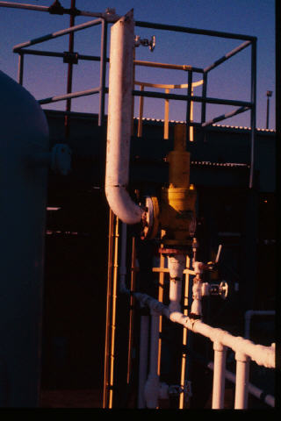
Anything wrong
here?

Slide 3
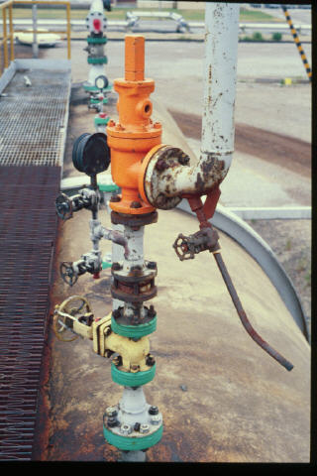
Any concerns
here?

Slide 4
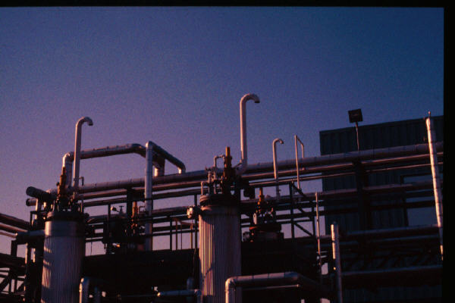
Anything wrong
here?

Slide 5
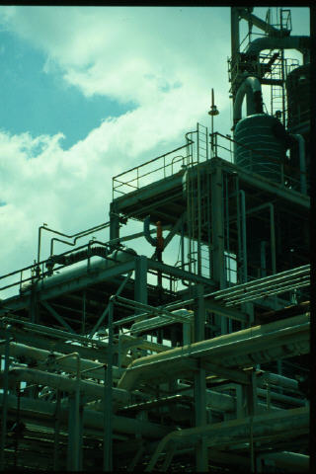
Anything wrong
here?

Slide 6
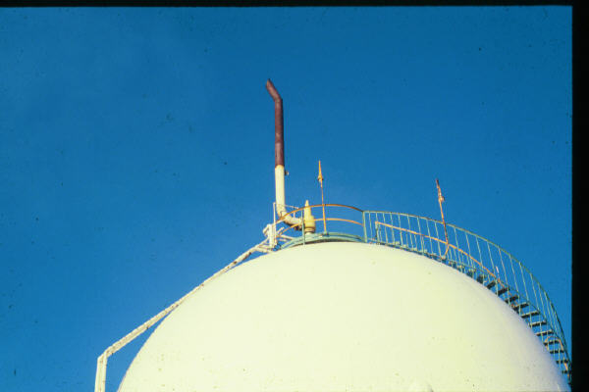
Anything wrong
here?

Slide 7
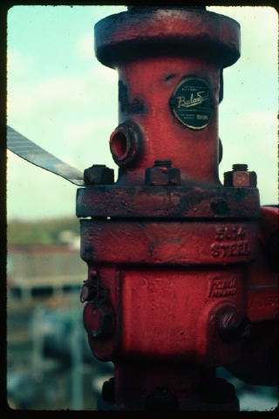
Anything wrong
here?

Slide 8
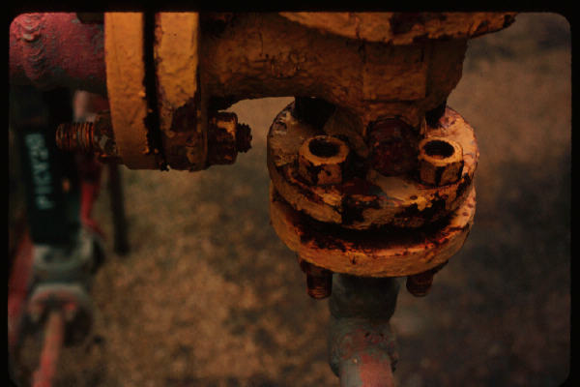
Anything wrong
here?

Slide 9
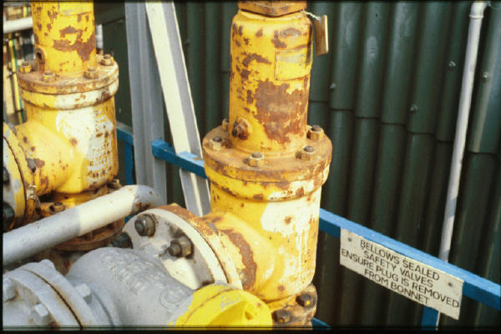
Anything wrong
here?

Slide 10
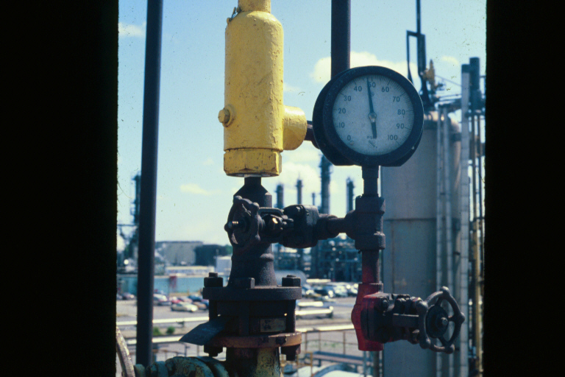
?? Reduced Inlet Piping
Anything wrong
here?

Slide 11
END OF PRESENTATION
Notes:
.

Slide 12
Student Print Stop

Slide 13
Undersized
inlet piping

Slide 14
Valve on the
vent drain

Slide 15
Discharge directed
downward

Slide 16
Discharge too
near deck

Slide 17
Long moment arm

Slide 18
Shipping plug still
in bellows vent

Slide 19
Will these bolts hold
when the PRV relieves?

Slide 20
?? Plugged Bellows, Failed Inspection, Maintenance
Bellows plugged
in spite of sign
Failed
Inspection
Program

Slide 21
Pressure above RD
Reduced inlet piping

