Slide 1
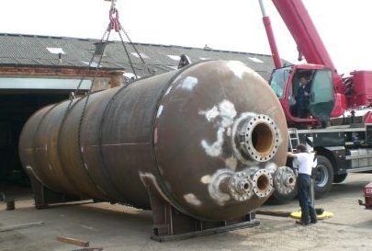

Pressure Vessels
Website: www.ttetraining.ltd.uk

Slide 2
What is a Pressure Vessel?
A pressure vessel is a closed vessel
of any capacity consisting of one or more
independent chambers, any or each of
which is or may be subjected to,
internal or external pressure,
greater or lesser to atmospheric
Notes:
2

Slide 3
PRESSURE VESSELS
Pressure vessels are the containers for fluids under high pressure.
They are used in a variety of industries like
    Petroleum refining
    Chemical
    Power
    Food & beverage
    Pharmaceutical

Slide 4
British Standards Design Codes
Design and testing standards and a system of certification came about as the result initially of fatal boiler explosions.
BS 5500: Former British Standard, replaced in the UK by a European Standard BS EN 1344 but retained under the name PD 5500 for the design and construction of export equipment.
Notes:
4

Slide 5
The Law
All pressure vessels must be registered in an equipment file.
Each Vessel must have a unique number and a name plate with year of manufacture
Certificate of test registered in the equipment file. Also frequency of testing

Slide 6
MAIN COMPONENTS OF
PRESSURE VESSEL
Following are the main components of pressure Vessels in general
Shell
Head
Nozzle
Support

Slide 7
Common Types of Pressure Vessels
The three very common type of pressure vessels are.
Horizontal Pressure Vessels
Vertical Pressure Vessels
Spherical Pressure vessels
However there are many others some special types of vessel like Regeneration Tower, Reactors but these names are given according to their use only.

Slide 8
HORIZONTAL PRESSURE VESSEL

Slide 9
VERTICAL PRESSURE VESSEL
The max. Shell length to diameter ratio for a small vertical drum is about 5 : 1

Slide 10
TALL VERTICAL TOWER
Constructed in a wider range of shell diameter and height.
They can be relatively small in dia. and very large (e.g. 4 ft dia. And 200 ft tall distillation column.
They can be very large in dia. and moderately tall (e.g. 3 ft dia. And 150 ft tall tower).
Internal trays are needed for flow distribution.

Slide 11
VERTICAL REACTOR
Figure shows a typical reactor vessel with a cylindrical shell.
The process fluid undergoes a chemical reaction inside a reactor.
This reaction is normally facilitated by the presence of a catalyst which is held in one or more catalyst beds.

Slide 12
SPHERICAL PRESSURIZED STORAGE VESSEL

Slide 13
SHELL
It is the primary component that contains the pressure.
Pressure vessel shells are formed form of different plates that are welded together to form a cylinder structure that has a common rotational axis.
The shell end are mainly either dished, spherical or conical in shape.

Slide 14
These cylindrical shells are constructed in a wide range of diameter and lengths.
The shell sections of a tall tower may be constructed of different materials, thickness and diameters due to process and phase change of process fluid.
Some shells can be spherical in shape these and can be very strong but have limited use.

Slide 15
HEAD
All the pressure vessels must be closed at the ends by heads (or another shell section).
Heads are typically curved rather than flat.
The reason is that curved configurations are stronger and allow the heads to be thinner, lighter and less expensive than flat heads.
Heads can also be used inside a vessel and are known as intermediate heads.
These intermediate heads are separate sections of the pressure vessels to permit different design conditions.

Slide 16
NOZZLE
A nozzle is a cylindrical component that penetrates into the shell or head of pressure vessel.
They are used for the following applications.
    Attach piping for flow into or out of the vessel.
    Attach instrument connection (level gauges, Thermowells, pressure gauges).
    Provide access to the vessel interior at MANWAY.
    Provide for direct attachment of other equipment items (e.g. heat exchangers).

Slide 17
Pressure Vessel Types and Vessel
End Shapes
These are the main types of cylindrical (closed ends) vessel used:-
Conical
Elliptical and semi Elliptical (Torispherical)
Rectangular (flat end)
Hemispherical
Ellipsoidal
Toriconical

Slide 18
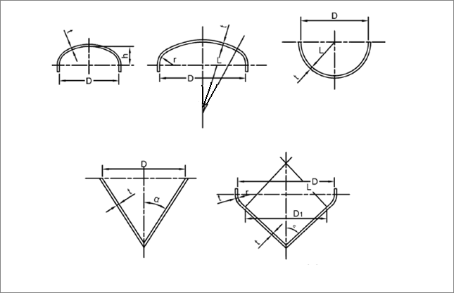
Ellipsoidal
Torispherical
Hemispherical
Conical
Toriconical

Slide 19
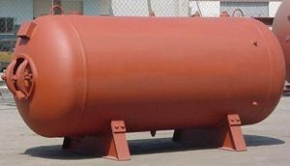
Semi Elliptical pressure vessels

Slide 20
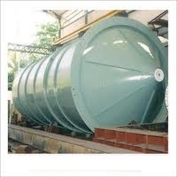
Conical

Slide 21
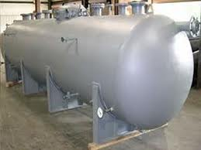
Torispherical

Slide 22
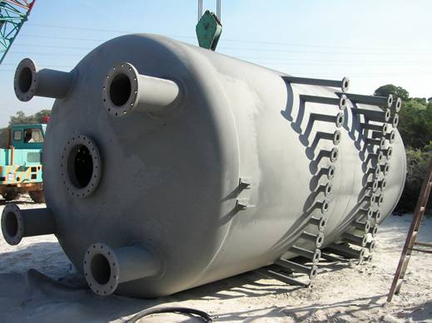
Semi Ellipsoidal

Slide 23
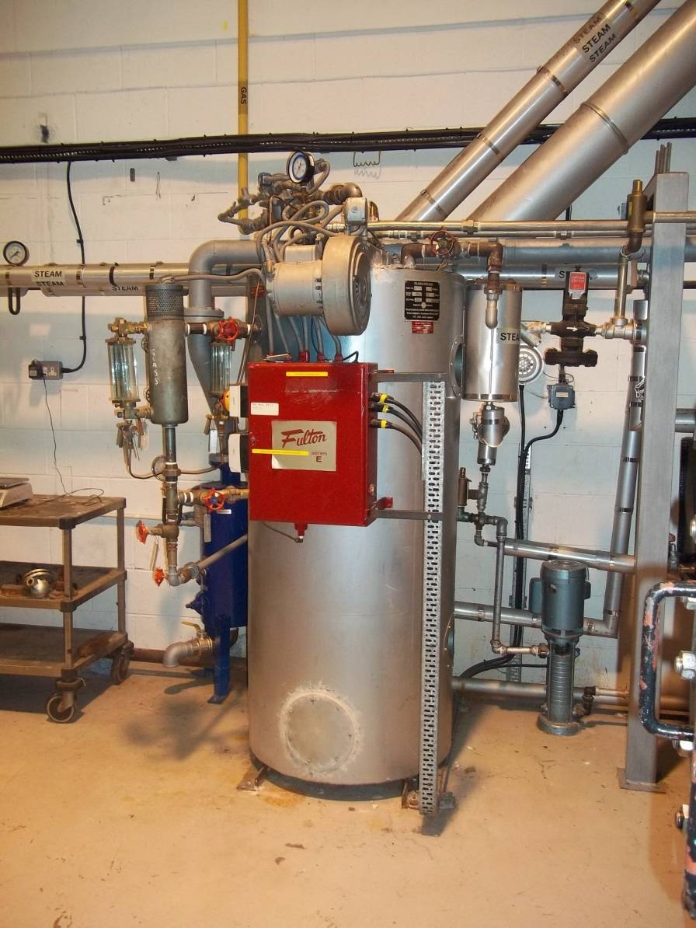
Rectangular

Slide 24
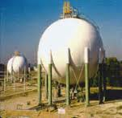
Spherical

Slide 25
SUPPORT
Support is used to bear all the load of pressure vessel, including earthquake and wind loads.
There are different types of supports which are used depending upon the size and orientation of the pressure vessel.
It is considered to be the non-pressurized part of the vessel.

Slide 26
TYPES OF SUPPORTS
SADDLE SUPPORT:
Horizontal drums are typically supported at two locations by saddle support.
It spreads over a large area of the shell to prevent an excessive local stress in the shell at support point.
One saddle support is anchored whereas the other is free to permit unstrained longitudinal thermal expansion of the drum.

Slide 27
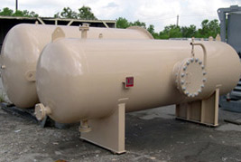

Slide 28
TYPES OF SUPPORTS
LEG SUPPORT:
Small vertical drums are typically supported on legs that are welded to the lower portion of the shell.
The max. ratio of support leg length to drum diameter is typically 2 : 1
Reinforcing pads are welded to the shell first to provide additional local reinforcement and load distribution.
The number of legs depends on the drum size and loads to be carried.
Support legs are also used for Spherical pressurized storage vessels.
Cross bracing between the legs is used to absorb wind or earth quake loads.

Slide 29
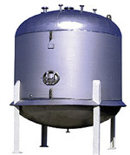

Slide 30
TYPES OF SUPPORTS
LUG SUPPORT:
Vertical pressure vessels may also be supported by lugs.
The use of lugs is typically limited to pressure vessels of small and medium diameter (1 to 10 ft)
Also moderate height to diameter ratios in the range of 2:1 to 5:1
The lugs are typically bolted to horizontal structural members in order to provide stability against overturning loads.

Slide 31
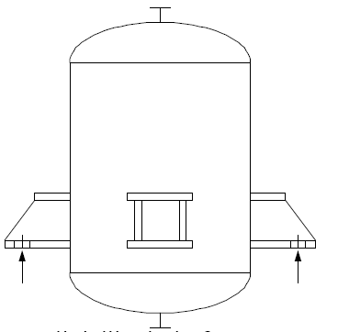

Slide 32
TYPES OF SUPPORTS
SKIRT SUPPORT:
Tall vertical cylindrical pressure vessels are typically supported by skirts.
A support skirt is a cylindrical shell section that is welded either to the lower portion of the vessel shell or to the bottom head (for cylindrical vessels).
The skirt is normally long enough to provide enough flexibility so that radial thermal expansion of the shell does not cause high thermal stresses at its junction with the skirt.

Slide 33
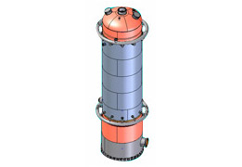

Slide 34
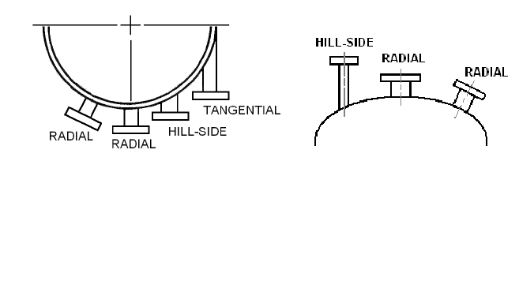
Types of Nozzle Mounting Attachment for Vessels

Slide 35
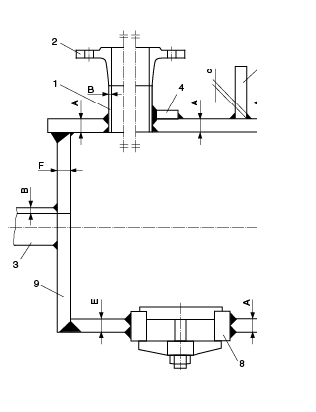
Types of Nozzle Attachment
Nozzle attachment to shell of a vessel.
Set-on.
Set-through.
Set-through with compensating ring.
Note the compensating ring is nearly always drilled and tapped for tell-tale leak decision or for pressure test

Slide 36
Steam Boilers
Among the vessels with the most potential are the steam raising equipment (Boilers) Steam is used throughout industry as it has an enormous capacity to store energy and do work. But because of both the heat and pressure they contain they have to be constructed and maintained to very high standards and operated with great care.
Notes:
36

Slide 37
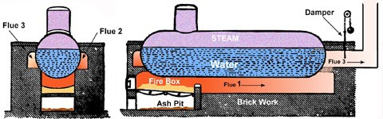
Boiler Evolution
The first advancement in boiler design came with the invention of the Plain Cylinder Boiler.
Notes:
37

Slide 38
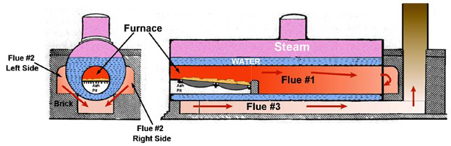
The Cornish Boiler
This greatly increased the amount of heat transferred to the water.
Notes:
38

Slide 39
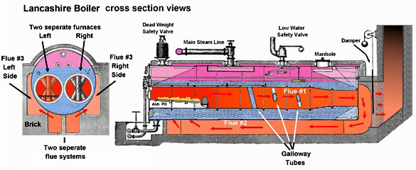
The Lancashire Boiler
The combustion takes place in 2 flue systems thereby increasing the amount of heating of the sides of the cylinder.
Notes:
39

Slide 40
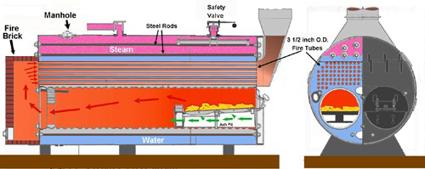
The Scotch Boiler (2-pass)
The water tank is made from corrugated plates to improve its strength and increase its surface area. Because of the larger water surface exposed to the heat more heat is transferred to the water.
Notes:
40

Slide 41
Boiler classification
There are two approaches in boiler design: fire tube and water tube. The goal in all cases is to maximize the heat transfer between the water and the hot gases heating it.
Notes:
41

Slide 42
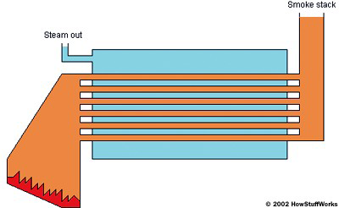
Fire-tube boilers
The fire, or hot flue gases from the burner, is channeled through tubes that are surrounded by the water to be heated.
Notes:
42

Slide 43
Advantages:
Relatively inexpensive
Easy to clean
• Compact in size
• Available in sizes from 600,000 btu/hr to 50,000,000 btu/hr
• Easy to replace tubes
• Well suited for space heating and industrial process applications
Notes:
43

Slide 44
Disadvantages:
• Not suitable for high pressure applications 250 psig and above
• Limitation for high capacity steam generation
• In a fire-tube boiler, the entire tank is under pressure, so if the tank bursts it creates a major
explosion.
Notes:
44

Slide 45
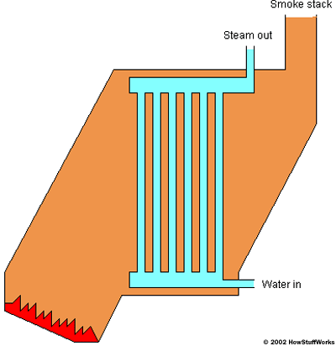
Water-tube boilers
A Watertube design is the exact opposite of a fire tube.
Notes:
45

Slide 46
Advantages:
• Available in sizes that are far greater than the firetube design. Up to several million pounds per hour of steam.
• Able to handle higher pressures up to 5,000 psig
• Recover faster than their firetube cousins
• Have the ability to reach very high temperatures
Notes:
46

Slide 47
Disadvantages:
• High initial capital cost
• Cleaning is more difficult due to the design
• No commonality between tubes
• Physical size may be an issue
Notes:
47

Slide 48
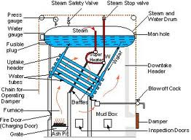
Sectioned View of a Modern Water Tube Boiler
Notes:
48

Slide 49
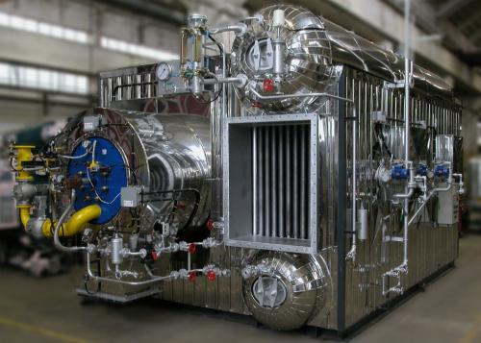
Modern High Pressure Steam Package Boiler
Notes:
49

Slide 50
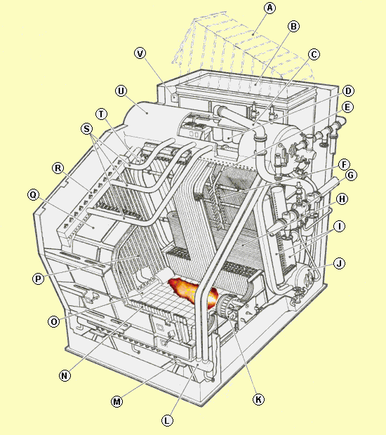
A sectioned view of the boiler arrangement showing all the integrated parts including the economizer (B.F.W. heater) and steam superheater.
Notes:
50

Slide 51
Part List Identification
A. Boiler Flue Gas Outlet
B. Economizer
C. Main Saturated Steam Outlet
D. Cyclone
E. Stay tube
F. Stays
G. Superheated steam outlet
H. Superheater
I. Superheater Headers
J. Water Drum
K. Burner
Notes:
51

Slide 52
Part List Identification
L. Waterwall Header
M. Support Feet
N. Waterwall
O. Waterwall Header
P. Back side Waterwall
Q. Boiler hood
R. Waterwall Header
S. Riser
T. Downcomer
U. Steam Drum
V. Economizer Header
Notes:
52

Slide 53
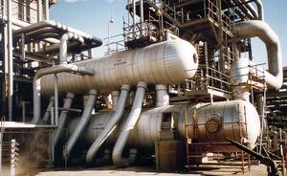
Process Plant Incorporating a Heat Recovery Steam Boiler
Notes:
53

Slide 54
One of the main differences between the process gas boiler (Heat Recovery Steam Boiler) and the conventional package boiler is the thermo-siphon effect. A package boiler will naturally circulate the water by thermo-siphoning were as the process gas boiler because of it layout sometimes have to have forced circulation via a boiler circ. pump.
Notes:
54

Slide 55
Testing of Pressure Vessels
Test Pressure
Test Fluid
Temperature of the Test Fluid
Are supporting structures Strong enough?

Slide 56
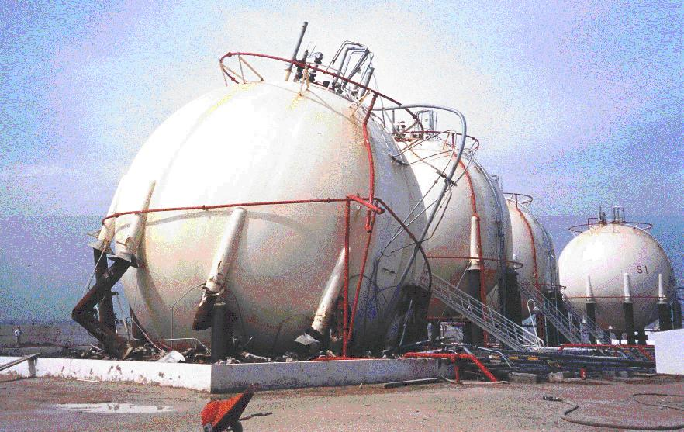
Gas storage sphere collapsed while being filled for a hydrostatic pressure test killing a worker underneath. Support legs had corroded due to water trapped between insulation and support column.

Slide 57
Stored Energy
Pressure testing is almost always done Hydraulic testing. If a weld or attachment does fail then there is very little of no stored energy to be release as long as the equipment has been vented and completely flooded.

Slide 58
Hydrostatic Test Check List
Structure
Joints and Spades
Removal of air
Pressure Gauges (QA checked)
Hammer Test
Multi-Chamber vessels.
Precautions
Drying

Slide 59
Hydrostatic Test Check List
Structure
Areas of interest and support should be de-lagged and cleaned and checked before flooding and that any spring support devices bellows compensators have had their gags fitted.

Slide 60
Hydrostatic Test Check List
Joints and Spades
All external inlet and outlet nozzles should be spaded or blanked off. Note all spading and blanking locations should be recorded on a check sheet.

Slide 61
Hydrostatic Test Check List
Removal of air
Ensure that you have a large and adequate method for venting the equipment in all the appropriate locations.

Slide 62
Hydrostatic Test Check List
Pressure Gauges (QA checked)
Most procedures require the fitting of two calibrated pressure gauges that read at least 1-1/2 to 2 times the required test pressure

Slide 63
Hydrostatic Test Check List
Hammer Test
Bring a vessel up to hydrostatic test pressure and hit each plate and nozzle welds with a hammer. This test was generally applied to carbon and low alloy materials but is not used much anymore.

Slide 64
Hydrostatic Test Check List
Multi-Chamber vessels.
Ensure that all inter vessel connection have adequate support and an adequate vent arrangement.

Slide 65
Hydrostatic Test Check List
Precautions
Before filling the vessel ensure that sight glasses or control instrumentation has been isolated, and if there is a danger of freezing the vessel is drained or protected by a heat source.

Slide 66
Hydrostatic Test Check List
Drying
If possible avoid getting the equipment wet during filling or that is in dried off as the test is in progress.

Slide 67
To compliment the Hydrostatic Test a series of other NDT techniques can also be used such as random radiography, dye penetration test, magnetic particle flaw detection, and ultrasonic tests if appropriate to further prove the equipment integrity.

Slide 68
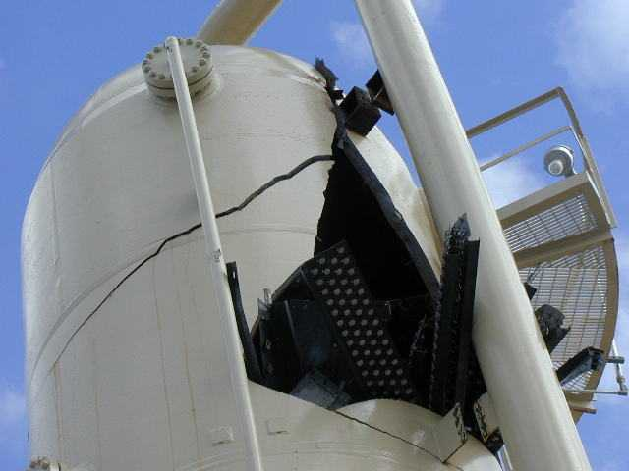
This is an example of a fracture caused by using water for a hydrostatic pressure test when the temperature fell well below freezing after the vessel was flooded.

Slide 69
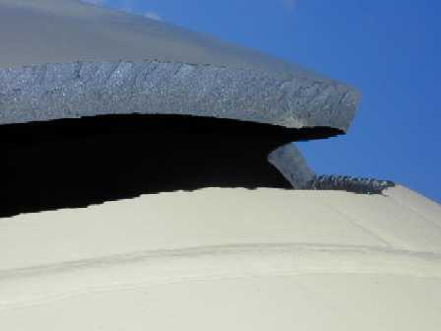

Slide 70
END OF PRESENTATION
ANY QUESTIONS

