Slide 1

FILXBOROUGH DISASTER
Website: www.ttetraining.ltd.uk

Slide 2
FILXBOROUGH NIPRO PLANT
Where unauthorised plant modification lead to catastrophic failure.

Slide 3
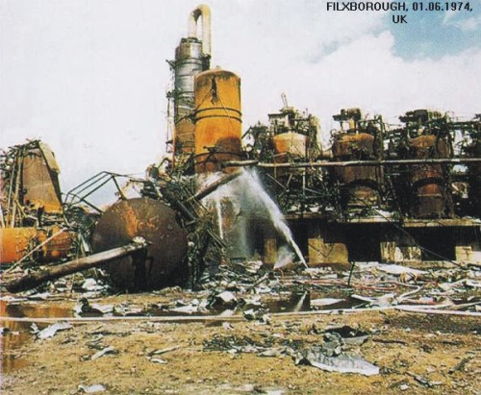
Filxborough Plant

Slide 4
Two months prior to the explosion, a crack was discovered in the number 5 reactor. It was decided to install a temporary 50 cm (20 inch) diameter pipe to bypass the leaking reactor to allow continued operation of the plant while repairs were made.

Slide 5
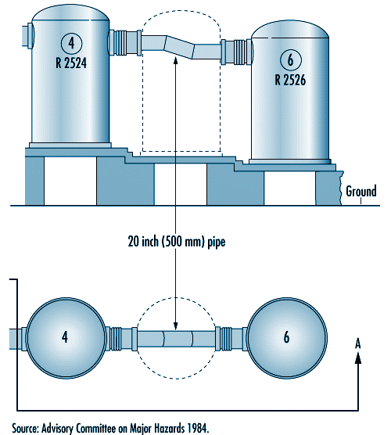

Slide 6
The bypass had been designed by engineers who were not experienced enough, this meant that the modification was not fit for purpose with unknown performance standards.

Slide 7
Under pressure the stress on the bellows eventually led to
a catastrophic failure of the line

Slide 8
28 men lost their lives and again millions of pounds worth of damage.

Slide 9
It follows on then, from such devastating incidents a very high degree of maintained control is required on the type of equipment that is permissible in hazardous areas, and this has lead to the ATEX equipment standards

