Slide 1

Website: www.ttetraining.ltd.uk

Slide 2
Agenda
Industry Trends & Challenges
Machinery Health Strategy
Automating Decision Support
Key Points

Slide 3
The ‘Game’ of Plant Reliability - Planning
Question: Can we make it to the next outage?
Challenge: Track fault… ‘get us to Nov 20’
Action: Alert Maintenance Planner
CMMS
OUTAGE PLAN
1. Change Bearing $$$
2. Align Motor $$$
3. Install New Coupling $$$
… … … … … … … … …
Planned Outage
Planned Outage
March 1
ID Fault
Nov 20
Nov 29
Failure
Outage

Slide 4
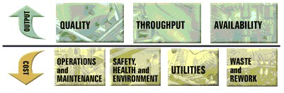
Business Metrics
Areas that are impacted most by Predictive Decision Support

Slide 5
Key Trends in Industry
Meet plant OUTPUT requirements
  Eliminate unplanned failures
Control COSTS
  ‘Smart’ skill set utilization – O&M COST
    Annual Maintenance Cost
  Optimize work planning – O&M COST
    Analyze MTBF / MTBM
    % Unplanned Maintenance
    Work Order Compliance
  Control outage times
    Utilize CMMS / Maint. Planning

Slide 6
Program Performance
 | 1988 | 2001 | Ideal
Reactive | 55% | 55% | 10%
Preventive | 30% | 31% | 25-35%
Predictive | 10% | 12% | 45-55%
Proactive | 5% | 2% | Balance
Reliability Magazine’s 2002 report
Over 11 years, plants are still REACTIVE.
World Class organizations focus on PREDICTIVE

Slide 7
Cost Statistics of the HPI Segments
Skill Sets
  75% or operations retiring in the next 15 years
    ‘Gray matter is leaving the plant!’
Costs
  20-30% of costs are related to maintenance
Mechanical Reliability
  3-7% Capacity Impact in loss/slowdown in production of key process equipment due to unplanned down
    Largest is due to mechanical equipment (40%)
  Predictive Maintenance program shown to impact reductions to unplanned mechanical shutdowns by ~30%
* HPI = Hydrocarbon Process Industries

Slide 8

Operational Challenges of Today
‘Our target is ZERO unplanned downtime!’
  Maximize Equipment Availability & Reliability
    Plan all maintenance - HOW?
‘We are trying to be competitive today with a plant that is typically more than 40 years old - and so are our competitors.’
  Extend Machinery Life & Rebuilds
‘We are running our equipment beyond its design capacity to handle the variety of materials that we must process’
  Running equipment beyond rated capacity
    Increased Throughput, but without RISK?

Slide 9
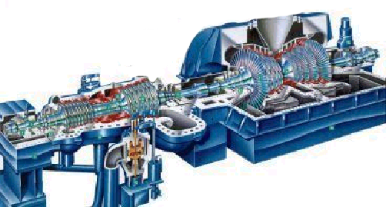
Answer These Tough Questions...
What maintenance does the machine need during the next planned shutdown?
  Are the spare parts in my inventory?
  Is my spares inventory too large?
Can the equipment run beyond the next scheduled outage?
Do I know when cavitation is occurring?
  Fact: 40-60% of machine problems related to lack of feedback to operators*
    Automation systems provide feedback (i.e., Cavitation) back to Operator
* Ron Moore book

Slide 10

Answer These Tough Questions...
Do you know the # of failures ranked by equipment type?
  Rotating Equipment can be segmented into…
    Pumps / Fans / Compressors
    Pumps can be segmented into…
      Centrifugal / Recip / Rotary / special effect
What are your most problematic machines?
  Are they the bottlenecks in your production facility?
    These machines = downtime cost for entire plant.
      Automated monitoring strategy would be ideal for these cases

Slide 11
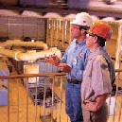
Answer These Tough Questions...
What are your Key Performance Indicators (KPI)?
  # failures, MTBF/MTBM
  Cost of Repairs, Avg. Repair Cost,
  Maintenance costs by Equipment Group
  Quantified Lost Production Opportunity (LPO)
  Ex.: ExxonMobil reduced maintenance costs 20% corporate-wide by considering these categorical cost concepts

Slide 12
Answer These Tough Questions...
Have you identified your most critical equipment?
  One facility has identified that…
    ~ 6 machines can bring them to 0 output MOST CRITICAL
    ~ 30 machines can reduce output to 40-60% ESSENTIAL
    Point: Some output is better than no output!
      If production is $1M / day, then 50% output loss = $500K / day
        Likely comes from O&M Budget
  Ex.: TN Eastman has 27,000 pieces of equipment
    3% (or ~750) need online-predictive & protection (AMI 1)
    26% (~7000) need online and walk-around (AMI 2 or 3)
    What percentage would your operations group tell you?
* AMI = Asset Management Index (1-5, 1 is most critical)

Slide 13
Conclusions…
The market is forcing major industrial facilities to adopt new methods for the sake of profitability
  Equipment is getting old…Running beyond design speeds…
Planning is everything
  But we don’t have unlimited man-power – industry is challenged!
Trained skill sets are starting to retiring
  How do you capture this knowledge?
Do I have MTBF statistics?
  CMMS is becoming important tool for O&M strategies
Identify the machines that reduce greatest percentage of output reduction
  These are most critical! Automation is easily justifiable.

Slide 14
Agenda
Industry Trends & Challenges
Machinery Health Strategy
Automating Decision Support
Key Points

Slide 15
Machinery Health Strategy
DESIGN
Business
Objective
Identification
Plant
Assessment
and
Benchmarking
Failure
Defense
Planning
Performance
Quantification
IMPLEMENTATION
Technology
Deployment
Expertise
Optimization
REVIEW
Performance
Measurement
and Analysis
Improvement
Planning
Work
Process
Optimization
Continuous
Improvement
Notes:
Achieving the optimum balance of technology, expertise, and work processes requires a machinery health strategy that is individualized to the needs of each facility. The strategy guides the design, implementation, and continuous improvement of the machinery health program. It is the roadmap to effective machinery health MANAGEMENT.
All facilities have some form of strategy whether formal or informal. Some strategies are effective but many are ineffective and result in program failure. We believe that this process is very effective in setting up or improving a Machinery Health Program.
“Design” is the planning phase of Machinery Health Management. All components of the strategy are planned at this time.
“Implementation” puts in place the technology, expertise, and processes. Implementation is where the program is both started up and operated.
“Review” is a process that is necessary to sustain the life and quality of the program and should be given just as much importance as the implementation phase.
Let’s look at each of these phases in more detail.

Slide 16
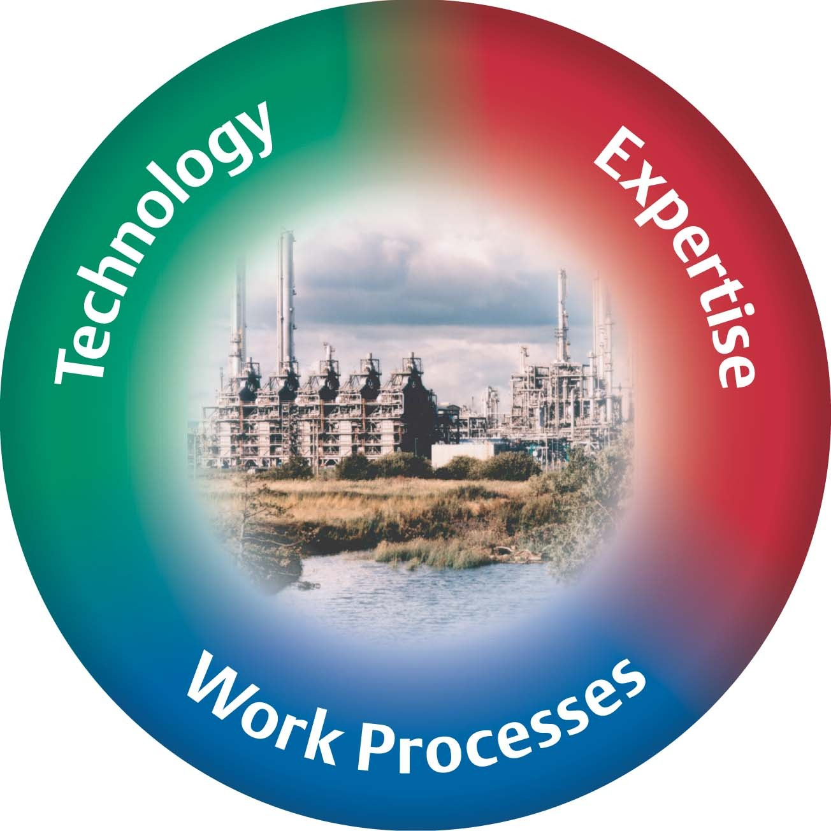
Asset Optimization
Technology
  To provide decision support
Expertise
  Qualified personnel with current knowledge
Work Processes
  To focus resources on priorities
Really need all
3 to realize true
POTENTIAL
Notes:
Asset Optimization closes the gap between plant performance and plant potential by increasing the performance and availability of plant assets. This is accomplished using a combination of Emerson Process Management’s Work Processes, Expertise, Technology and Management.
Work Processes: How the customer approaches maintenance, plans for reliability and executes activities is essential to sustaining equipment performance. Emerson’s experts apply their knowledge of best practices to
assess and make recommendations for existing processes and to educate facility personnel.
Technology: Organizations may purchase the technologies or purchase a turn-key implementation including the experts to operate the program.
Expertise: Expertise in reliability, monitoring, and diagnostics *is* necessary for optimization success. If facilities don’t have the internal resources to dedicate to optimizing performance, 3500 Emerson experts worldwide already have these skills and can be incorporated into the program.
Management: Asset optimization management balances work processes, expertise, and technology to ensure that each optimization program delivers long-term business benefits.

Slide 17
Agenda
Industry Trends & Challenges
Machinery Health Strategy
Automating Decision Support
Key Points

Slide 18
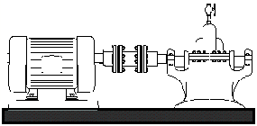
Automated Monitoring Concepts
Detect Detailed Machinery Problems
  Unbalance, Misalignment, Looseness, Shaft Cracks, Oil Whirl, Phase, Rubs, Gear and Bearing Problems
Looseness
Problem!

Slide 19
Signal Processing Flow
Transducer
Waveform
Amplitude
Time
FFT
Spectrum
Amplitude
Data Collector/Analyzer
Frequency

Slide 20
Time Waveform
Amplitude
Heavy Spot
+
0
Time
360 degrees
-
Rotation
1 revolution
3600 rpm = 3600 cycles per minute
60 Hz = 60 cycles per second
1 order = one times turning speed

Slide 21
Time Waveform
Amplitude
+
0
Time
-
1000 rpm
1 revolution
4 blades = vibration occurs 4 times per revolution
4 x 1000 rpm = vibration occurs at 4000 cycles per minute
= 4000 cpm

Slide 22
Time Waveform
Amplitude
+
12 tooth
gear
0
Time
-
1 revolution
1000 rpm
12 teeth are meshing every revolution of the gear
12 x 1000 rpm = vibration occurs at 12,000 cycles per minute
= 2,000 cpm = 200 Hz

Slide 23
+
0
Time
-
+
0
Time
-
+
0
Time
-

Slide 24
Complex Time Waveform
Time Waveform contains all the different frequencies mixed together
+
0
Time
-

Slide 25
Complex Time Waveform
Time Waveform contains all the different frequencies mixed together

Slide 26
We are now entering the Frequency Domain
FFT - Fast Fourier Transform
Separates individual frequencies
Detects how much vibration at each frequency

Slide 27
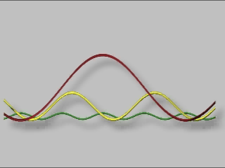
TIME WAVEFORM
AMPLITUDE VS TIME
Notes:
A typical time waveform
Horizontal axis is time in milliseconds
Vertical axis is amplitude of acceleration in G-s

Slide 28
Amplitude
Frequency
Time
Amplitude
Amplitude
Time
Frequency
Amplitude
Time
Notes:
The FFT process (Fast Fourier Transform) is a process which separates out the numerous pure frequencies (Sine Waves) that make up the Time Waveform.
After the Time Waveform is processed the discrete frequencies and their associated magnitudes are displayed.

Slide 29
0
Time
-
1x
Frequency
+
0
Time
-
4x
Frequency
+
Time
0
-
12x
Frequency

Slide 30
Predefined Spectrum Analysis Bands
1xRPM - BALANCE
1.8
2xRPM - ALIGNMENT
1.5
1.2
3-5xRPM - LOOSENESS
0.9
ANTI-FRICTION BEARINGS & GEARMESH
0.6
0.3
5-25xRPM
25-65xRPM
20000
5000
10000
15000
Frequency Hz

Slide 31
Bearing Fault Frequencies
Function of the Geometry of the Bearing
Outer Race
(BPFO)
Inner Race
(BPFI)
Ball Spin
(BSF)
Cage (FTF)

Slide 32
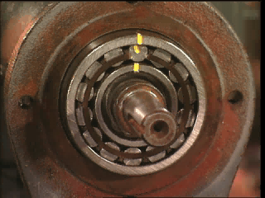
ROLLER BEARING EXAMPLE
Notes:
F= Ball Pass Frequency on the Outer raceway
Notice Nonsynchronous Order number (7.39) for BPFO
Note: Nonsynchronous energy will rise during bearing failures

Slide 33
Frequency Band Alarming and Trending
Sub-
Har
monic
1X
2X
Bearing
Bearing
Gears
Bearing
Amplitude
1x
2x
25-60 x
Trend of
Balance
Trend of Bearings
Alarm
.5
Alarm
in/sec
Warning
.1
Warning
in/sec
Time
(Days)
Time
(Days)
Notes:
Selective frequency bands are a reliable alarming technique for determining specific machine problems
Much research has been put into the suggested levels and placement of selective frequency bands for common machinery

Slide 34

Automated Monitoring Concepts
Detect Detailed Machinery Problems
  Unbalance, Misalignment, Looseness, Shaft Cracks, Oil Whirl, Phase, Rubs, Gear and Bearing Problems
Pass Information to DCS Plant Information Systems via OPC
  Use existing plant LAN Ethernet infrastructure
Looseness
Problem!

Slide 35
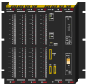


Like Process Control for the Vibration World
PLC
PLC
Controllers/Servers
PLC
Network Hub, Router, or Switch
Network Hub, Router, or Switch
PLC
=
Reliability Engineering
=
Maintenance Office
Customer Provided Windows 95/NT Workstation with CSI’s Online WATCH S/W loaded.
Customer Provided Windows 95/NT Workstation with CSI’s Online WATCH S/W loaded.
Control Room

Slide 36
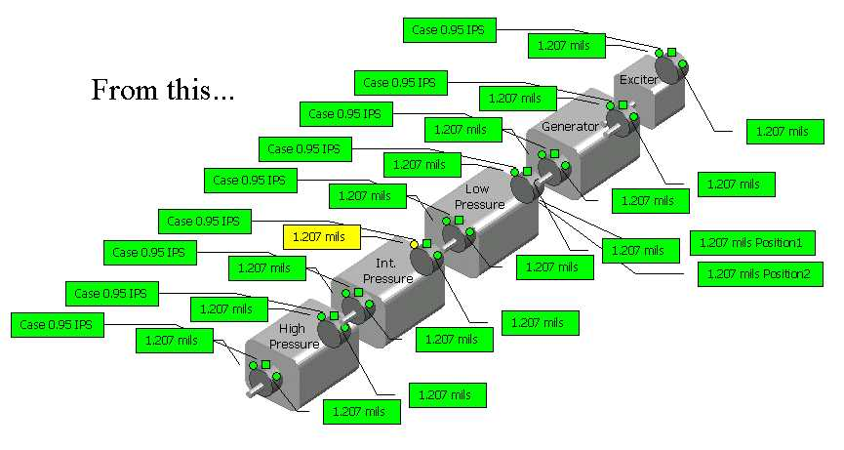
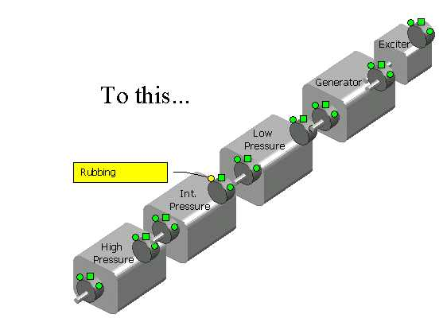
General…to Specific

Slide 37

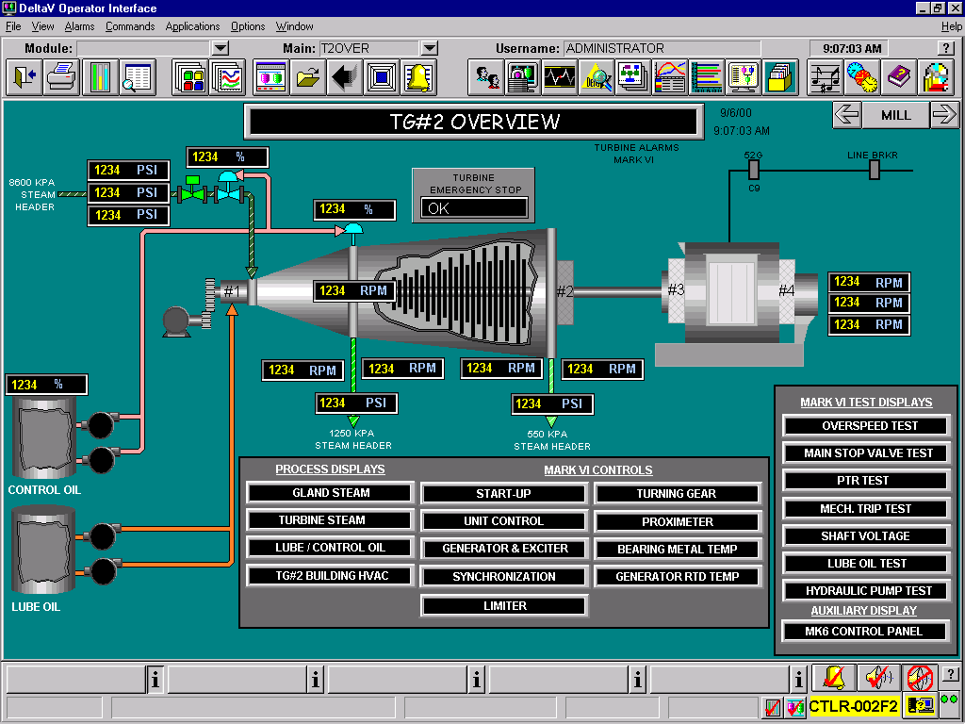

Graphical Interfaces - Overall
2301 Compressor - Asset Reliability System - CSI 4500 Series Online RBMCONSULTANTTM

Slide 38
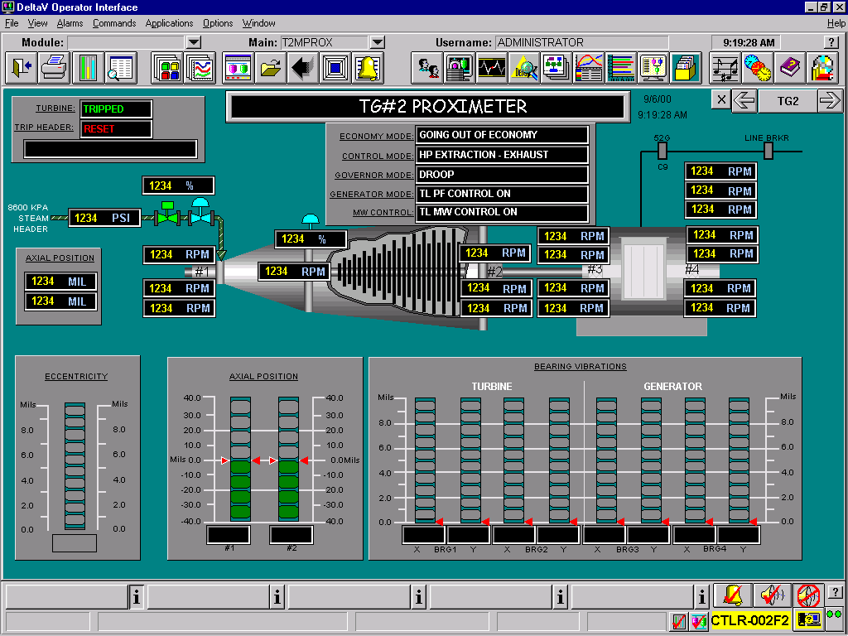
Graphical Interfaces - Specific Faults
Monitored Fault
Value
Overall Vibration
3.204 mils
Oil Whirl/Whip
0.506 mils
Rubs
0.112 mils
Unbalance
1.886 mils
1x Peak
0.231 mils
1x Phase
72 degrees
Misalignment
0.107 mils
2x Peak
1.886 mils
2x Phase (cracked shaft)
35 degree
Looseness
0.231 mils
Non-Rotational
0.501 mils

Slide 39
Automated Monitoring Concepts
Detect Detailed Machinery Problems
  Unbalance, Misalignment, Looseness, Shaft Cracks, Oil Whirl, Phase, Rubs, Gear and Bearing Problems
Pass Information to DCS Plant Information Systems via OPC
  Use existing plant LAN Ethernet infrastructure
Confirm mechanical conditions will reach planned shutdown, i.e., plant capacity target
  Fix what is ‘broke’ before failure
Looseness
Problem!
Failure
Outage

Slide 40
Automation Technology – Best Practices
Data-to-Information
  Assess condition/faults of machine in field
    Report results – not just data
Accuracy of automated analysis
  Combine analysis with machine operating condition
    Addresses false alarming
Report-upon-exception
  Keep skilled analysts focused on problems
    Addresses the ‘data generator’ issue
Today's
Best
Practices

Slide 41
Report-upon-Exception – not just data
- - - - - - - HI HI - - - - - - - - - - - - - CRITICAL - - - - - - - - - - - - - - - - - - - - - - - - - - -
DEADBAND
Deadband (hysterysis) - limits annoyance alarms
AMPLITUDE
- - - - - - - - HI - - - - - - - - - - - - - - URGENT - - - - - - - - - - - - - - - - - - - - - - - - - - - -
DEADBAND
ALARM TYPES
Fault HI HI
Caution HI
Caution LO
Fault LO LO
Δ Rate ROC
Δ Amplitude ABS EPS
RATE-OF-CHANGE
(ROC)
URGENCY
Critical
Urgent
Notify
Normal
ACTIONS
Relay Activate
Relay Activate
Relay Activate
OPERATE
RELAYS
!
Δ Time Report
Δ Amplitude Report (ABSOLUTE EPLISON)
Exception
Report on Exception
TIME HISTORY
System reports only when health CHANGES

Slide 42
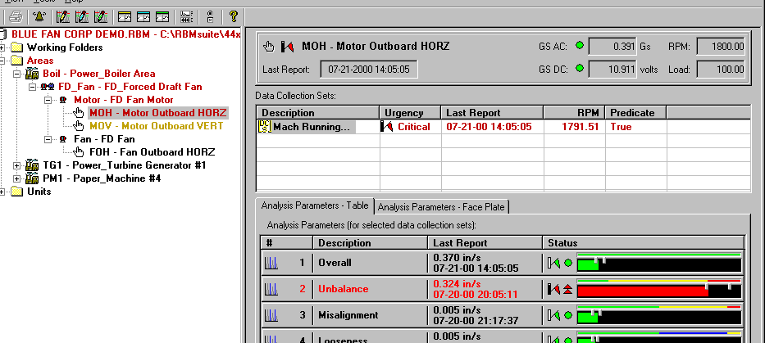
Benefits of Reporting only Exceptions
Too Much Data!
Automation should handle data rejection so
Reliability Group only has to handle EXCEPTIONS
Allows valuable human experience to be applied to analyzing problems
Logic helps to ID
canned observations
versus
reporting numbers
Result is
- Eliminate repetitive work
- Easy for end user
Efficient analysis only on problems
Optimize labor effort

Slide 43
Agenda
Industry Trends & Challenges
Machinery Health Strategy
Automating Decision Support
Key Points

Slide 44

Using Web Technologies to Enable
Remote Monitoring & Analysis
Provides customers with cost-effective access to information and expertise not previously available in their own plants
AOS Server
HQ
Process Plant
Emerson
Service
Professional
Process Plant
KEY:
Reliability
Engineer
Submit Data
Access to Reports via Internet Link
Subsidiary
Notes:
We host the application out of the U.K. You can see that various plants for a customer around the world can push their information to the server, and then the site can have information back, but also anybody else from that company who’s got the appropriate login and password privileges can also look at those results. This has been a big appeal of this solution for companies like BP, who have been one of the earlier adapters. BP is rolling out e-fficiency; it currently has about 50 pieces of equipment in the North Sea that are being monitored by e-fficiency and they are currently rolling out about an additional 50 in the southern part of the north sea. And, not only then is the asset manager on shore, who’s responsible for that specific platform able to look at the e-fficiency results, but additionally the compressor and the turbine experts, there’s just a handful of those guys who sit at headquarters, they’re also able to look at that. They can look at the compressors, because of the multiple platform, they can benchmark them, they can provide recommendations back to the individual site managers on when maintenance needs to be done and things like that. So, again, it’s a great way of moving information around the world to experts who can best advise on what needs to be done, getting information into the hands of the right people.

Slide 45







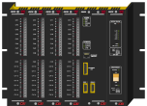
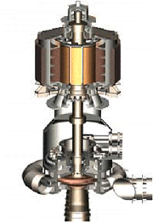
Asset Management Integration
Asset Optimization Interface
Enterprise
Ethernet WAN
World Wide Web
Operation
Optimization
Asset Management
Control and Application
GRA
Process Control
(DeltaV)
Process
Decision Support
CMMS
Device Management
Equipment Diagnostic
Condition Monitoring
Efficiency Monitoring
Ethernet LAN
Connectivity
Control Bus (FieldBus, HART, ProfiBus), Ethernet LAN, modem
Device
I & C monitoring, measurement, and regulation
Assets
Motors, pumps, fans, boilers, turbines
motor control centers, transformers
Periodic Monitoring

Slide 46
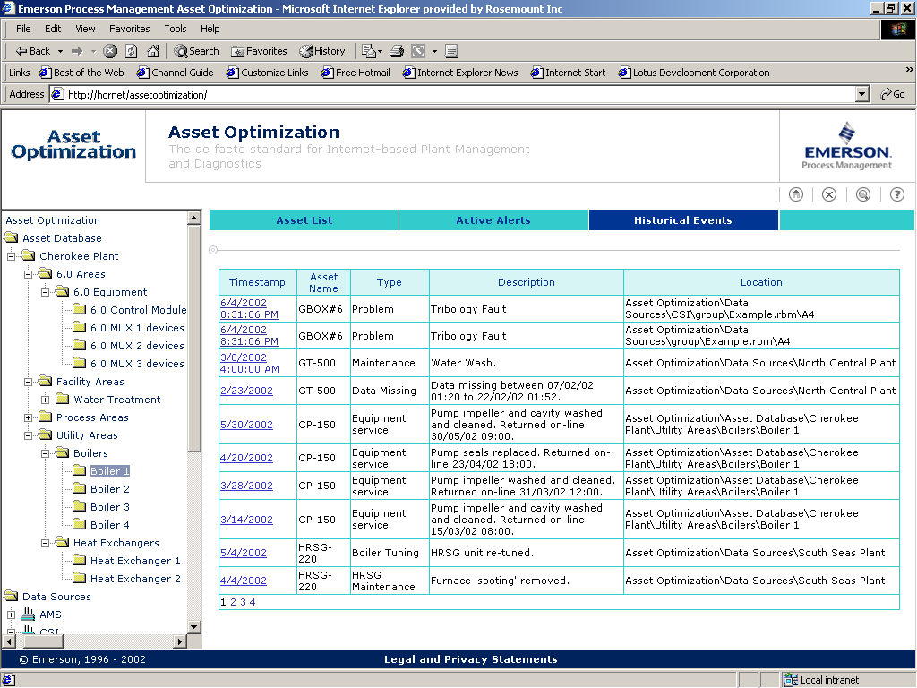
Emerson Asset Optimization Architecture phase1
AOweb
Asset Optimization Server
Data Collector
AMSweb
AO Web
Services
RBMweb
AO Web
Services
e-fficiency
AO Web
Services
AMS
RBMware
e-fficiency

Slide 47
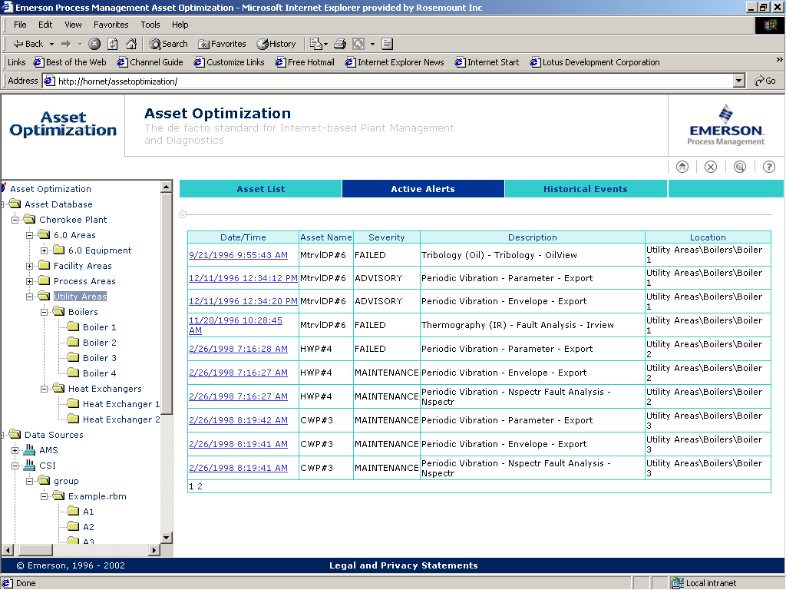
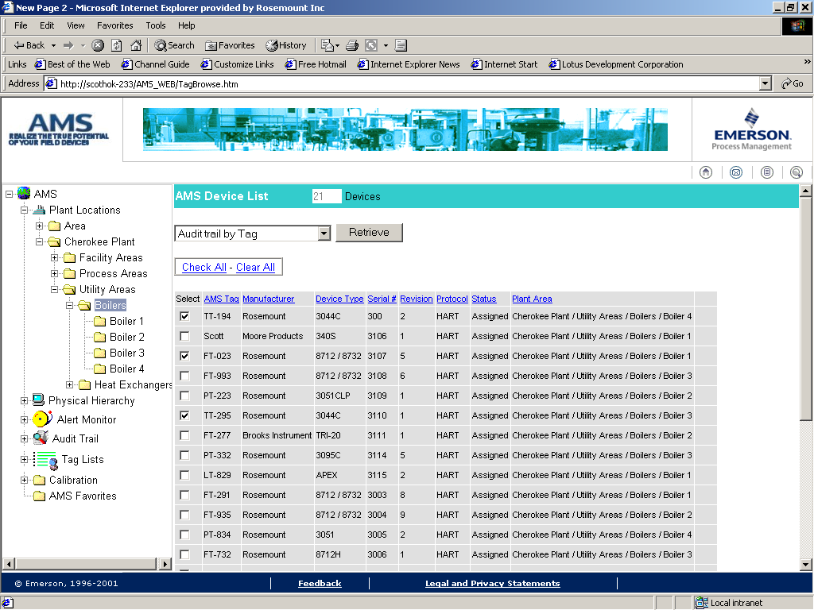
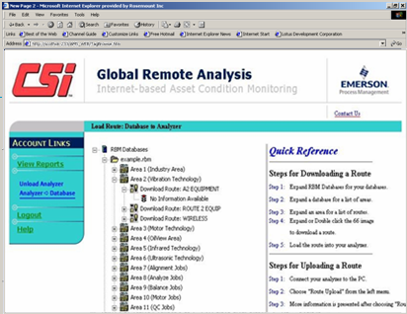
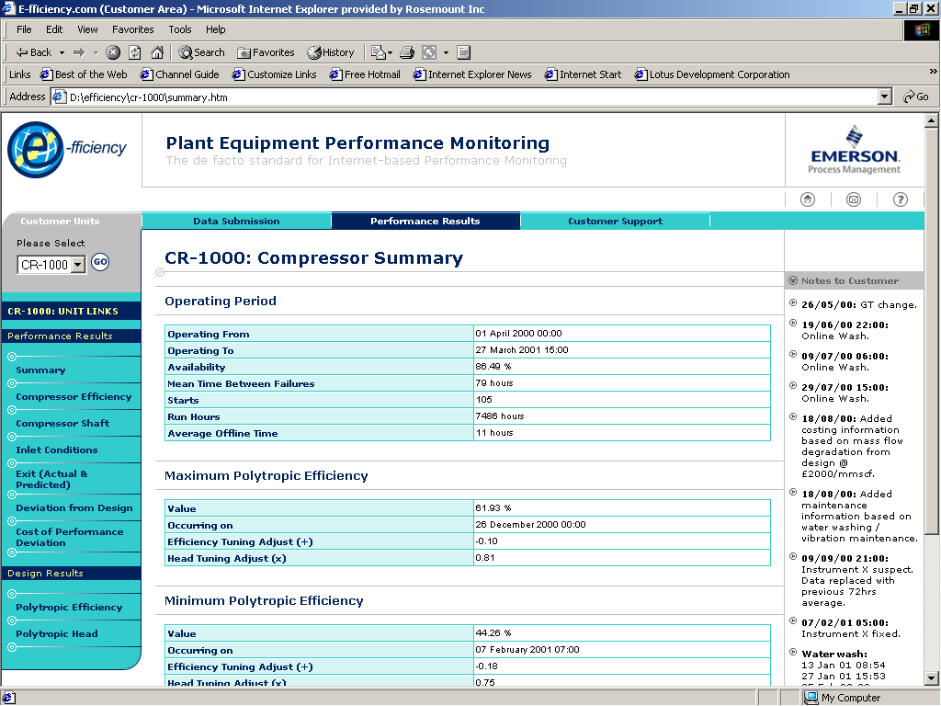
Using Advances in Web Technology
e-fficiency
AMSweb
Asset Optimization
web server

Slide 48
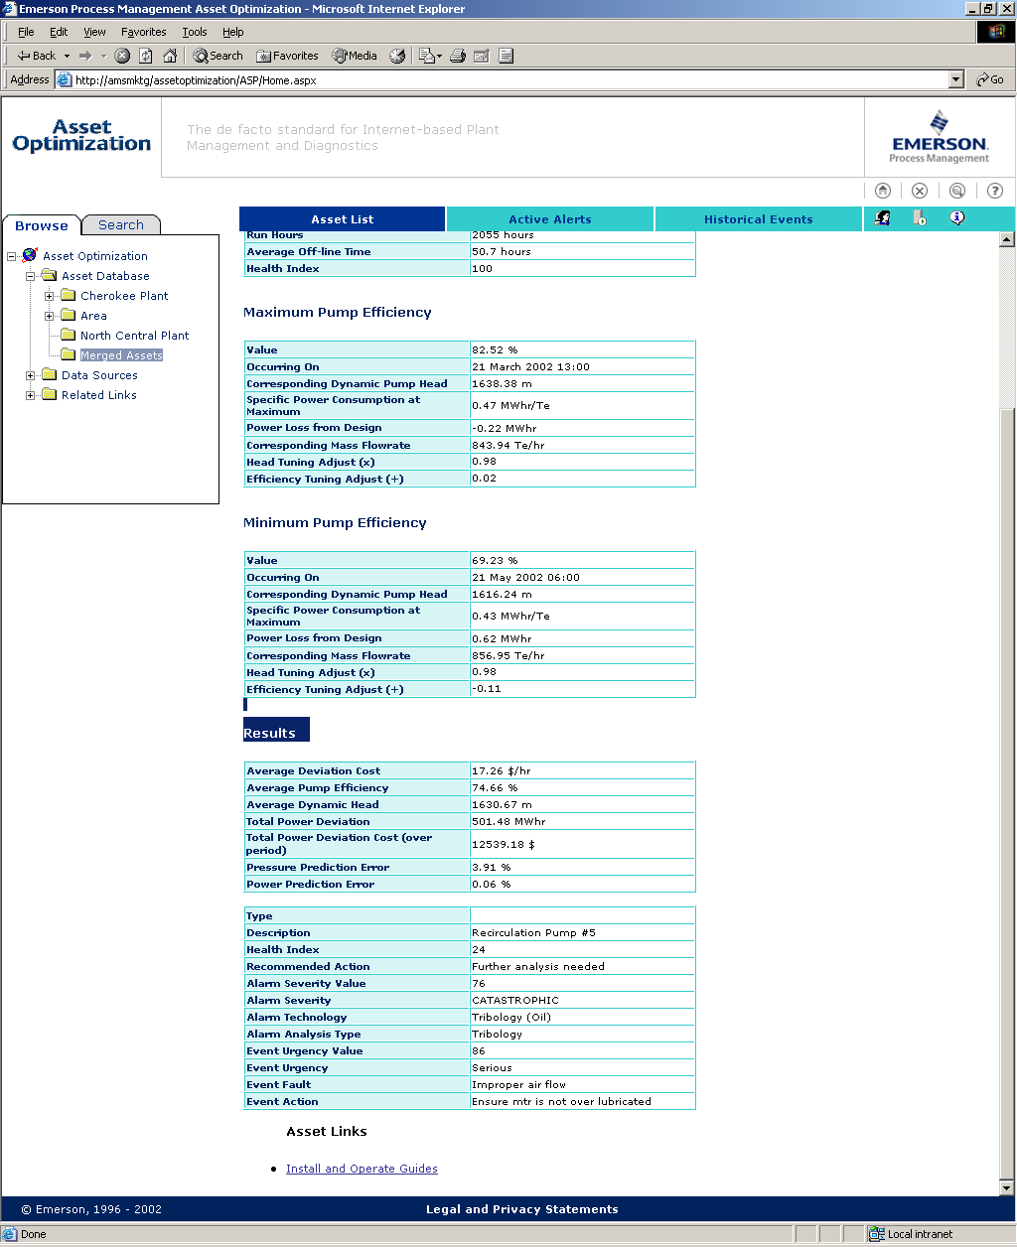
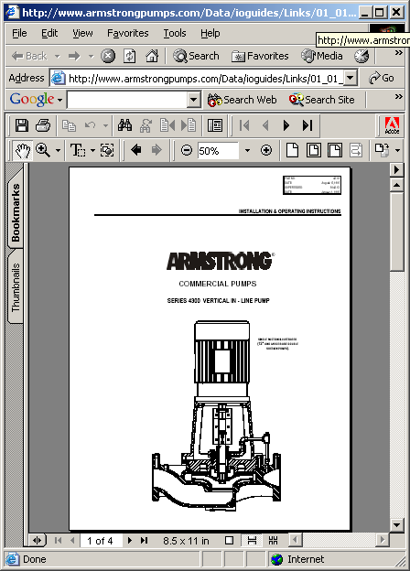
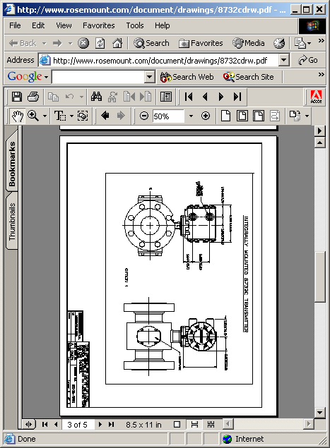
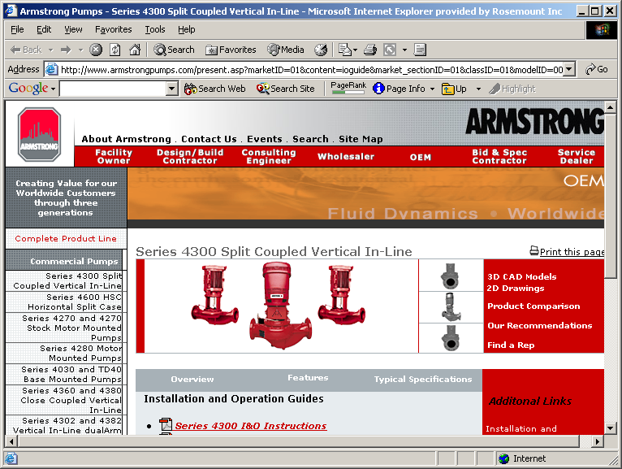
Link Relevant Information
Embed links to other sources of information

Slide 49

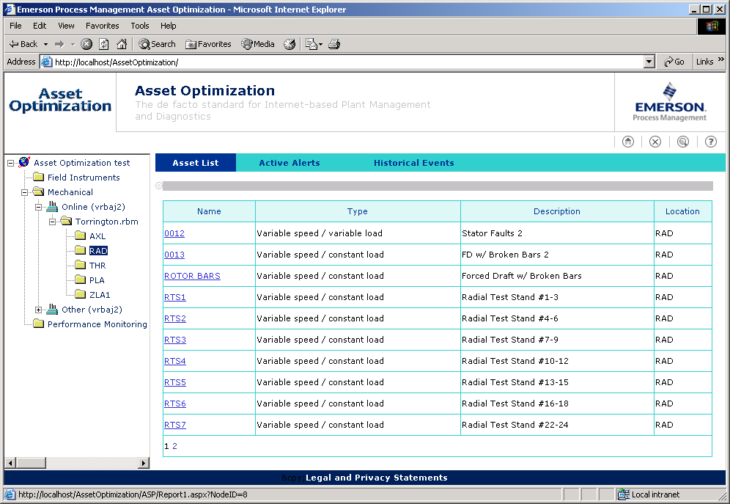
Asset Optimization Web Server
Integrating mechanical equipment, electrical equipment, process equipment, instruments and valves is key to automating information flow to the people who run the business
Consolidated reporting for
all assets
Plant-wide asset analysis
Easy and secure access

Slide 50
Key Points
Automation & Decision Support Tools help the plant meet OUTPUT & COST targets by…
  1. Optimize Reliability Group’s Time / Effort
  2. Capture Plant Knowledge
  3. Reduce O&M Costs by Managing Reliability
Questions?
Comments?

Slide 51
51
Notes:
51

Slide 52
52
Notes:
52

Slide 53
53
Notes:
53

Slide 54
54
Notes:
54

Slide 55
55
Notes:
55

Slide 56
56
Notes:
56

Slide 57
57
Notes:
57

Slide 58
58
Notes:
58

Slide 59
59
Notes:
59

Slide 60
60
Notes:
60

Slide 61
61
Notes:
61

Slide 62
62
Notes:
62

Slide 63
63
Notes:
63

Slide 64
64
Notes:
64

Slide 65
65
Notes:
65

Slide 66
66
Notes:
66

Slide 67
67
Notes:
67

Slide 68
68
Notes:
68

Slide 69
69
Notes:
69

Slide 70
70
Notes:
70

Slide 71
71
Notes:
71

Slide 72
72
Notes:
72

Slide 73
73
Notes:
73

Slide 74
74
Notes:
74

Slide 75
75
Notes:
75

Slide 76
76
Notes:
76

Slide 77
77
Notes:
77

Slide 78
78
Notes:
78

Slide 79
79
Notes:
79

Slide 80
80
Notes:
80

Slide 81
81
Notes:
81

Slide 82
82
Notes:
82

Slide 83
83
Notes:
83

Slide 84
84
Notes:
84

Slide 85
85
Notes:
85

Slide 86
86
Notes:
86

Slide 87
87
Notes:
87

Slide 88
88
Notes:
88

Slide 89
89
Notes:
89

Slide 90
90
Notes:
90

Slide 91
91
Notes:
91

Slide 92
92
Notes:
92

Slide 93
93
Notes:
93

Slide 94
94
Notes:
94

Slide 95
95
Notes:
95

Slide 96
96
Notes:
96

Slide 97
97
Notes:
97

Slide 98
98
Notes:
98

Slide 99
99
Notes:
99

Slide 100
100
Notes:
100

Slide 101
101
Notes:
101

Slide 102
102
Notes:
102

