Slide 1
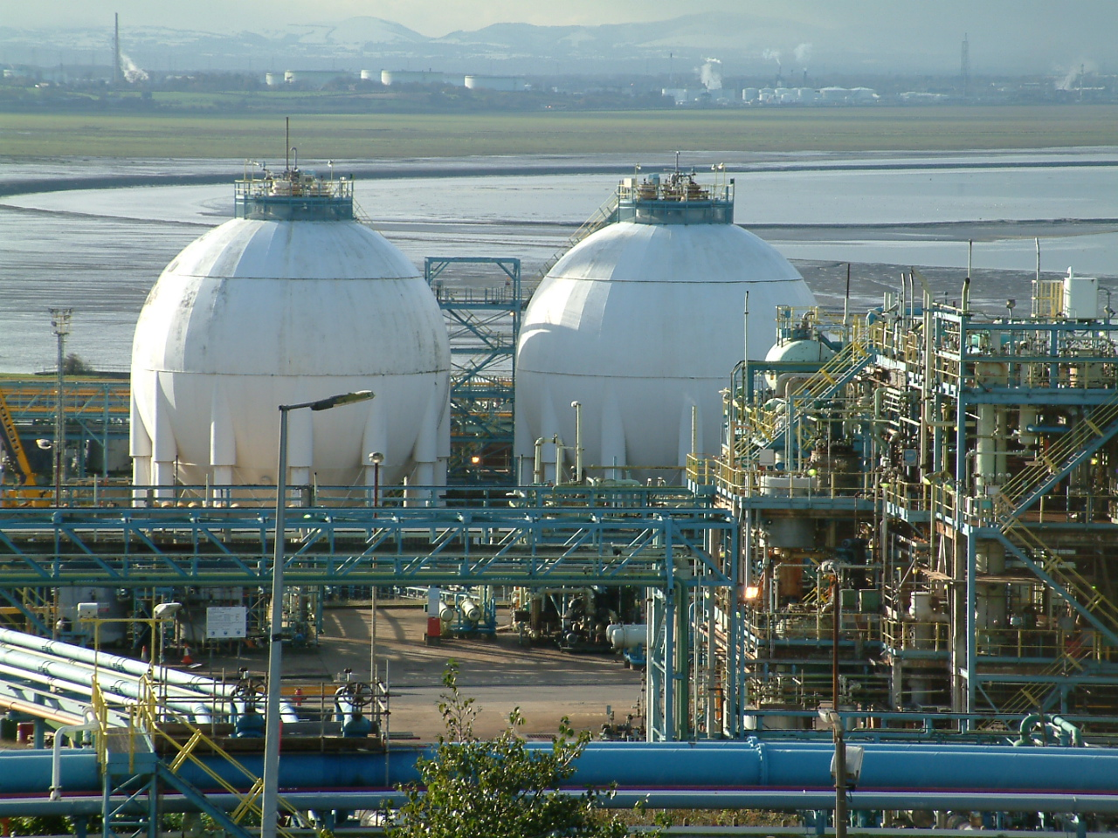
PIPEWORK SUPPORT SYSTEMS

Slide 2
Pipe supports are an important part of any piping system and are considered to be an integral part of the piping design.
It is true to say that the piping system will only be good as what is holding it in place.

Slide 3
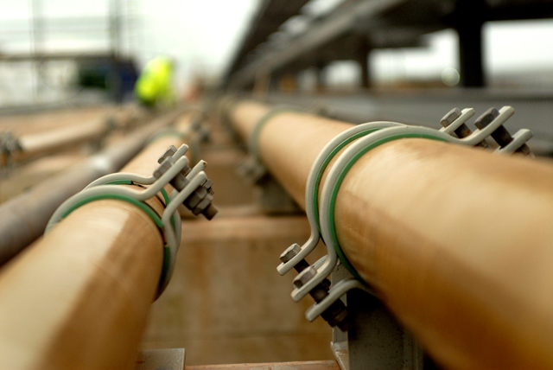

Slide 4
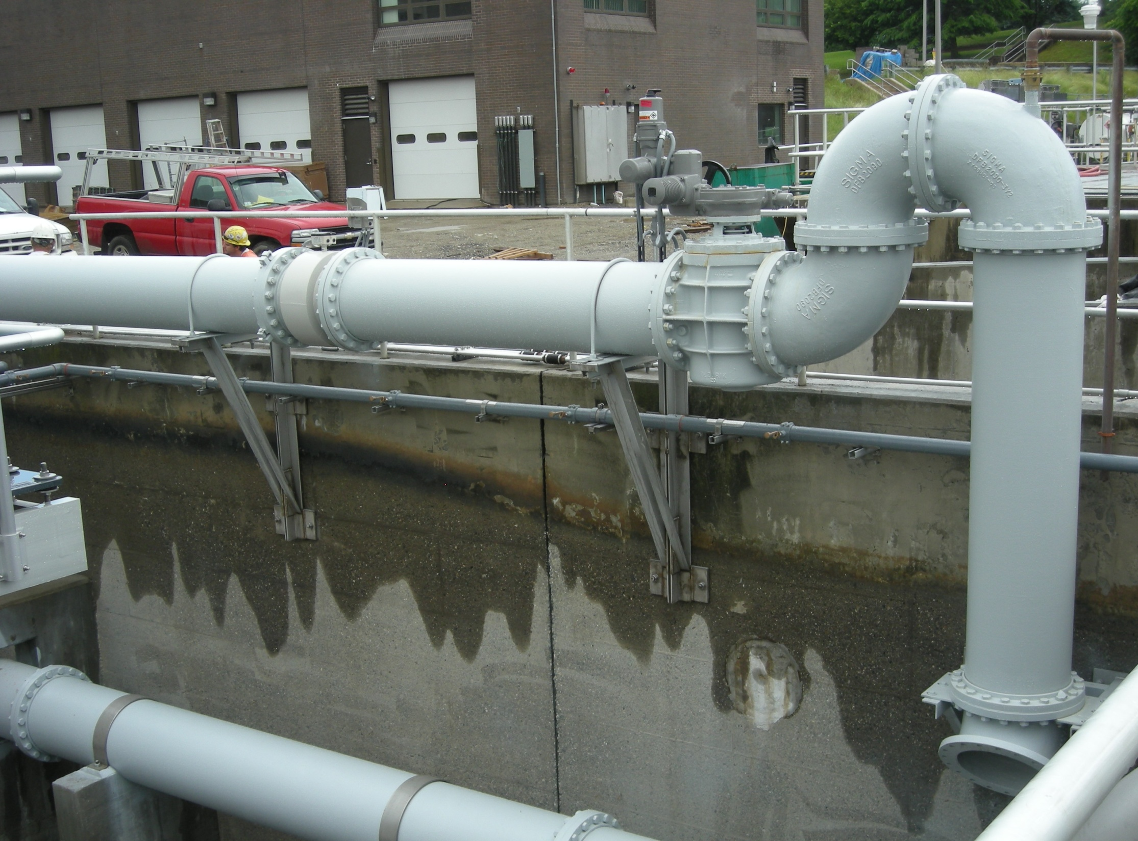

Slide 5
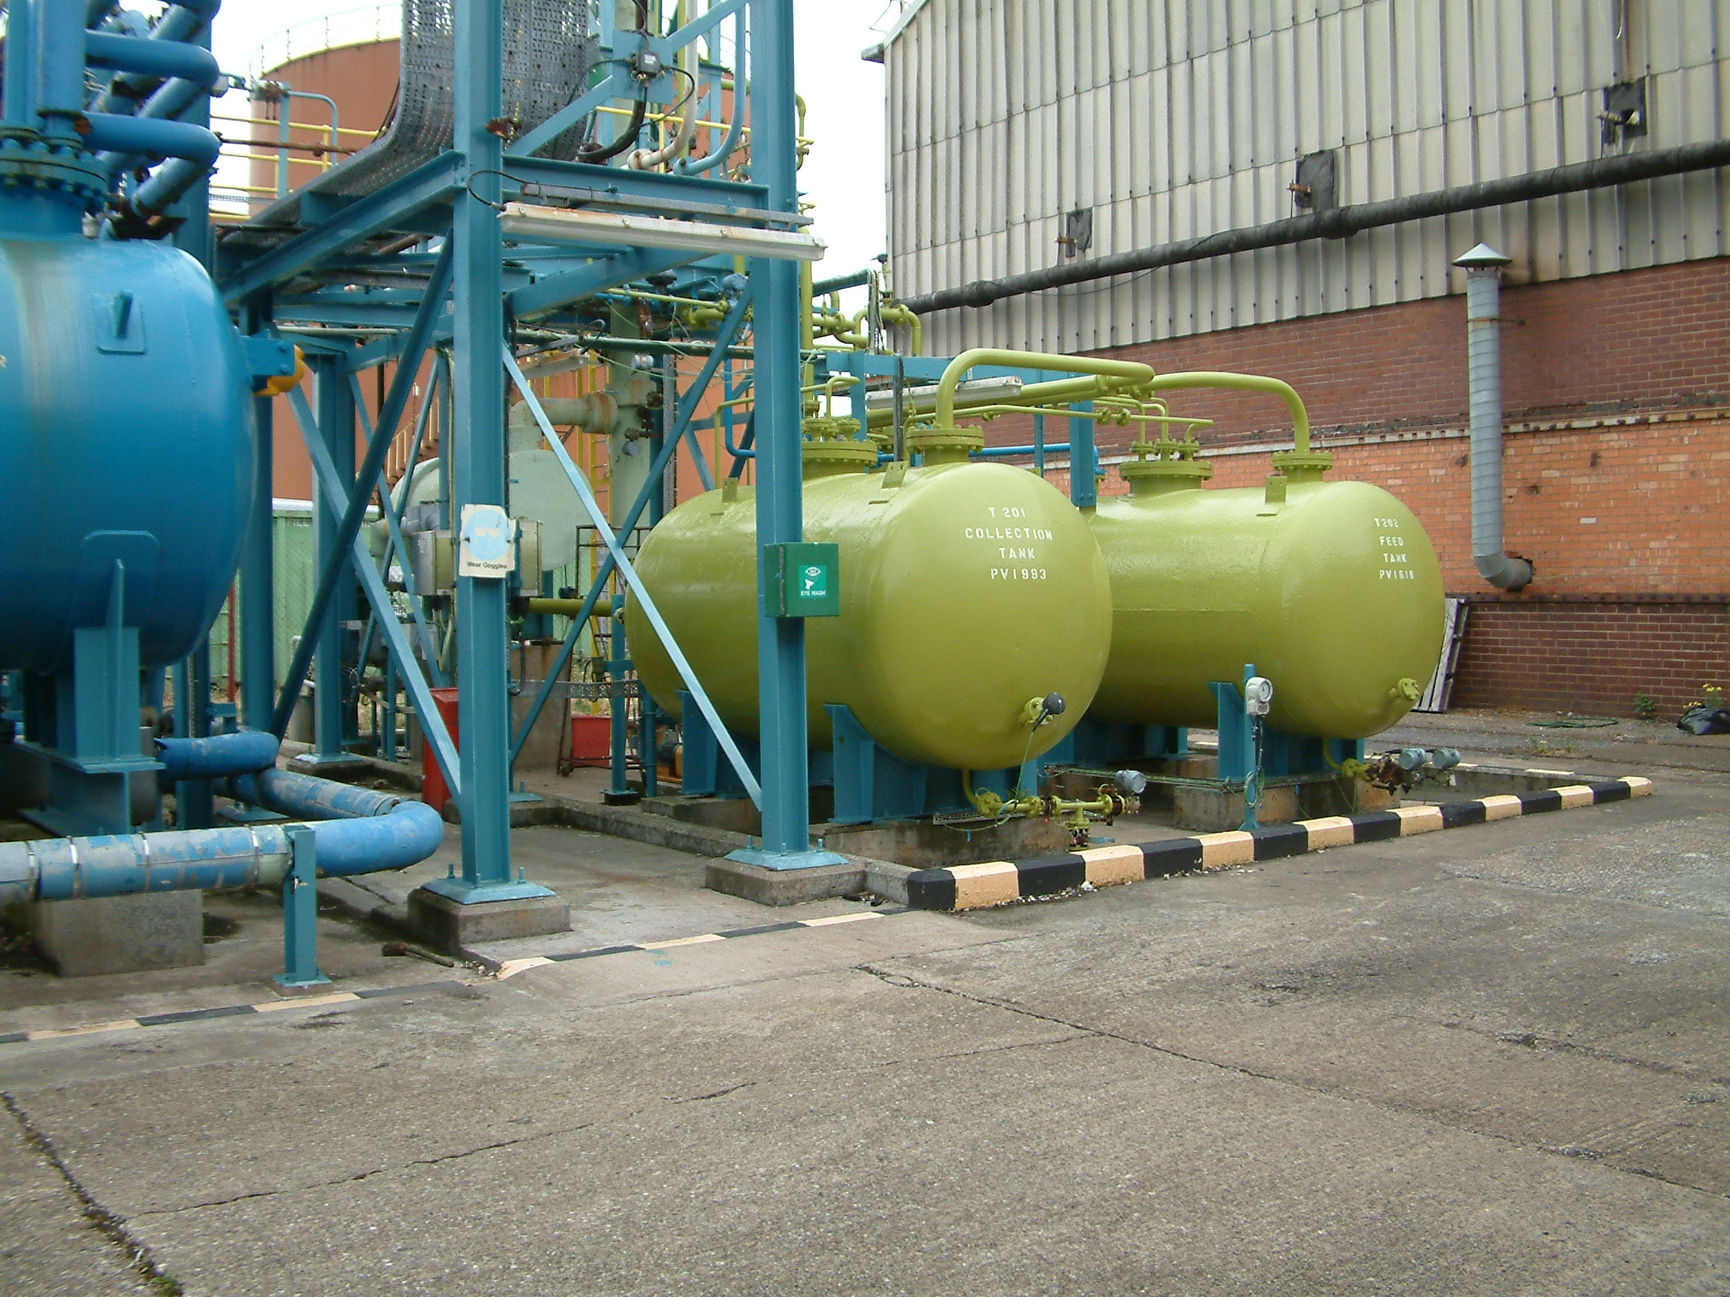

Slide 6
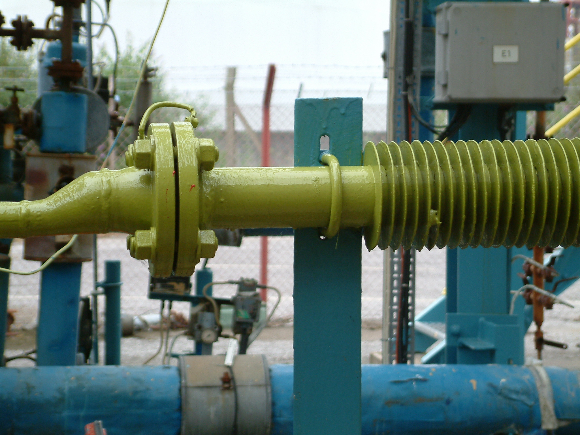

Slide 7
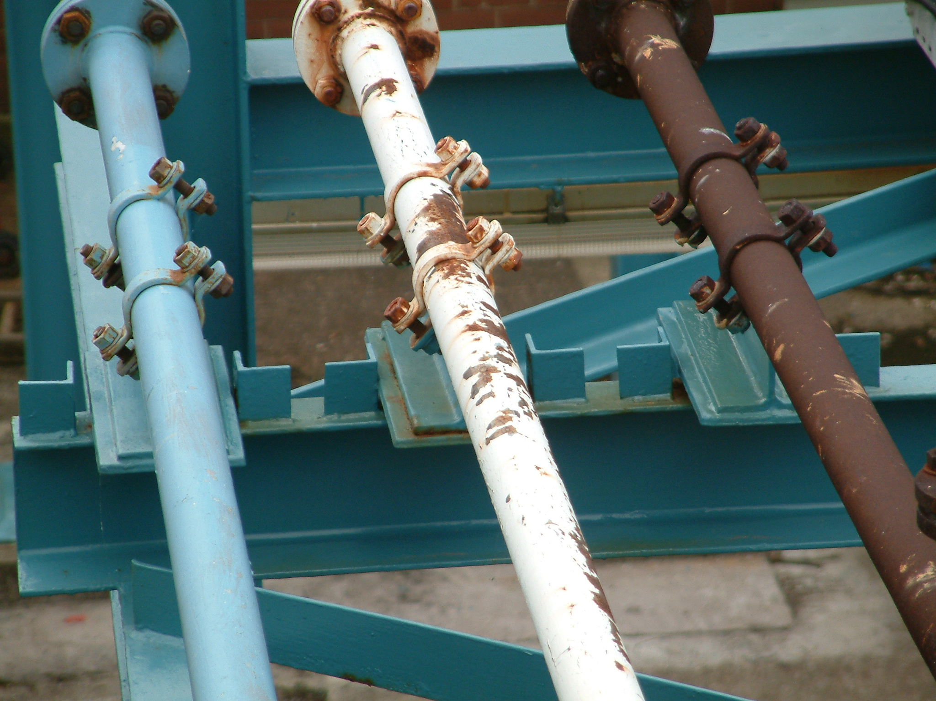

Slide 8
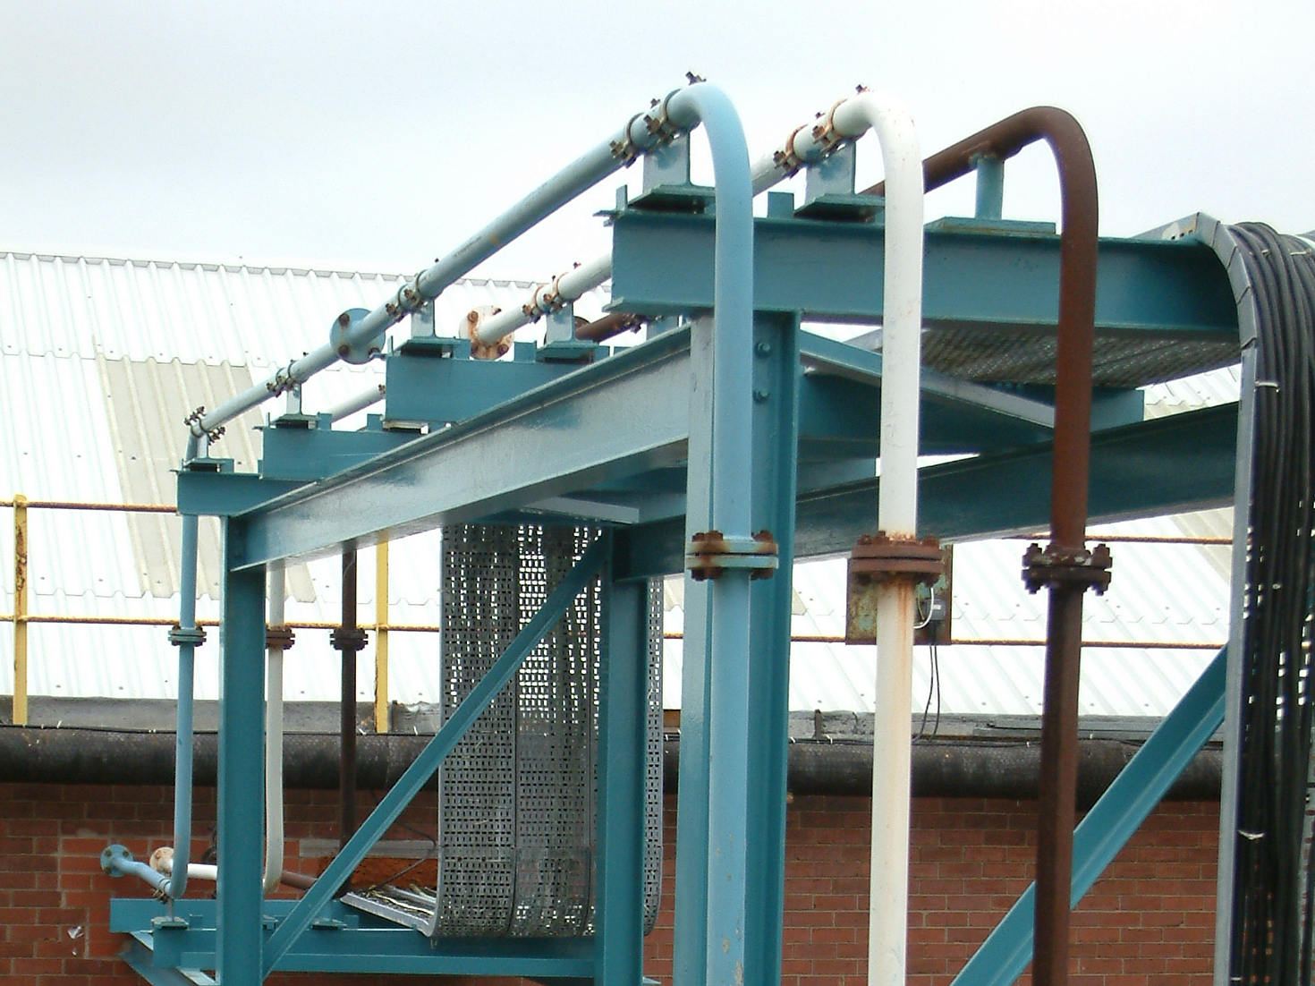

Slide 9
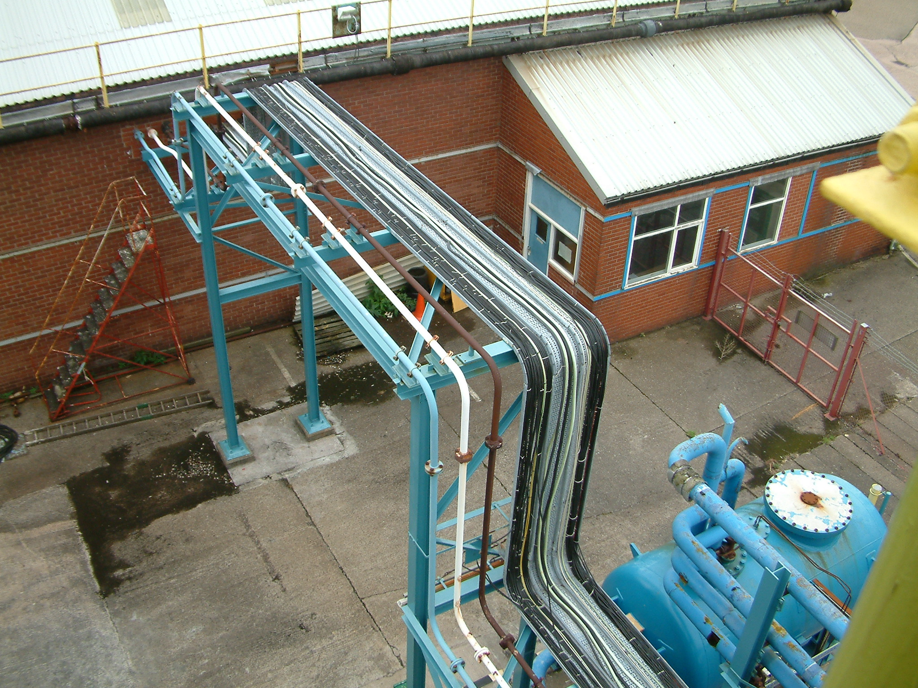

Slide 10
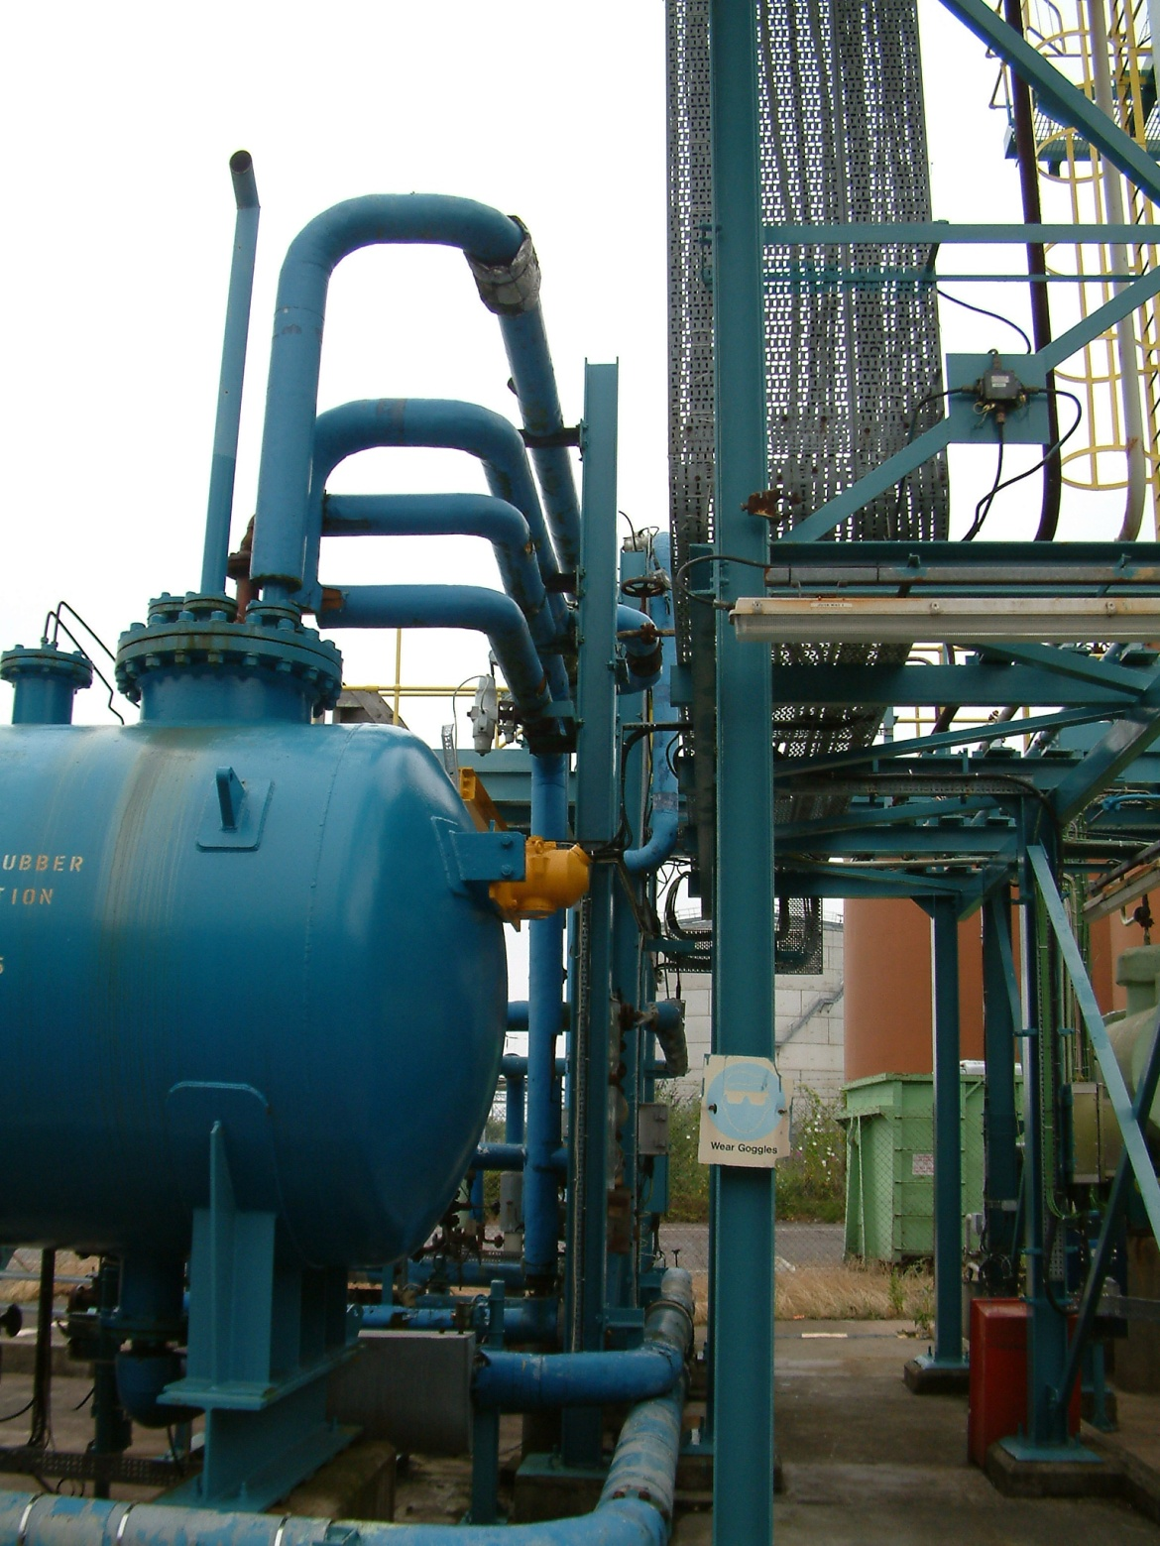

Slide 11
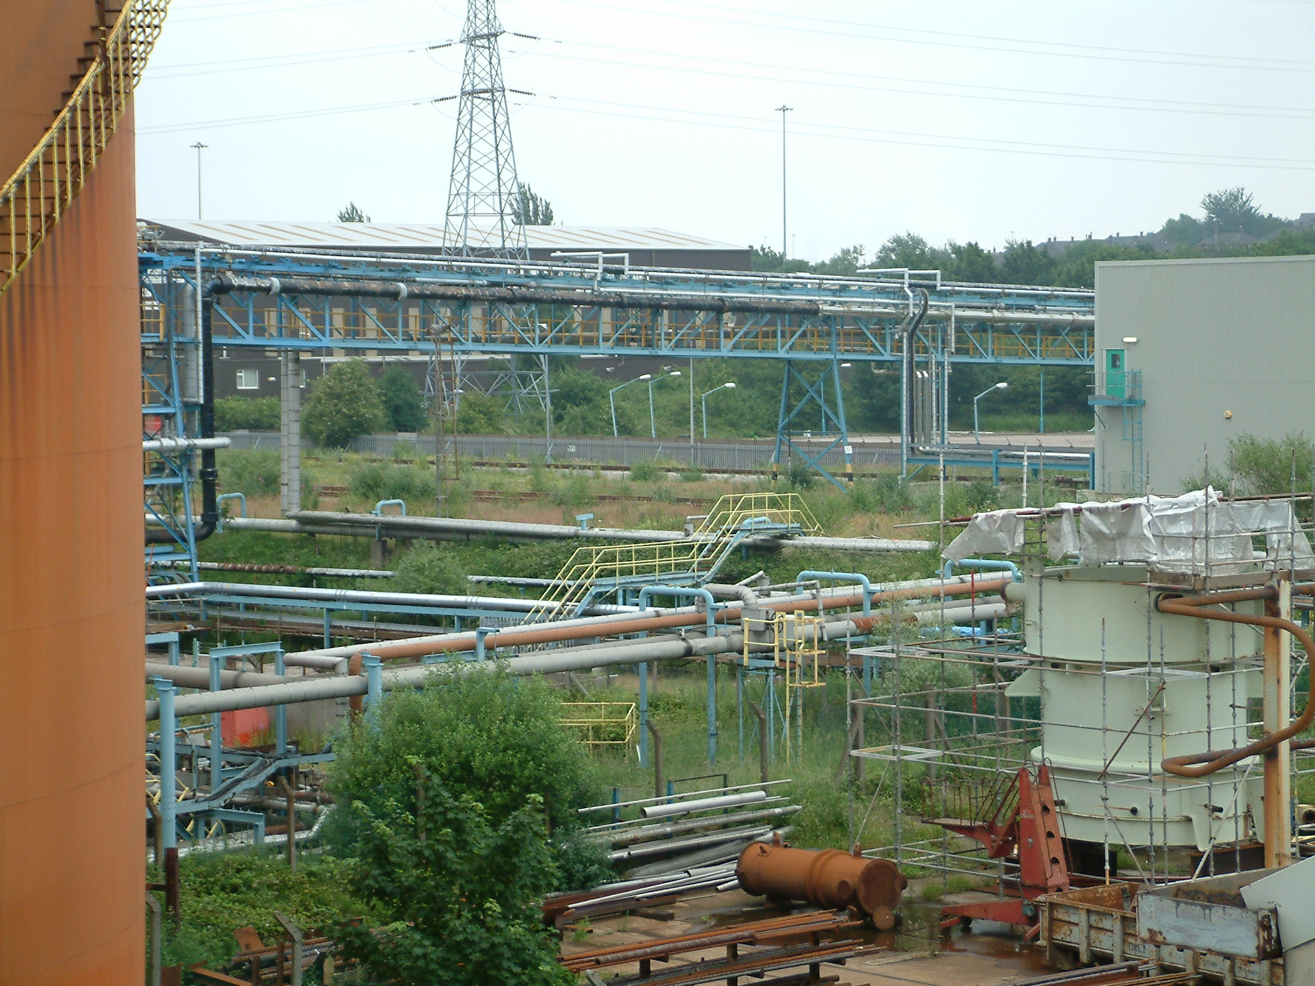

Slide 12
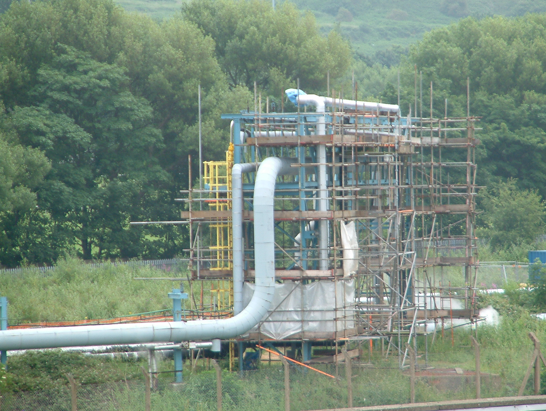

Slide 13
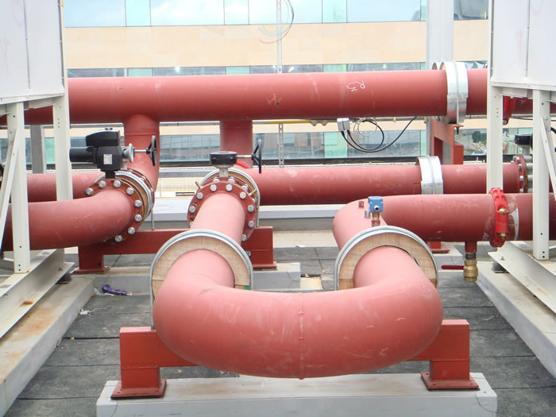

Slide 14
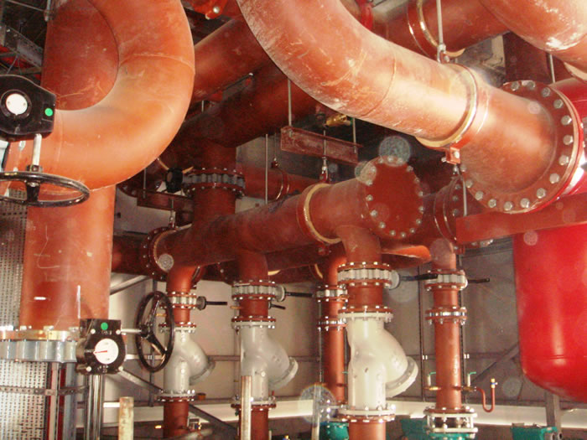

Slide 15
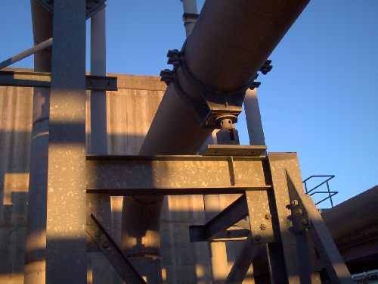

Slide 16
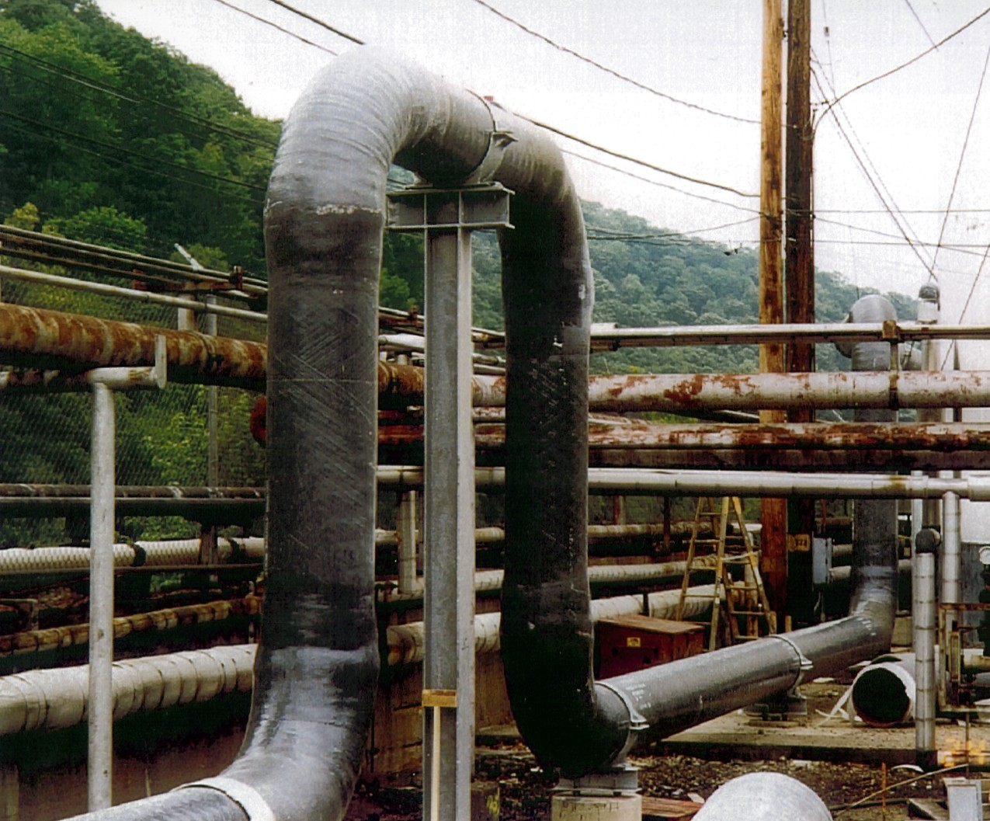

Slide 17
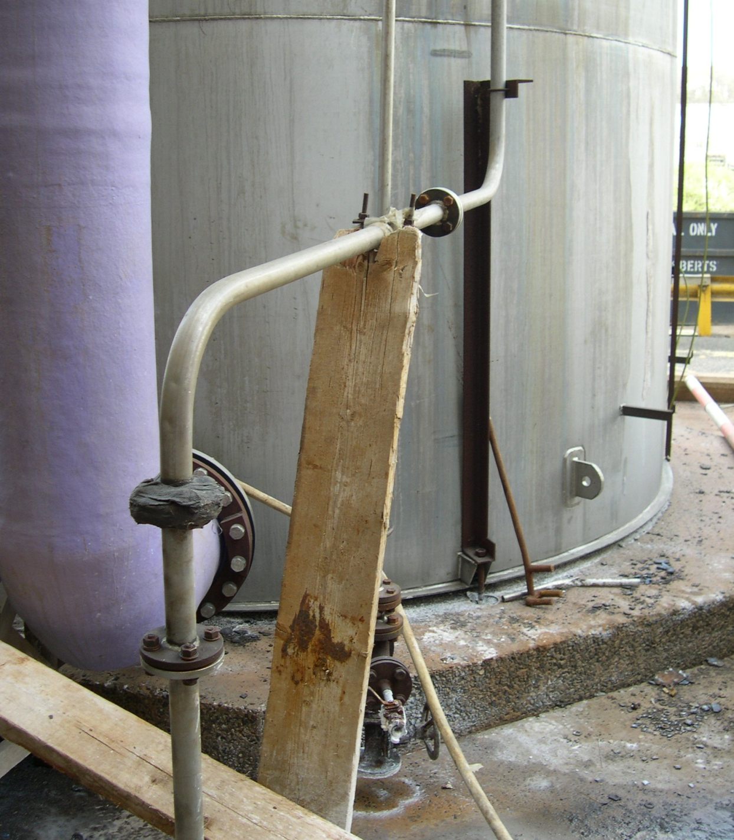

Slide 18
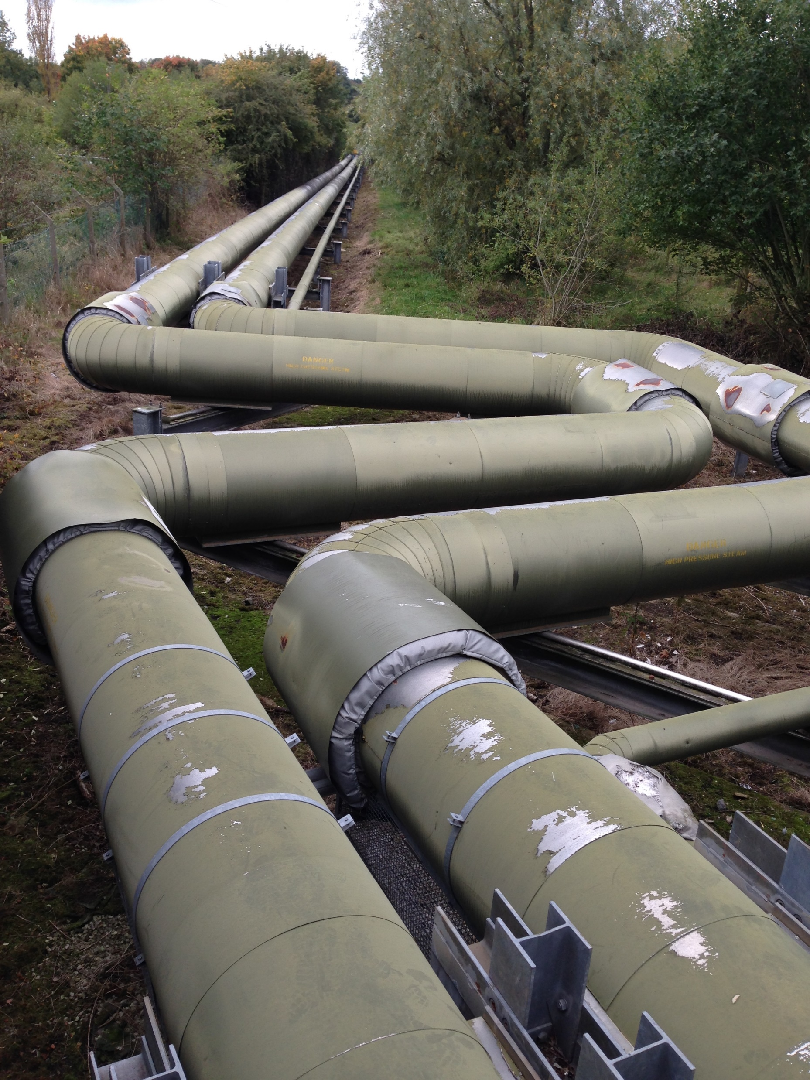

Slide 19
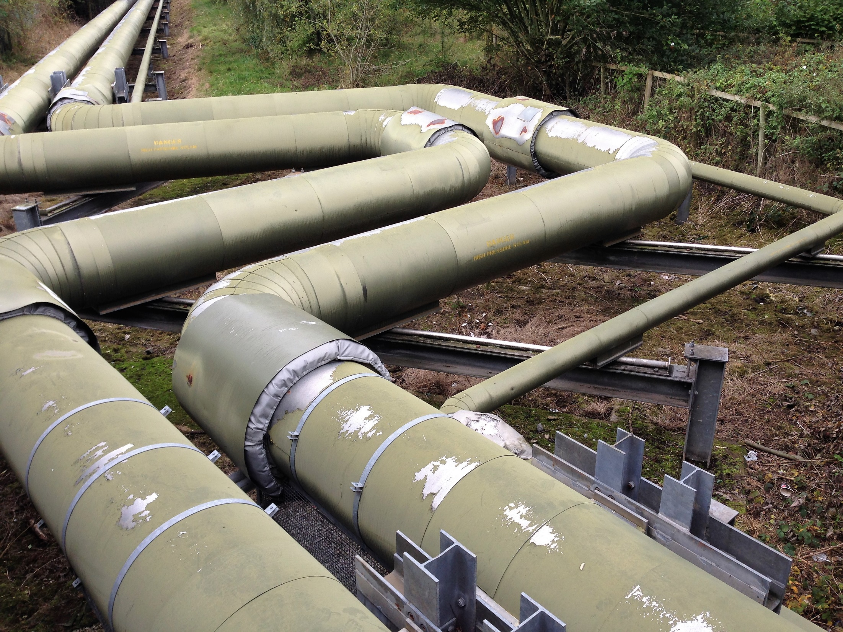

Slide 20
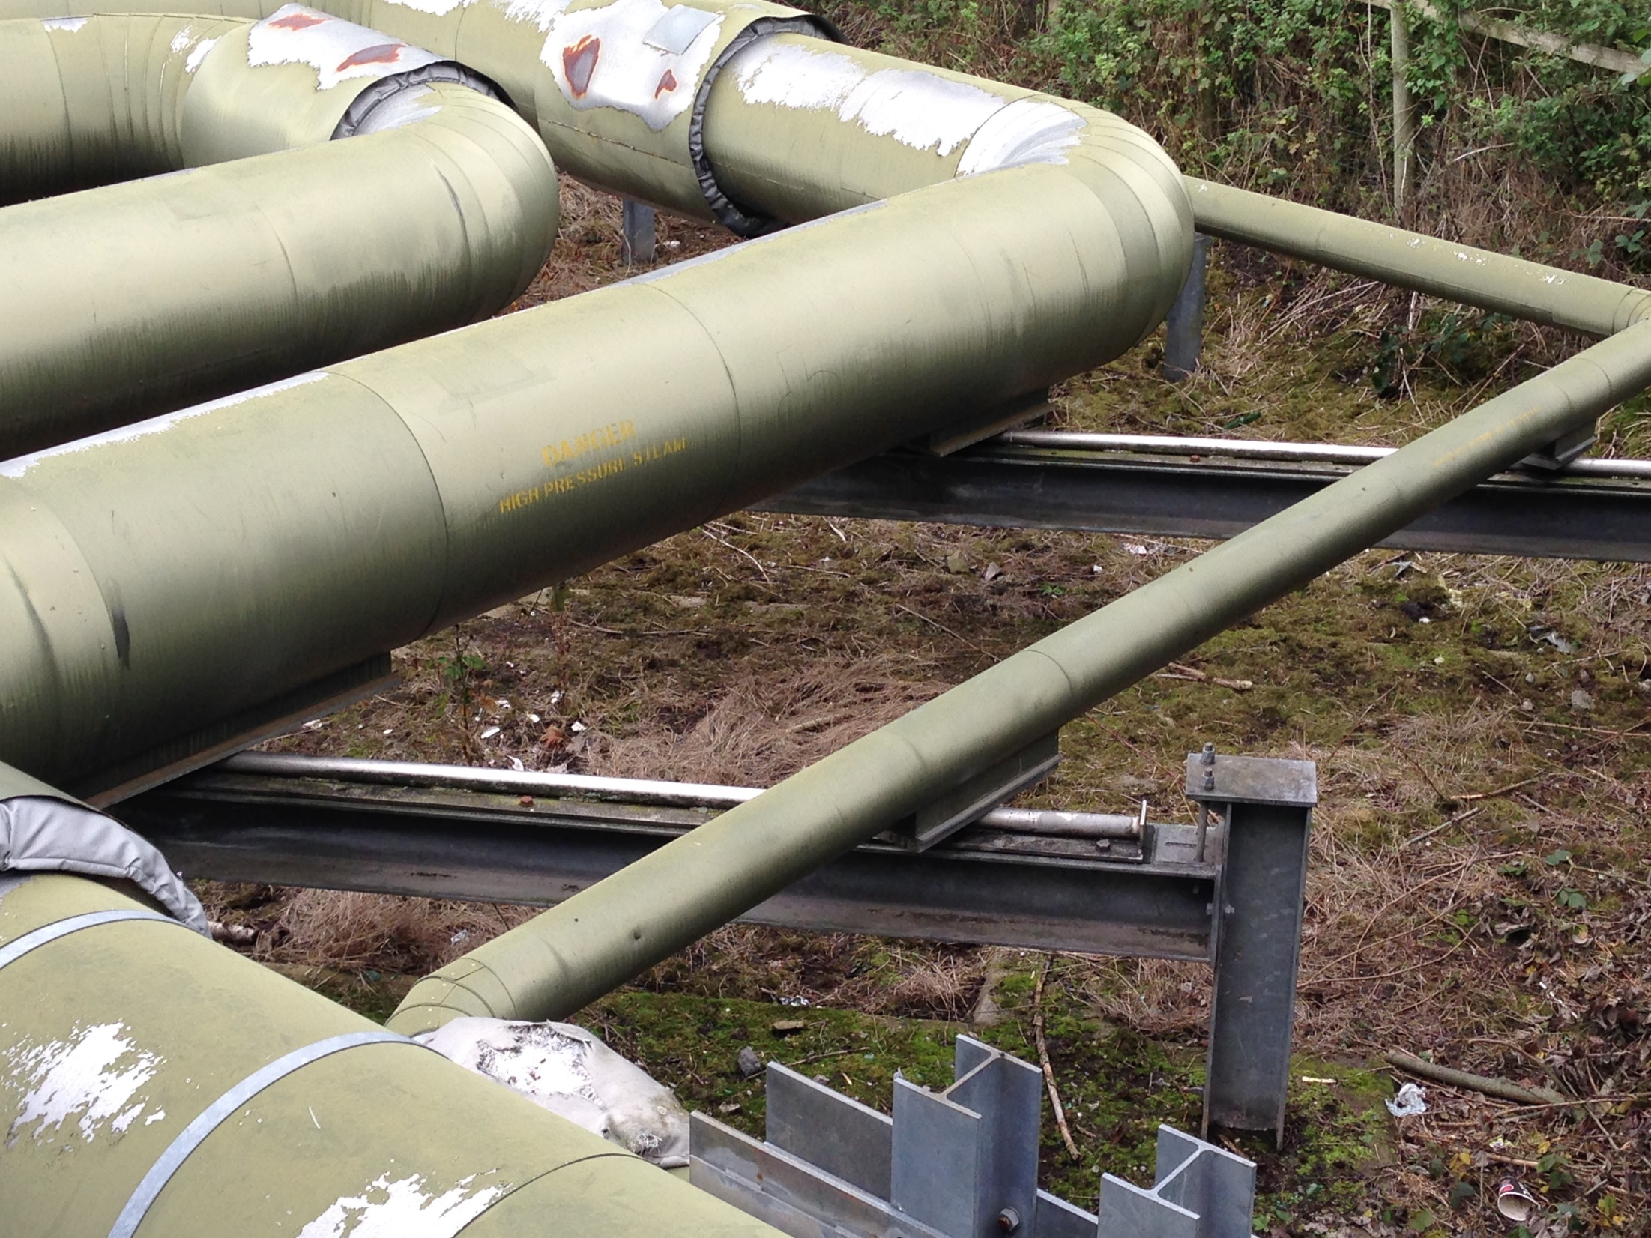

Slide 21
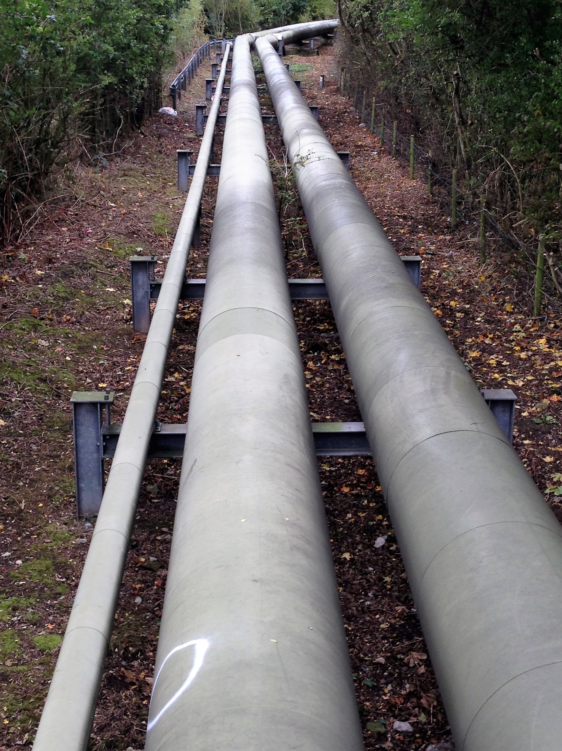

Slide 22
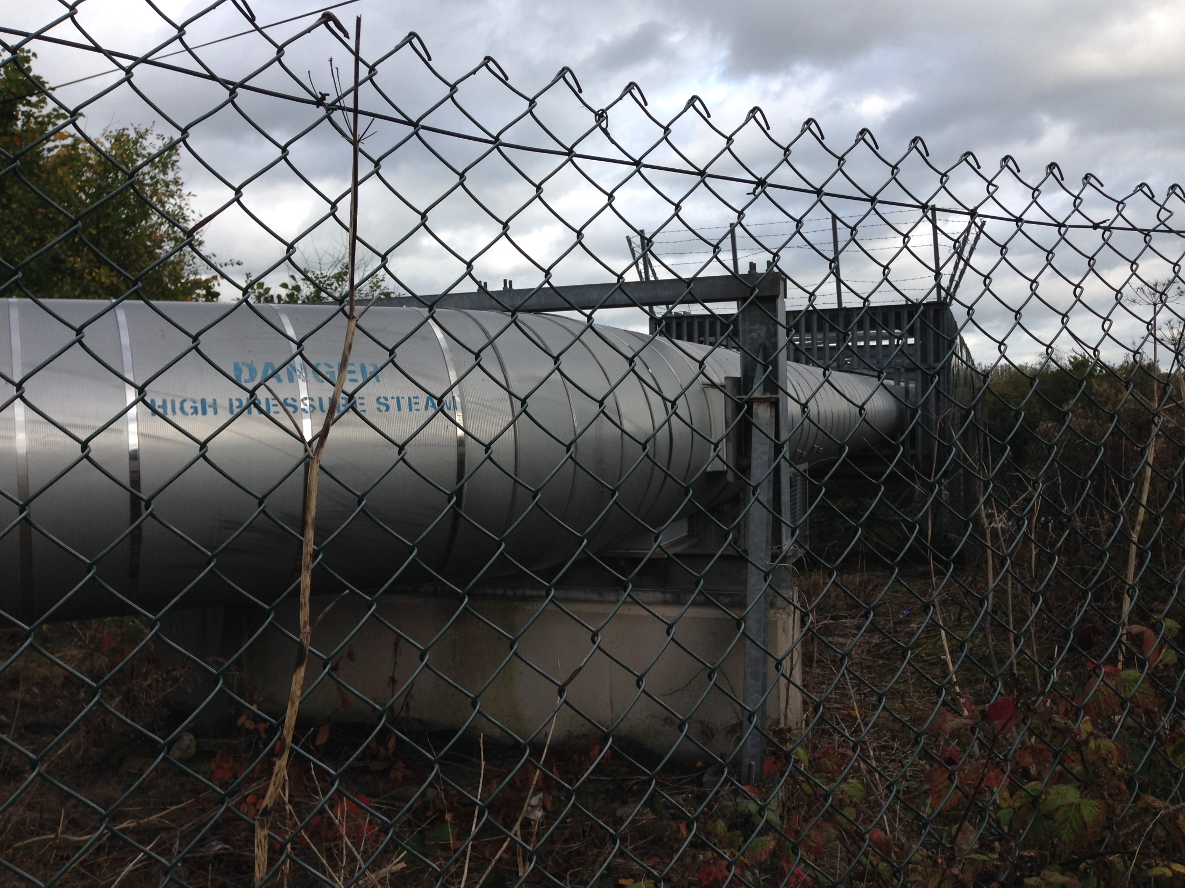

Slide 23
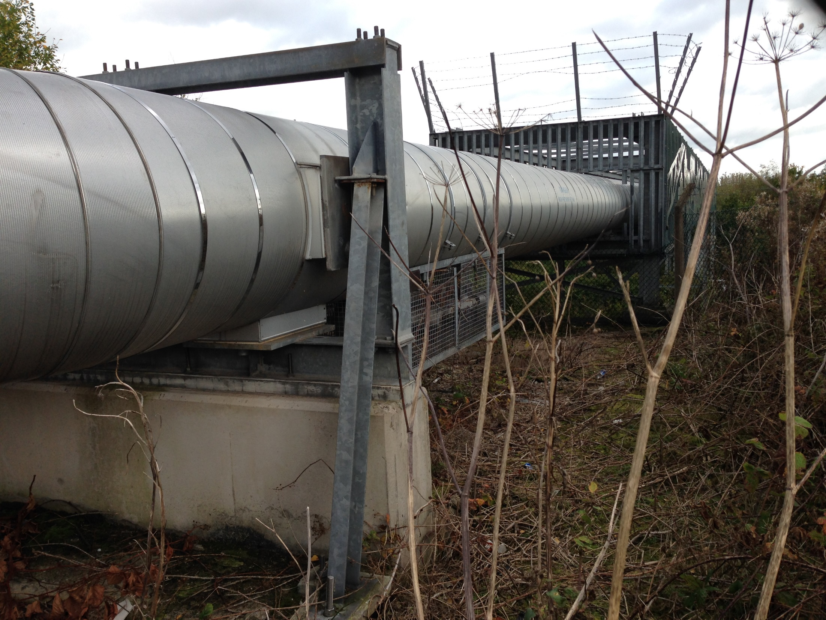

Slide 24
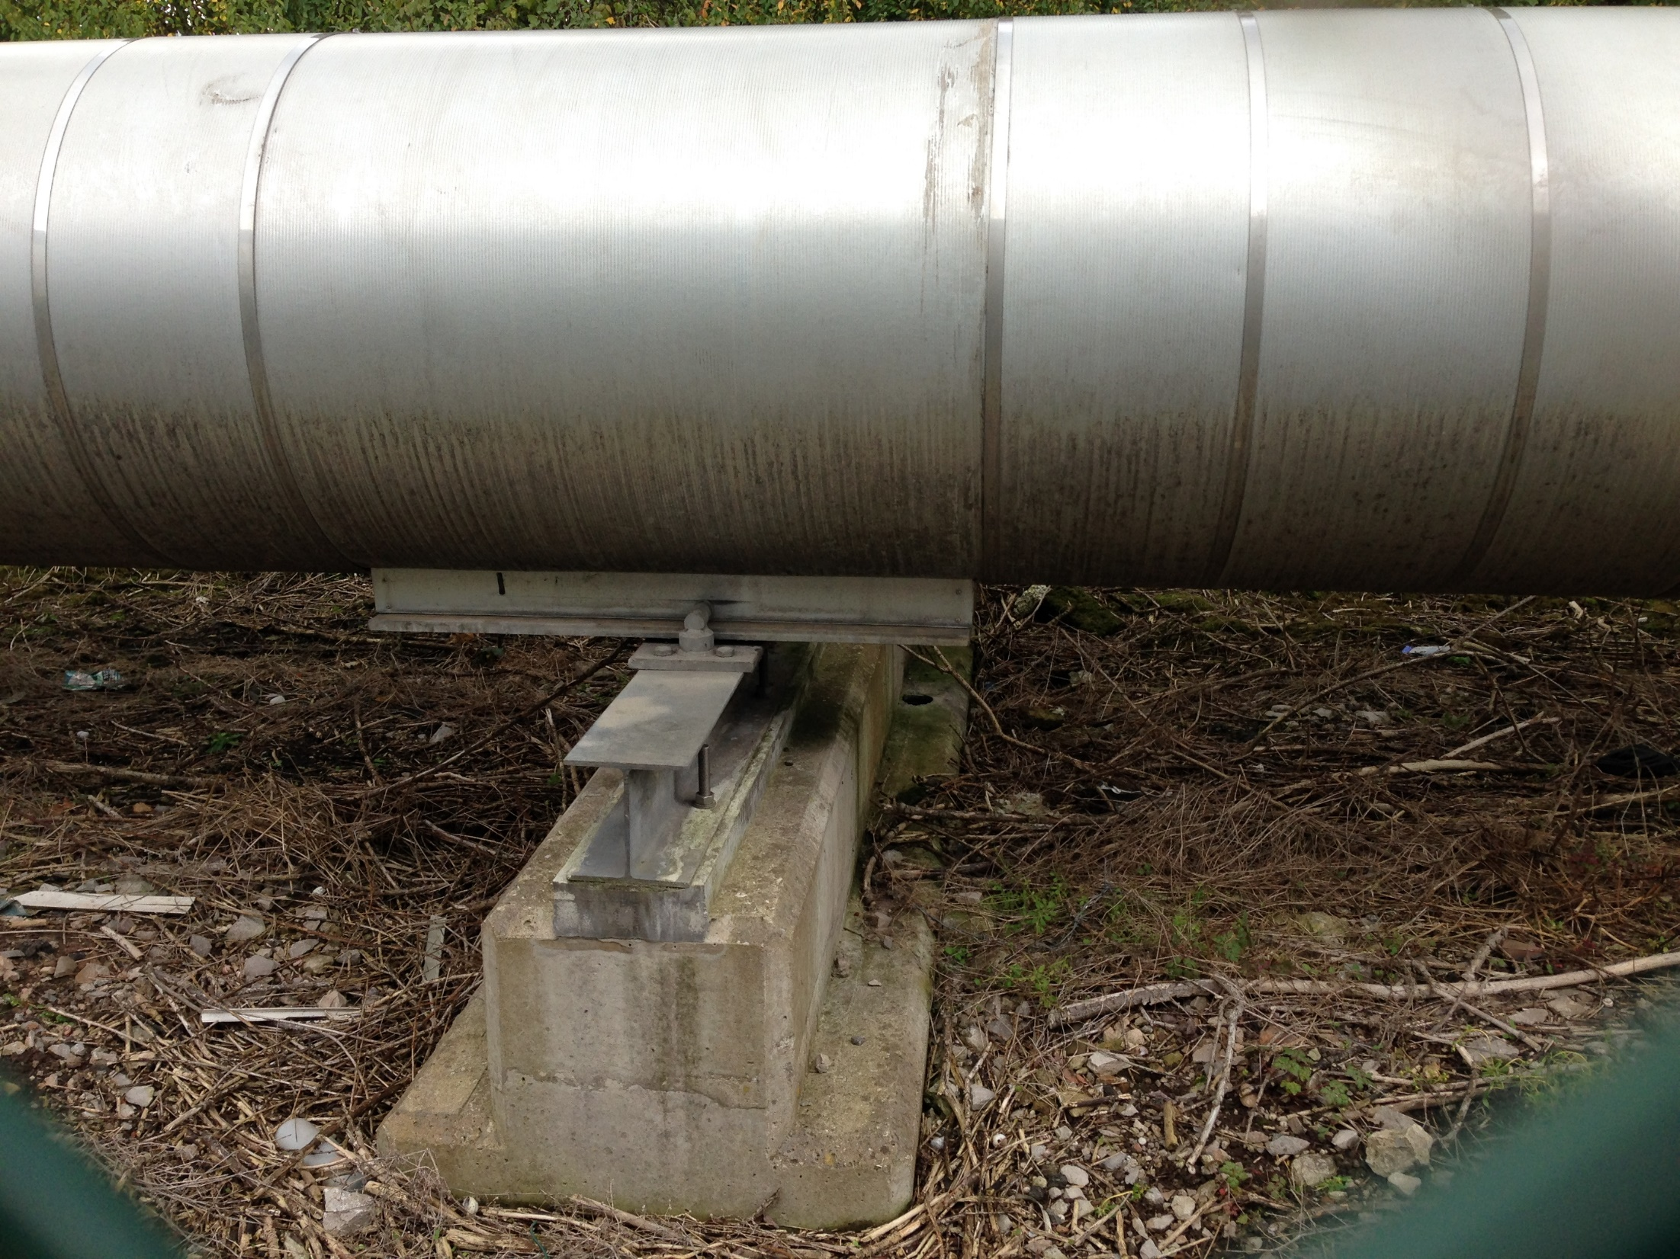

Slide 25
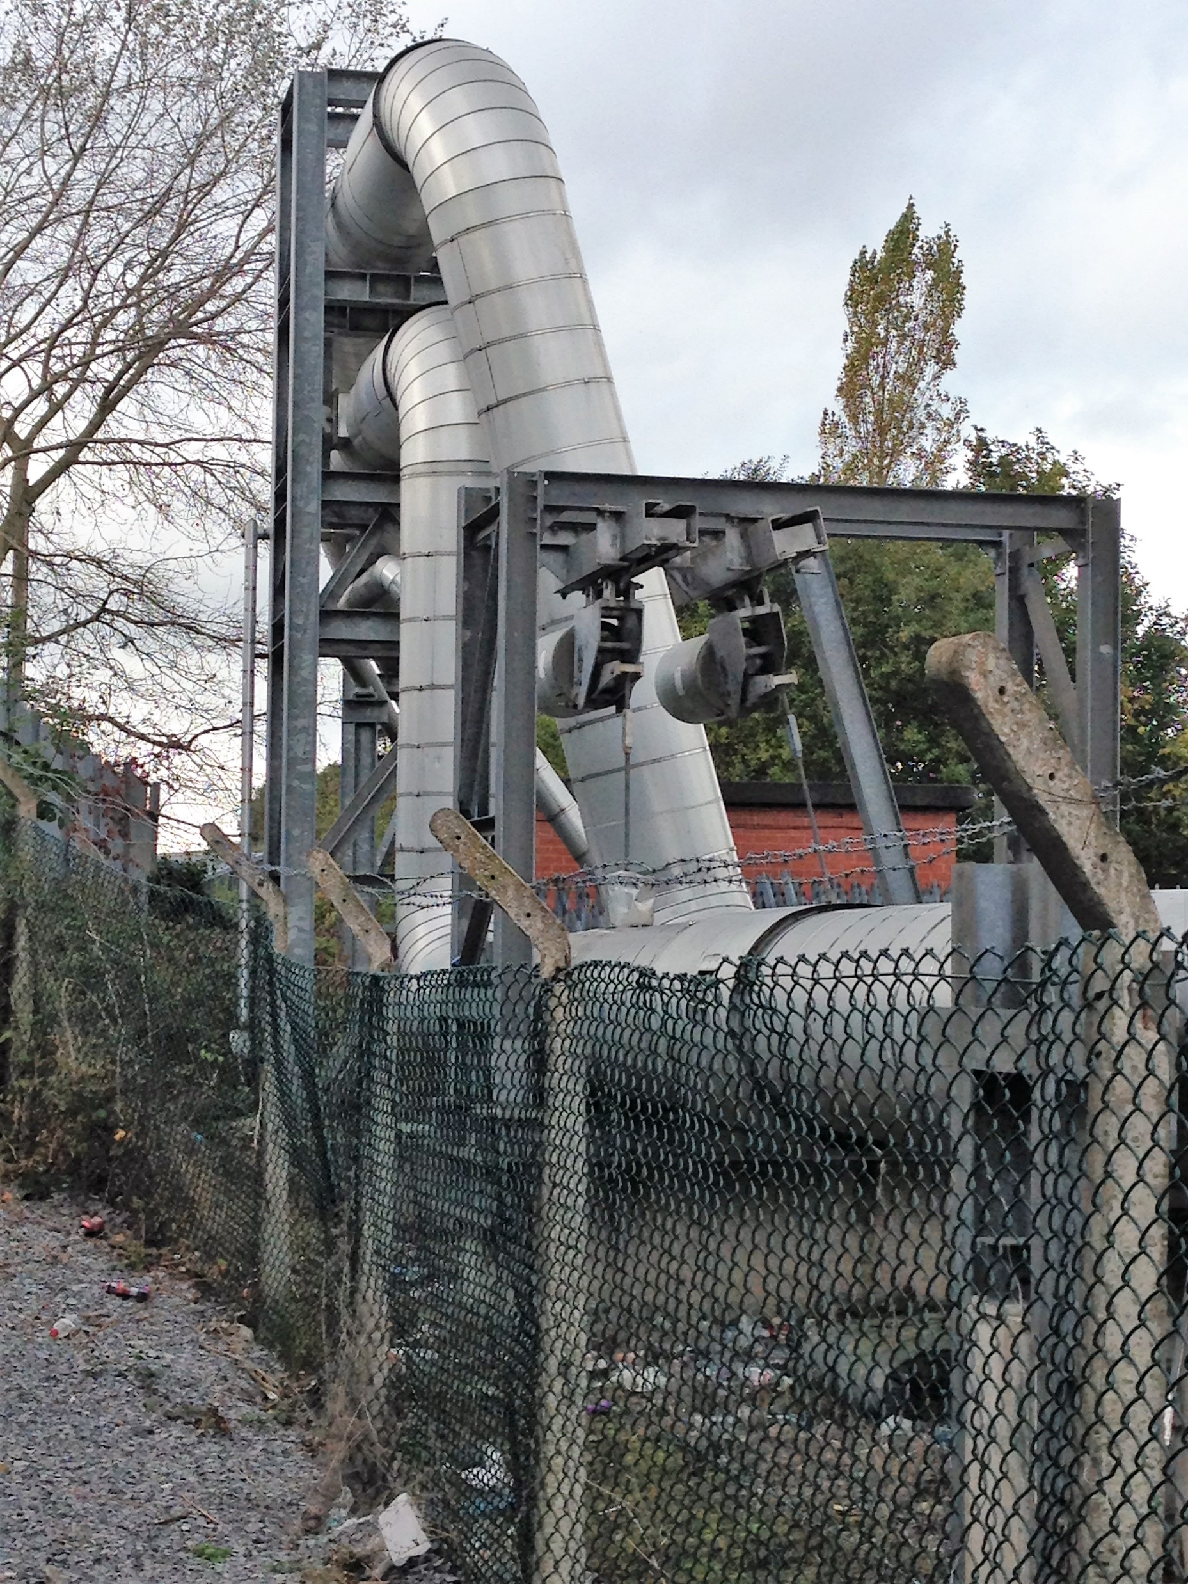

Slide 26
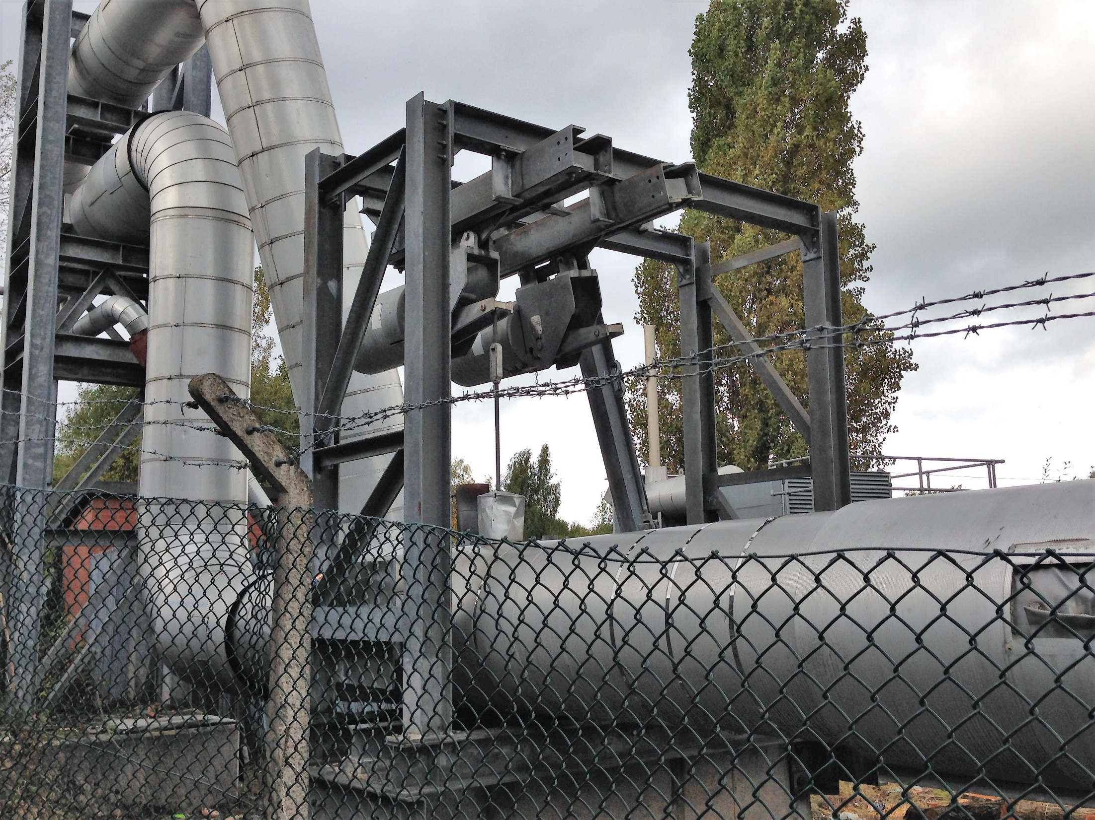

Slide 27
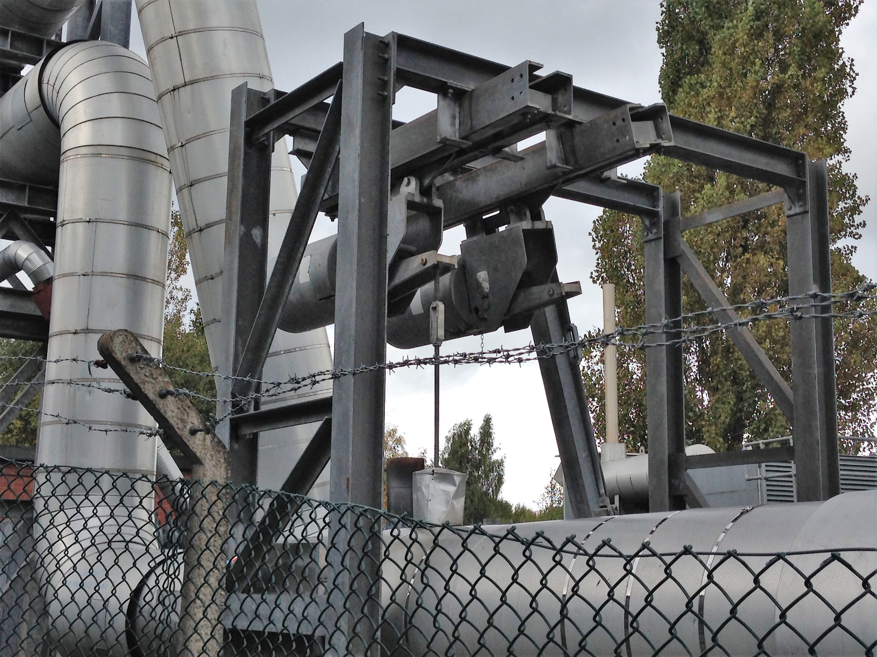

Slide 28
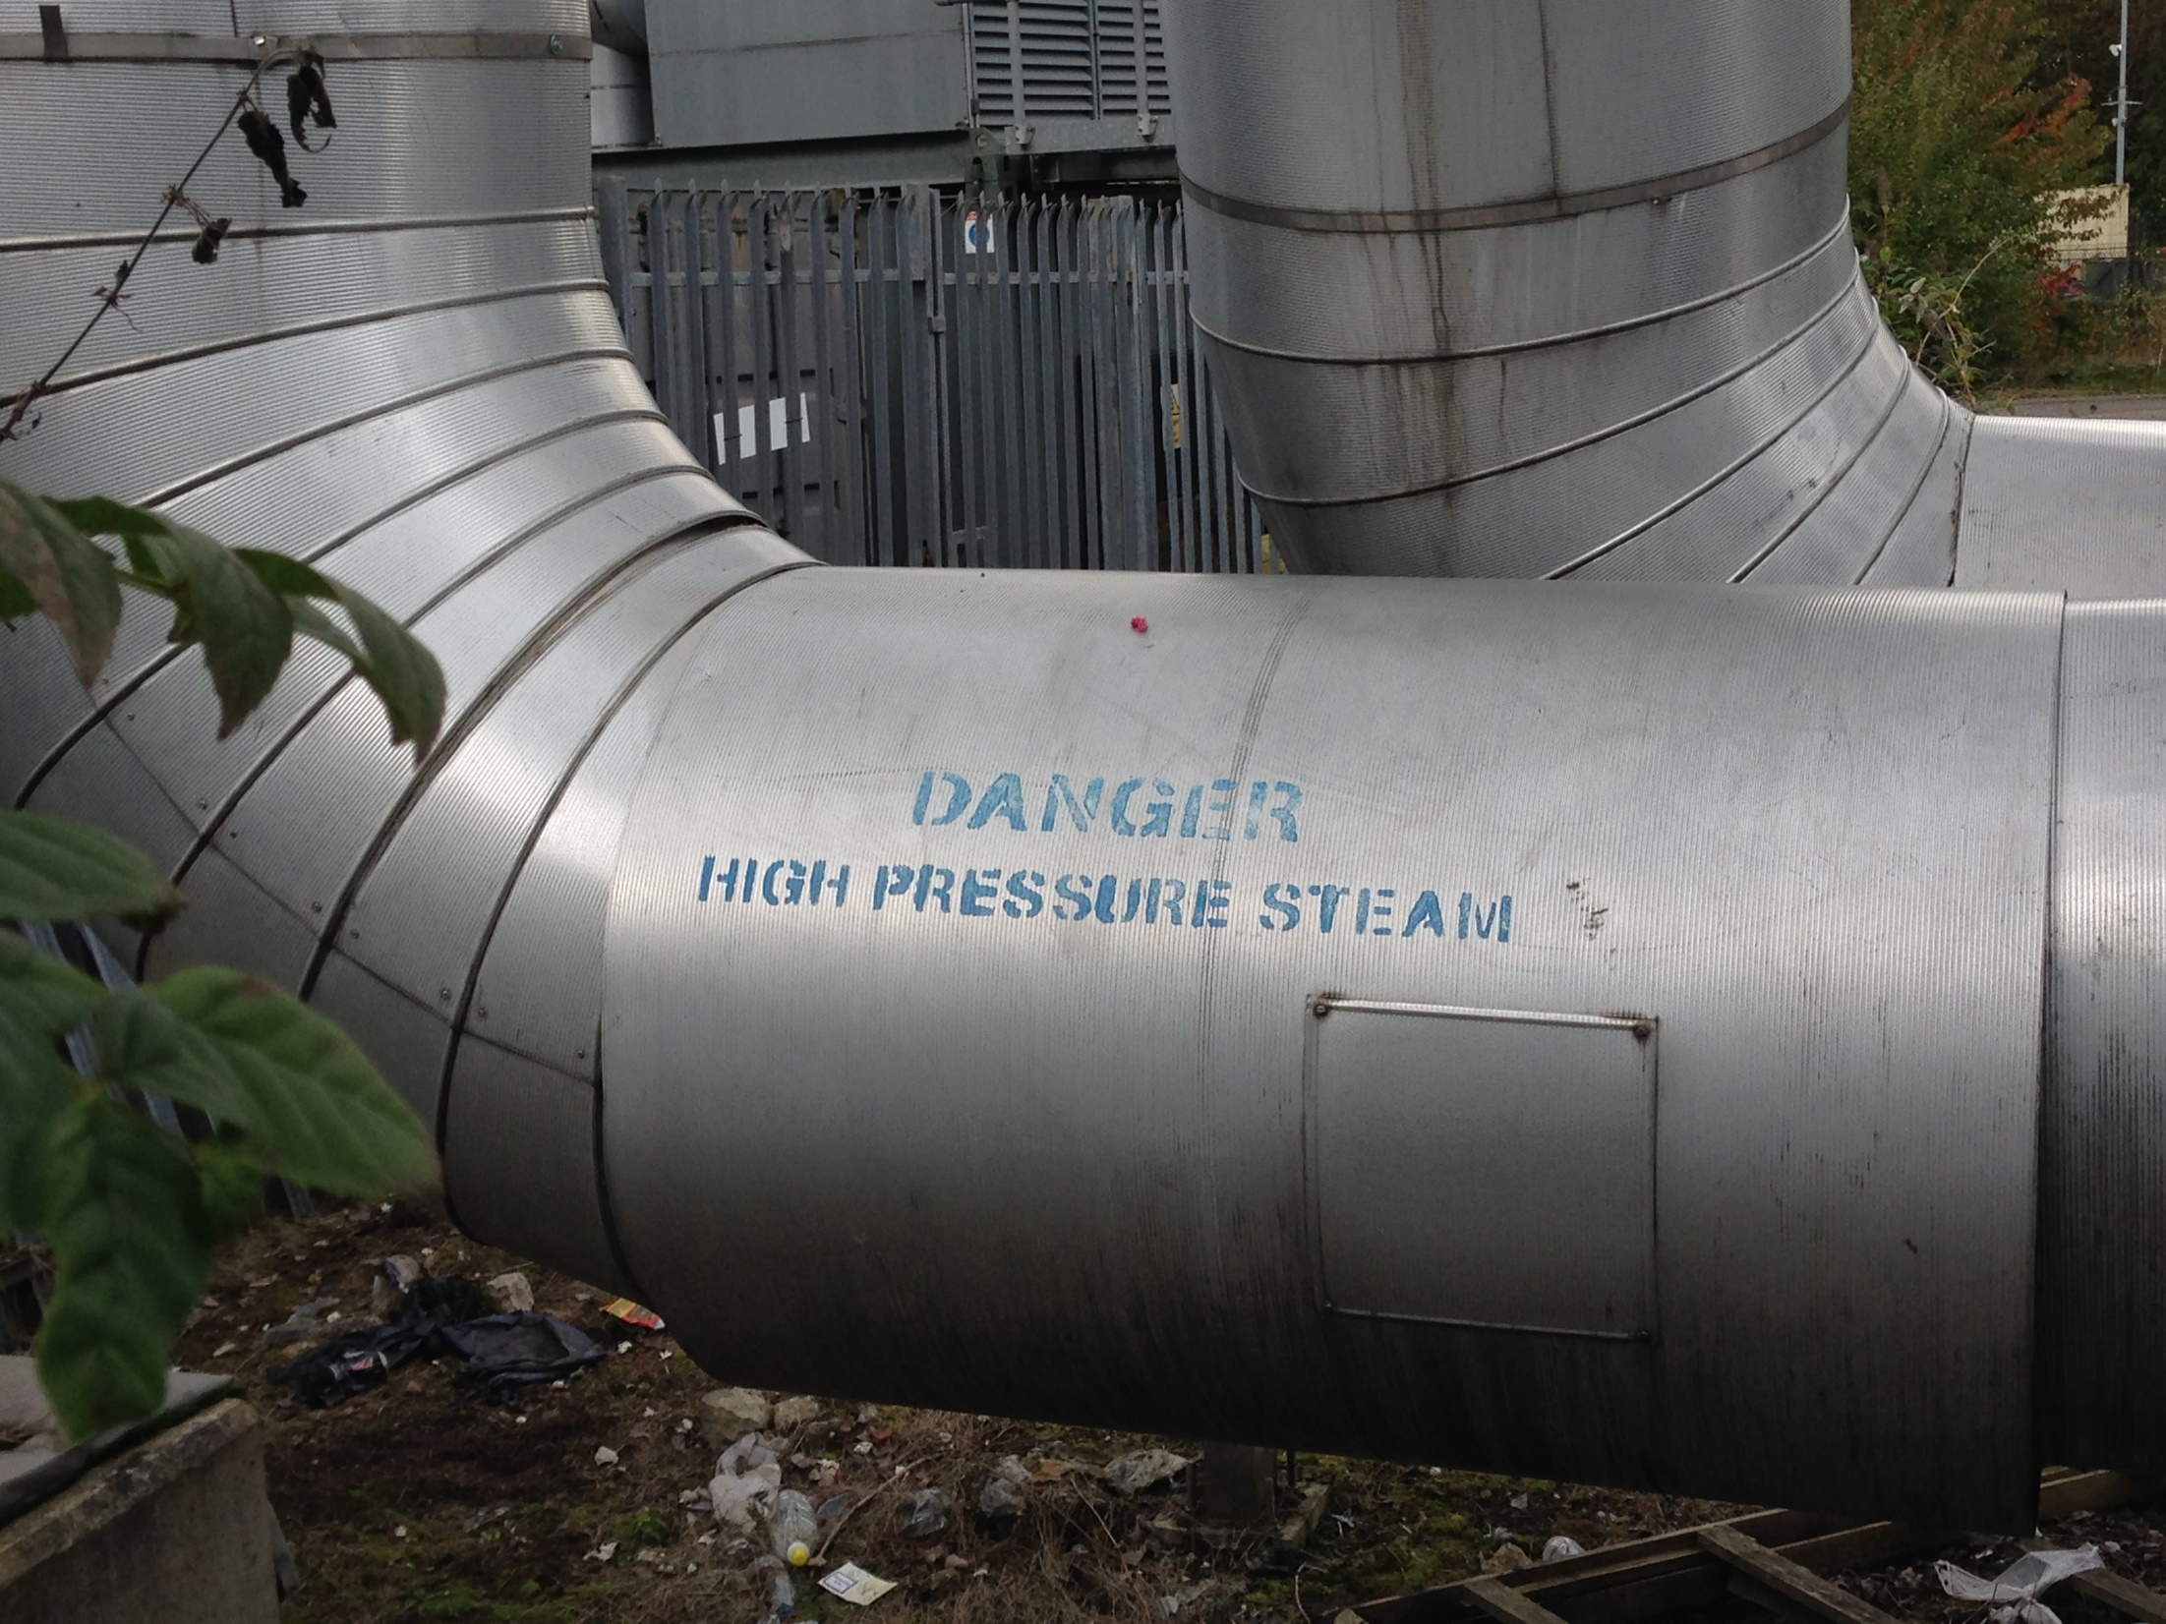

Slide 29
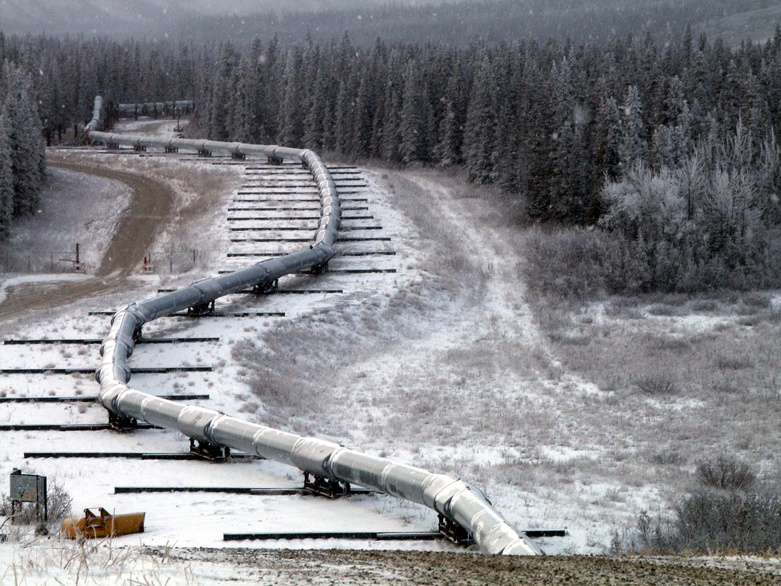

Slide 30
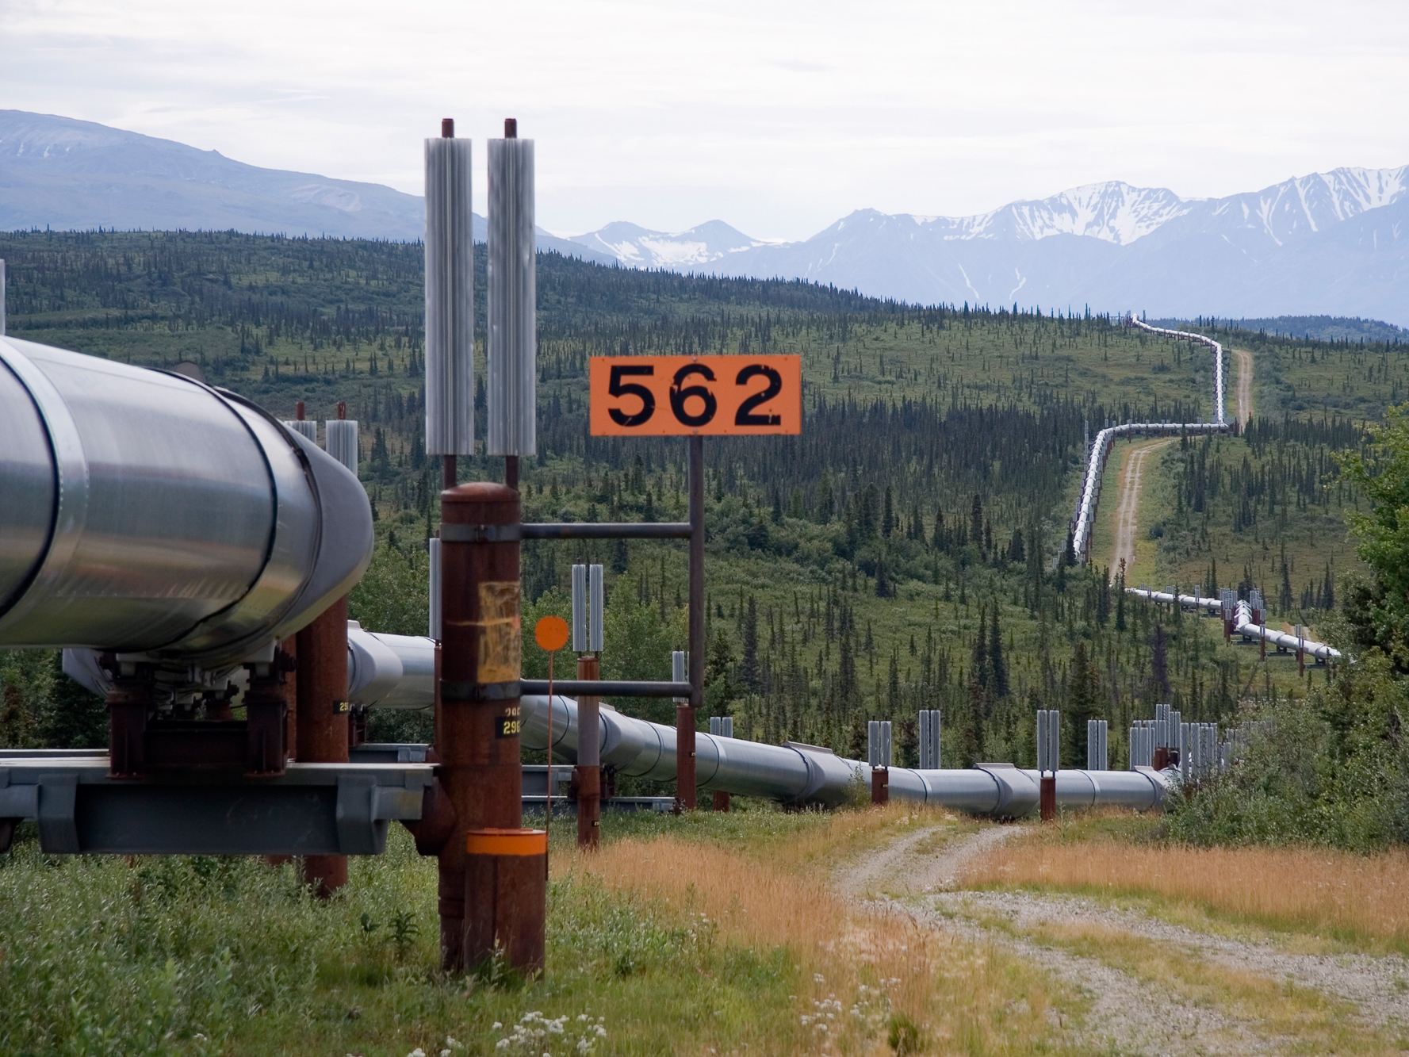

Slide 31
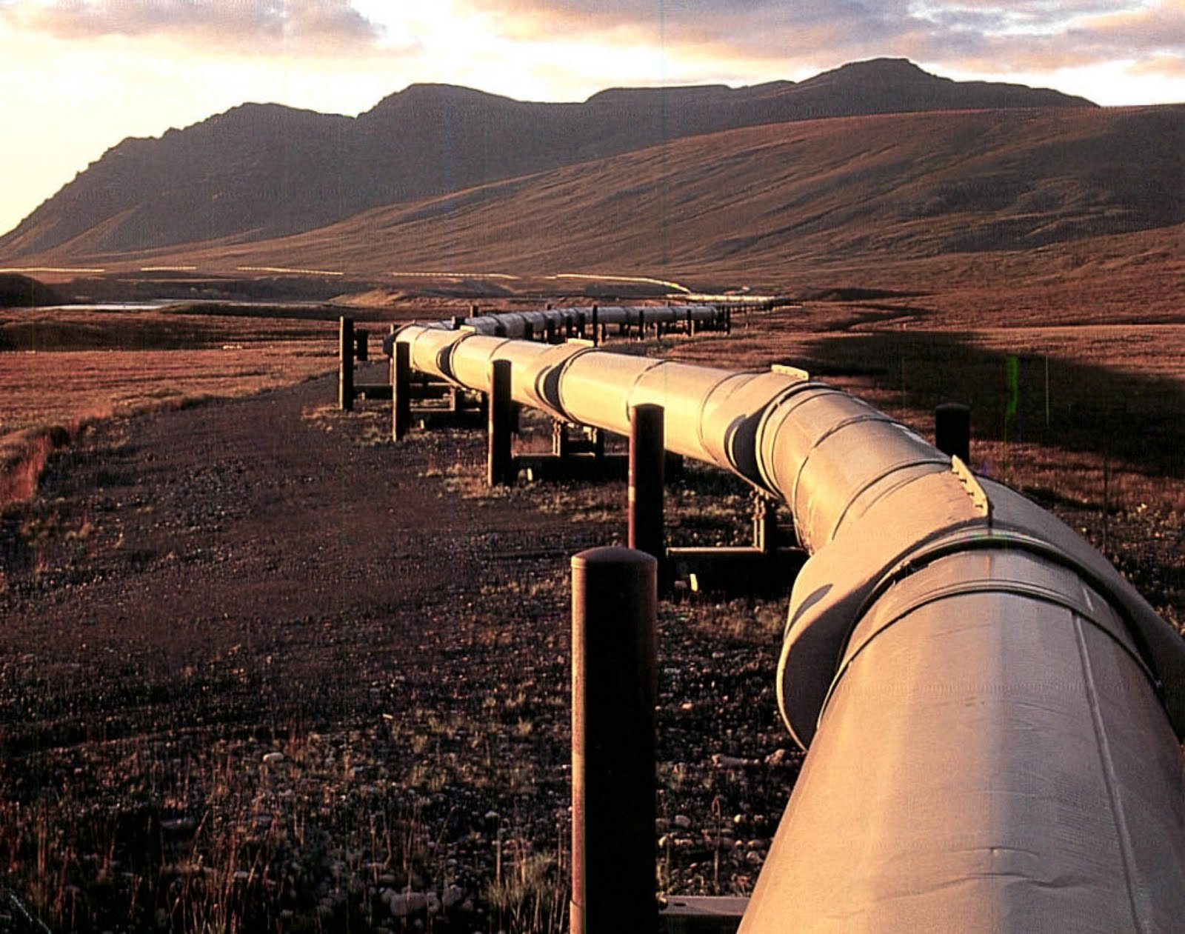

Slide 32
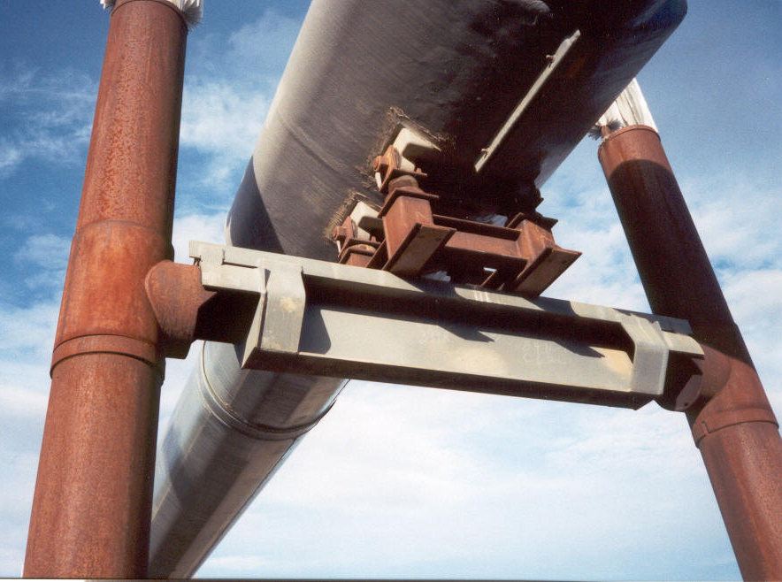

Slide 33
Piping Supports
By the consideration of pipe routes at an early stage, structural members and plant items can be arranged in the most convenient positions to give a simple and economical and safe arrangement for supporting the pipework.

Slide 34
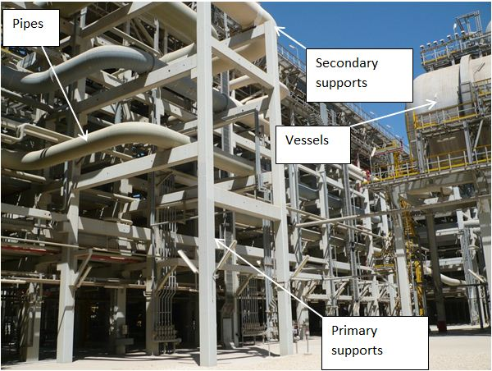
Pipe Rack Structure and Equipment Components

Slide 35
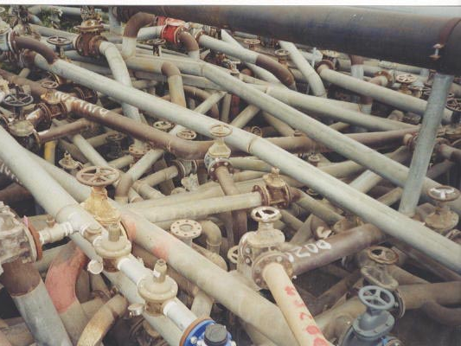

Slide 36
Main factors to consider when installing pipe support systems
To allow or control expansion and contraction of
pipes as they heat up and cool down.
To absorb or minimise vibration transmitted to pipes
from operating equipment.
To counteract pipe movement or shock caused by
rapid changes in flow through pipes.

Slide 37
Piping Supports
Piping must be supported in such a way as to prevent its weight from being carried by the equipment to which it is attached.
The supports used must prevent excessive sagging of the pipe and at the same time must allow free movement of the pipe due to expansion or contraction.

Slide 38
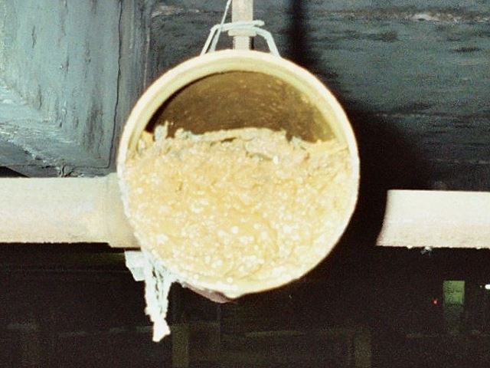
Piping Supports
The supporting arrangement must be of minimum design to carry the weight of the pipe, valves, fittings and insulation plus the weight of the fluid contained within the pipe.
Basically, the heaviest load that the system may possibly have to carry.

Slide 39
Supports are available in many different designs, but they are usually divided into two categories:
pipe supports, which support pipes from underneath.
(2) pipe hangers, which secure pipes from above.
The choice of which is used depends on the requirements of the particular system.
Piping Supports

Slide 40
Hangers
Hangers consist of a pipe clip round the pipe, a sling rod and a top attachment to the supporting steelwork.
1 Upper component - fixed attachment
2 Intermediate component - adjustable section
3 Lower component - pipe clip

Slide 41
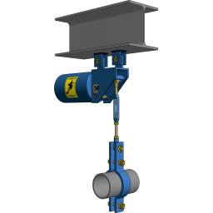
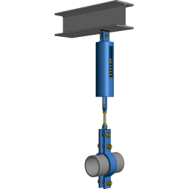
Upper component - fixed attachment
Intermediate component - adjustable section
Lower component - pipe clip/strap

Slide 42
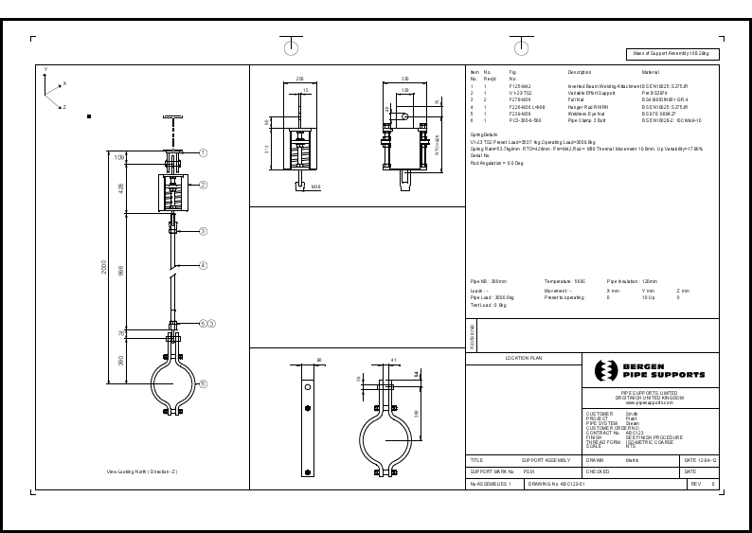
Support design

Slide 43
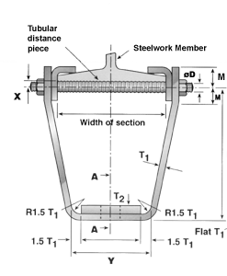
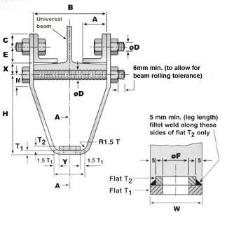
UPPER COMPONENTS - FIXTURE
Clamps and fittings designed to specification

Slide 44
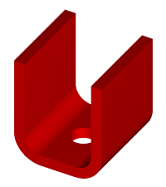
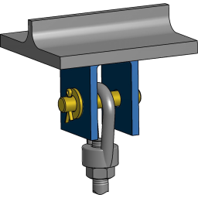
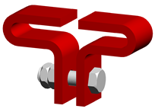
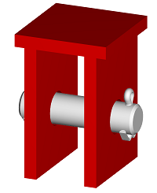
UPPER COMPONENTS- FIXTURE
Beam clamp
Welded brackets to underside of beam

Slide 45
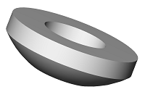
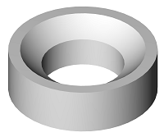
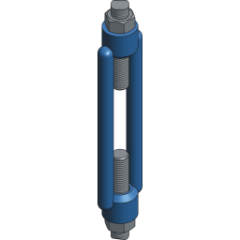

INTERMEDIATE COMPONENTS - ADJUSTABLE
Drop-rod
Turnbuckle

Slide 46

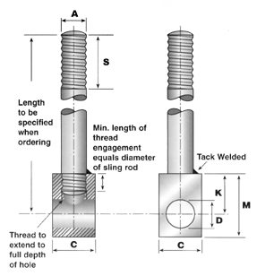
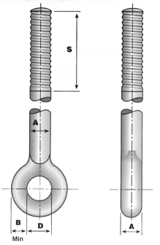
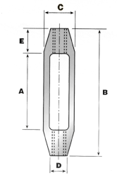

Slide 47
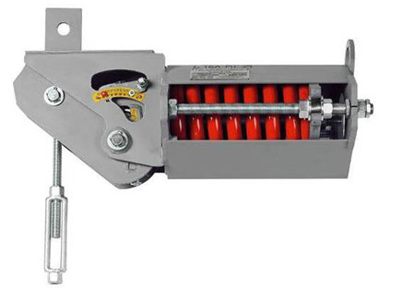
INTERMEDIATE COMPONENTS - ADJUSTABLE
Constant load spring hanger

Slide 48

Constant hangers and constant supports are used for piping and related components where higher levels of vertical travel occur.
Their job is to transfer the working load over the whole travel area while maintaining constancy, i.e., without any considerable deviations.

Slide 49


INTERMEDIATE COMPONENTS - ADJUSTABLE
Variable load spring hanger

Slide 50


Slide 51
Variable load spring hanger
Variable support hangers are also used to support pipes, that experience vertical movement.
Unlike constant support hangers, the variable support hangers are used where the supporting components have the capability to withstand load variations of up to 25%.

Slide 52

LOWER COMPONENTS - HOLDING

Slide 53



LOWER COMPONENTS - HOLDING

Slide 54


Slide 55


Slide 56
Supporting pipework from beneath

Slide 58


Pipe Skids

Slide 59




Pipe Skids

Slide 60


SUPPORTS – HOLD FROM BENEATH
Welded elbow support
Saddle support

Slide 61


Slide 62


Slide 63


Variable load spring support

Slide 64

Adjustable to suit compressive pipe loading

Slide 65

Constant load spring support

Slide 66



Support rollers and chairs

Slide 67


U-bolts
U-bolt, horizontal fix or guide
U-bolt, vertical fix or guide

Slide 68

SUPPORT FRAME

Slide 69




CANTILEVERS

Slide 71

Pipe racks and bridges

Slide 72


Slide 73

Pipe rack support frames

Slide 74


Slide 76
Supports should be of ample strength to carry the most severe load combination:-
Weight of pipe, fittings, valves etc.
Weight of operating or test fluid
whichever the greater.

Slide 77
Weight of insulation.(wet)
Weight of pipe support components.
Expansion and contraction loads.
Reaction from line discharging to atmosphere.
Wind, snow and ice loads.
Any other forces. (people climbing)

Slide 78
Consideration should also be given to:
Any forces arising from two-phase flow.
Need to control the magnitude of forces and
moments on equipment.
Vibrations.
Settlement of large storage tanks.
Removal of pipework or equipment for maintenance.
Access to equipment.
Differential settlement of the building.

Slide 79
Expansion joints in the building structure.
Avoiding damage to any pipe insulation.
Avoiding stress concentration at the point of attachments to the pipe
Process mal-operation or just plainly the unexpected, e.g. Gas lines filling up with water or dust/silt.
The effect of ‘Water’ hammer.

Slide 80
POSITIONING OF PIPE
The position of the pipe will determine type of support to be used.
Pipe routing usually has to be made with the supports required in mind.

Slide 81


Slide 82
POSITIONING OF PIPE
Pipes should be grouped to minimise the
number of structural members needed solely
for the supporting of pipes.
Supports should be located to reduce the
necessity for temporary supports.
Where regular maintenance requires removal
of equipment, vessel covers, control valves etc.
Where the pipes must be dismantled for cleaning.

Slide 83
POSITIONING OF PIPE
Where practical, a support should be located immediately adjacent to any change in direction of the pipes.
Supports should not be located on sharp radius bends or weld elbows which are already subjected to high localised stresses but should be located at points of low stress in pipes.

Slide 84
POSITIONING OF PIPE
Screwed or flanged joints should not be sited at mid span or close to a support (i.e. at high points of high bending moment).

Slide 85
POSITIONING OF PIPE
Pipes from upper connections on tall free standing vertical vessels (e.g. distillation columns) are supported from the vessel to minimise relative movement between support and the pipes.

Slide 86


Slide 87
Support Inspection
Corrosion at pipe supports is one of the leading causes of process piping failures.
It is the beam supports and saddle clamps that have historically caused the majority of problems.

Slide 88


Slide 89


Slide 90


Slide 91


Slide 92


Slide 94


Slide 95


Slide 96


Slide 97



Slide 98
Generally, the root causes of failure with hangers and their associated piping include:
Design (product insufficiencies or a mistake in their application)
Installation (improper hanger position or calibration)
Fabrication (substandard manufacture/quality)
Service (cyclic loading, adverse environment or operational events)
Hanger degradation and ultimate failure, thus transferring unsupported static load back into the piping systems and increasing stress levels.

Slide 99
Inspections Are Critical for Piping Safety
Hanger Problems
Adverse consequences arising from improper hanger performance include unpredictable stress and elevation changes within the suspended piping.
Problem areas are often the result of root causes acting independently of one another or in various combinations.

Slide 100
Checklist for Inspection of Hanger Assembly
Check the beam attachment, pin and the spring hanger attachment for any cracks, fractures, or signs of corrosion.
Check the pipe clamp attachment, the weldless eye and threaded rod for integrity.
Test the turnbuckle, locknuts, and other threaded items to be sure they will turn.
Check the spring coil for any sign of corrosion.

Slide 101

Corrosion
Crevices – the formation of a crevice at the pipe surface.
Water Entrapment – water is trapped and held in contact with the pipe surface.
Poor Inspect - ability and Maintainability – virtually impossible to paint or otherwise maintain; visual and/or NDT inspection are often difficult.
Galvanic Couples – even when both the pipe and support are steel, the metallurgical differences can still provide enough potential difference to drive a corrosion cell.

Slide 102


Slide 103




A FLAT SURFACE
A CREVICE FORMS
PIPE FAILS
CORROSION SPREADS

Slide 104


Slide 105


Slide 106


Slide 107


Slide 108
PIPE SUPPORT FAILURE

Slide 109


Slide 110


Slide 111


Slide 112


Slide 113


Slide 114


Slide 115


Slide 116

A “Temporary rope support” !!!

Slide 117


