Slide 1
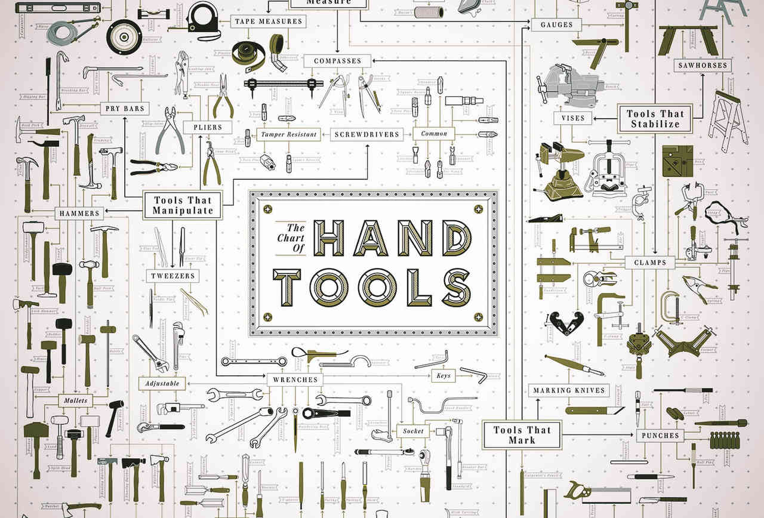
Typical TTE Mechanical Hand Tools
Recognition & Uses

Slide 2
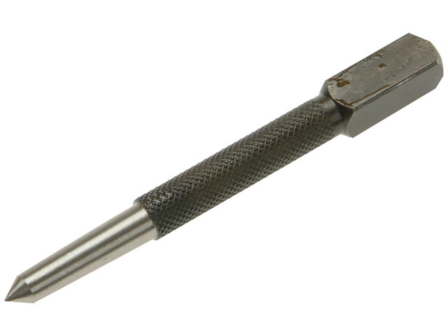
Name the tool
Centre Punch – What is the angle of the tip?
90° - What is it used for?
To produce a dimple in the material to assist drilling , so the drill does not skid on the surface, thus producing a accurately placed hole.
What is it made from?
High carbon steel (HCS) which is hardened & tempered

Slide 3
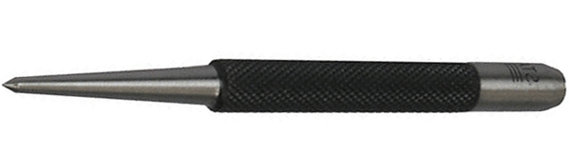
Name the tool
Dot Punch – What is the angle of the tip?
120° - What is it used for?
To proof punch, to assist marking out by producing “dots” along the marked lines for clarity.
What is it made from?
High carbon steel (HCS) which is hardened & tempered

Slide 4
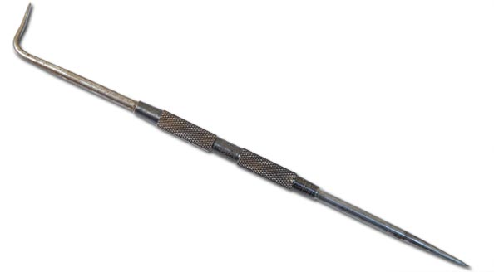
Name the tool
Scriber– What is it used for?
Marking out – scribing lines and features on metals.
What is it made from?
High carbon steel (HCS) which is hardened & tempered
Notes:
Cutting tools
cutting tools should be kept sharp.
Always cut away from yourself, hands behind the cutting edge.
Store with the sharp edges protected

Slide 5
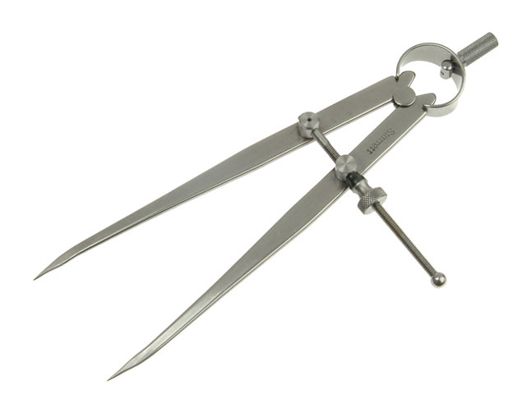
Name the tool
Dividers– What are they used for?
Marking out – Circles & Arcs on metals.
What is it made from?
High carbon steel (HCS) which is hardened & tempered
Notes:
Knives and cutting tools
Knives and cutting tools should be kept sharp.
Always cut away from yourself, hands behind the cutting edge.
Store with the sharp edges protected

Slide 6
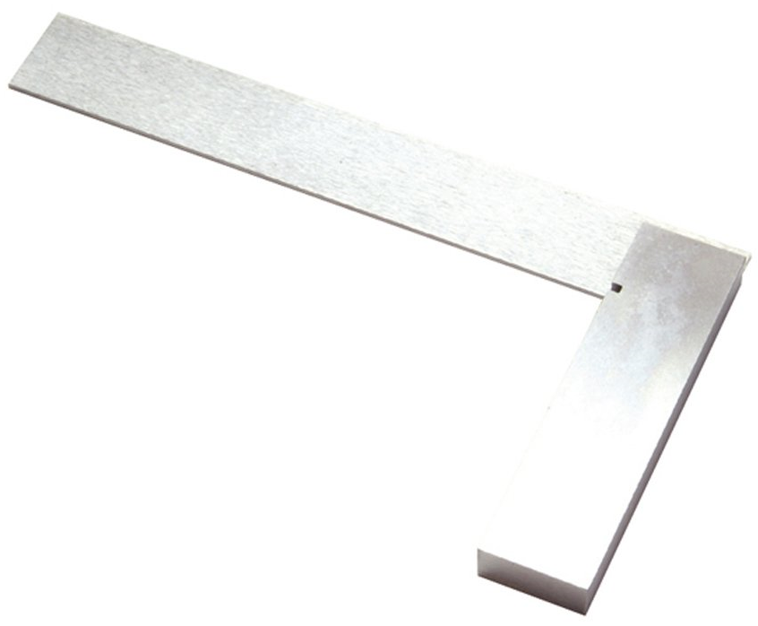
Name the tool
Engineers “Try Square”– What is it used for?
Marking out square /perpendicular lines. Checking for squareness / Flatness.
What is it made from?
The “Body” is usually made from mild steel and the “Blade” being High carbon steel (HCS) which is hardened & tempered
Notes:
Mention types and sizes

Slide 7
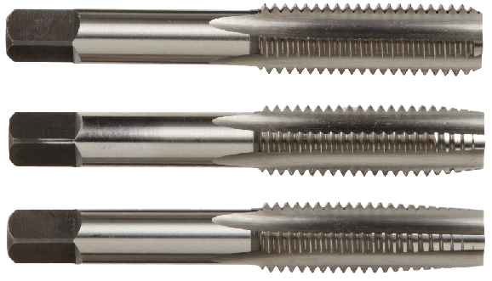
Name the tool
Hand Taps – Set of 3
What are they used for?
Producing a internal screw thread.
What are they made from?
“HSS” High speed steel and are very hard.
Name the 3 taps which constitute a set?
Taper.
Second or Intermediate.
Plug or Bottoming.
Notes:
Cutting tools
cutting tools should be kept sharp.
Always cut away from yourself, hands behind the cutting edge.
Store with the sharp edges protected

Slide 8
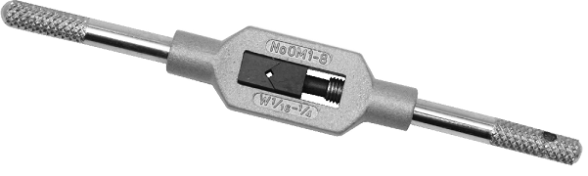
Name the tool
Tap Wrench -
What is it used for?
Holding a tap or a hand reamer, and being able to provide rotary leverage to “Tap” or “Ream” a hole.
What is it made from?
The “Body” is usually made from mild steel and the “Jaws” being High carbon steel (HCS) which is hardened & tempered
Notes:
Talk a bout reamers

Slide 9
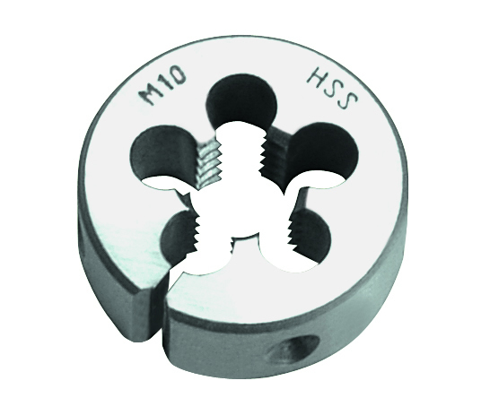
Name the tool
Split Die -What is it used for?
To produce an external screw thread
What is it made from?
“HSS” High speed steel and are very hard.
Notes:
Cutting tools
cutting tools should be kept sharp.
Always cut away from yourself, hands behind the cutting edge.
Store with the sharp edges protected

Slide 10

Name the tool
Die Stock -What is it used for?
Hold a split die and being able to provide rotary leverage to be able to produce an external thread
What is it made from?
It is usually made from mild steel.

Slide 11
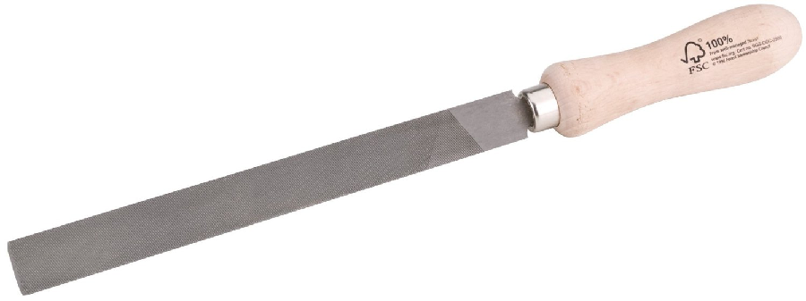
Name the tool
Hand File-What is it used for?
Cutting & shaping materials usually metals
What is it made from?
The “Handle” is usually made from wood with a steel ring called a “Ferrule”. The file is High carbon steel (HCS) which is hardened & tempered but the end “Tang” which goes into the handle is left soft – Why?
So it does not break when under pressure form the forces exerted by the operator
Notes:
Files
A file or should have a correct sized fitted handle.
Never use a file as a lever.
Do not use if the handle is split
Do not use without a handle
Store safely

Slide 12
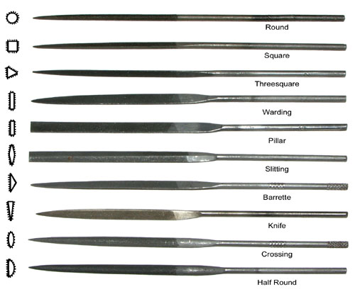
Name the tool
Needle Files-What are they used for?
Precision cutting & shaping materials usually metals
What are they made from?
They are made from High carbon steel (HCS) which is hardened & tempered but the end “hand grip” is left soft – Why?
So it does not break when under pressure form the forces exerted by the operator

Slide 13
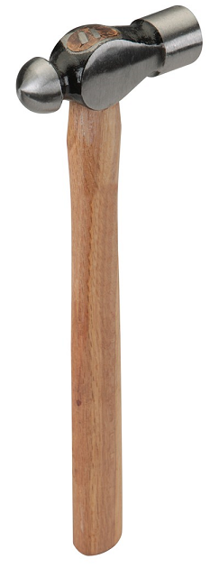
Name the tool
Ball Pein Hammer-What is it used for?
Shaping materials , punching, chiselling, dismantling, riveting and many more applications.
What is it made from?
The handle is usually made from Wood – What type of wood?
Traditionally “Hickory”
The head made from High carbon steel (HCS) which is hardened & tempered.
Notes:
Hammers
Avoid split, broken or loose shafts.
Avoid worn or chipped heads.
Hammer heads must be tightly fixed with a proper wedge

Slide 14
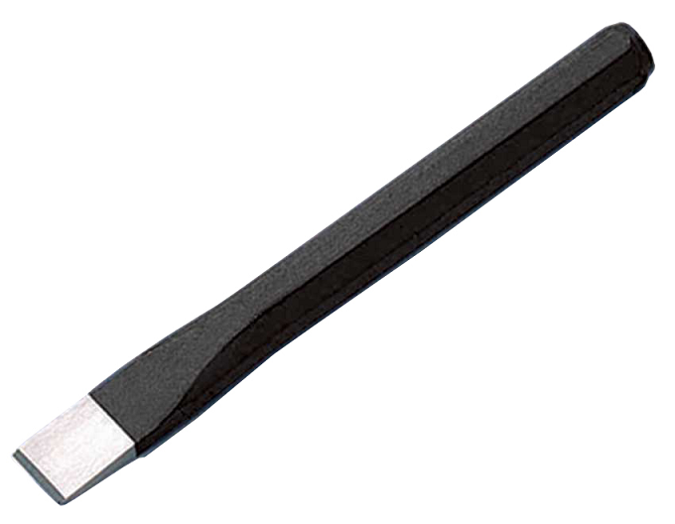
Name the tool
Cold Chisel – What is it used for?
Cutting & shaping materials usually metals.
What is the angle of the cutting edge?
60° Inc
What is it made from?
It is made from High carbon steel (HCS) which is hardened & tempered at the cutting edge, but the end is left soft – Why?
So that it can absorb the hammer blows without shattering.
Notes:
Chisels
The cutting edge should be sharpened to the correct angle.
Do not use a chisel with a mushroomed head – trim the sides regularly.
Always cut away from the body.
chisel work requires the wearing of approved eye and hand protection - VISOR

Slide 15
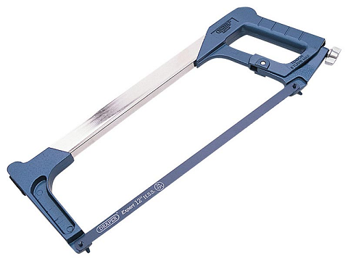
Name the tool
Hacksaw – What is it used for?
Cutting & shaping materials usually metals.
What is it made from?
The body is made from Cast Steel. The interchangeable blade can be made from High carbon steel (HCS) which is hardened & tempered. But for the best performance (HSS) High speed steel is used.
Notes:
Hacksaws
Do not use if the blade is not taut.
Do not use a saw that has dull or damaged blades.
Do not carry a saw by the blade.
Ensure the correct TPI is selected for the operation undertaken.
Never saw with one hand always hold the saw with both hands.
Ensure the work-piece is securely gripped with minimum overhang.
Right handed people – saw on the Right hand side of the vice.
Left handed people – saw on the Left hand side of the vice.
Never saw upwards.
*Talk about blade types, TPI, Direction of cutting.

Slide 16
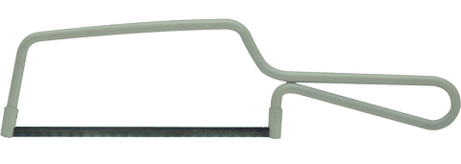
Name the tool
Junior Hacksaw – What is it used for?
Cutting & shaping materials usually metals.
What is it made from?
The body is made from Mild Steel. The interchangeable blade can be made from High carbon steel (HCS) which is hardened & tempered. But for the best performance (HSS) High speed steel is used.
Notes:
Hacksaws
Do not use if the blade is not taut.
Do not use a saw that has dull or damaged blades.
Do not carry a saw by the blade.
Ensure the correct TPI is selected for the operation undertaken.
Never saw with one hand always hold the saw with both hands.
Ensure the work-piece is securely gripped with minimum overhang.
Right handed people – saw on the Right hand side of the vice.
Left handed people – saw on the Left hand side of the vice.
Never saw upwards.

Slide 17
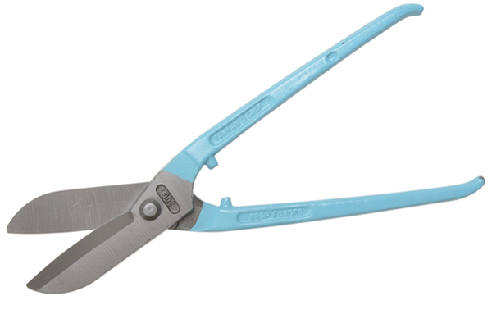
Name the tool
Tin Snips – What is it used for?
Cutting & shaping sheet metals & Alloys.
What is it made from?
Body is made of drop forged chromium vanadium steel. The blades are induction hardened.
Notes:
Tin Snips
Do not use straight snips to cut curves.
Keep the blade aligned by tightening the nut and bolt on the snips.
Do not use snips as a hammer, screwdriver or pry bar.
Use the locking clip on the snips after use

Slide 18
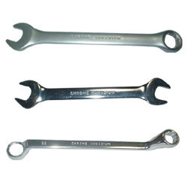
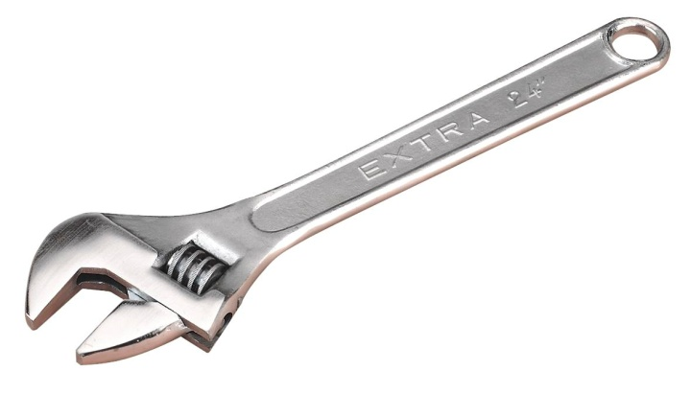
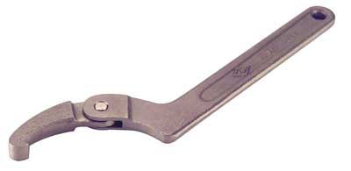
Name the tool
Spanners– What are they used for?
Fixing and removing hexagonal fasteners or specific types of fasteners.
What are they made from?
They are made from drop forged chromium vanadium steel.
Notes:
Spanners
Always use the correct size spanner for the job.
Avoid splayed jaws.
Where practicable always use a ring spanner rather than an adjustable spanner.
Do not use pliers etc. as make shift spanners.
Never use a spanner (or a wrench) as a hammer.
Do not improvise by using pipes etc. as extension handles

Slide 19
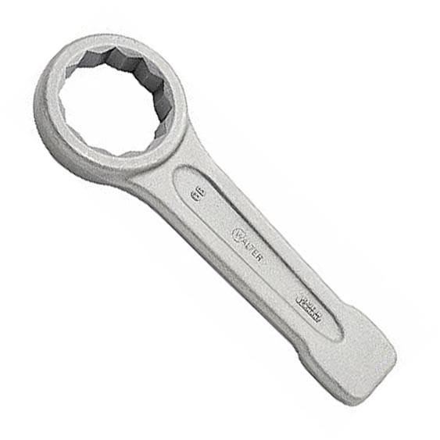
Name the tool
Flogging Spanner– What is it used for?
Fixing and removing very large hexagonal fasteners
What is it made from?
They are made from drop forged chromium vanadium steel.
Notes:
Mention hazards – reference “Finger Saver”

Slide 20
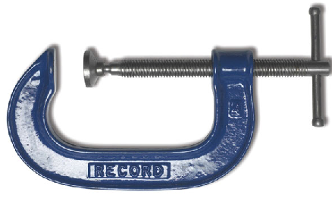
Name the tool
G- Clamp – What is it used for?
They are an essential tool in the workshop and they come in a range of sizes and are generally used for clamping work securely to a surface/workbench top. They can also be used to hold parts together for example items to be welded.
What is it made from?
The thread of a G Cramp is made from hardened and tempered steel which means it is quite resistant to wear. The frame is normally made from drop-forged steel.
Notes:
G-Clamp
Do not use the G-clamp for hoisting materials.
Do not use the G-clamp as a permanent fastening device

Slide 21
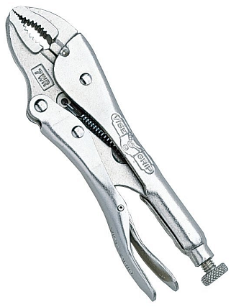
Name the tool
Vice “Mole” Grips– What is it used for?
Griping and holding parts- for example items to be welded or drilled. They are a very useful to have.
What is it made from?
They are made from drop forged chromium vanadium steel.
Notes:
Mention sharp jaws.

Slide 22
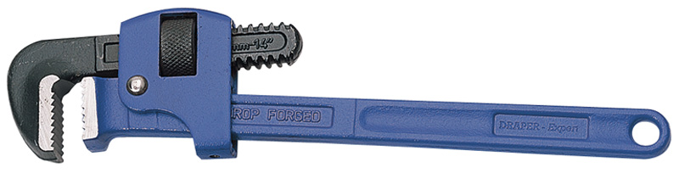
Name the tool
Pipe “Stilson” Wrench– What is it used for?
For turning / tightening / adjusting soft iron pipes and fittings.
What is it made from?
It is made from drop forged chromium vanadium steel.
Notes:
Pipe Wrench
Do not use a pipe wrench on nuts or bolts.
Do not use a pipe wrench for lifting or bending pipes.
Do not improvise by using pipes etc. as extension handles “Cheaters”
Do not expose to excessive heat (like from a blow torch) that could affect the temper of the metal.
Do not use a Pipe wrench on moving machinery.

Slide 23
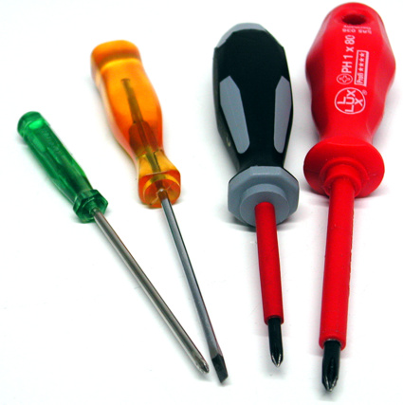
Name the tool
Screwdrivers–
What are they used for?
Adjusting tools & machinery, Assembling /de -assembling electrical and mechanical devices.
What are they made from?
The blade is usually made (HCS) hardened and tempered or sometimes chromium vanadium steel and induction hardened. The handles are made from various materials such as – Plastics, Woods, Metals.
Notes:
Screwdrivers
Always use the correct size of screwdriver for the job.
Make sure the handles are sound – split handles are hazardous.
Keep the end square and blunt.
Do not hold the work in your hand – screwdrivers often slip.
Never use a screwdriver as a chisels
Never strike with a hammer

Slide 24
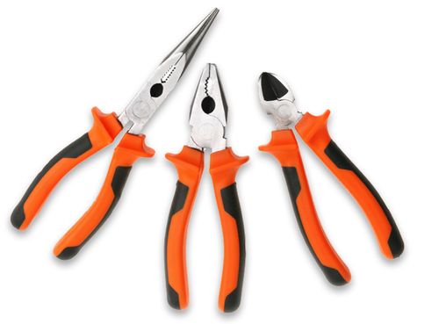
Name the tool
Pliers – What are they used for?
They are designed to be used for a combination of tasks including cutting wire, twisting wire, forming , griping – and many more applications
What are they made from?
The blade/ jaws are usually made (HCS) hardened and tempered or sometimes chromium vanadium steel and induction hardened. The handles are made from various insulating materials such as rubber.
Notes:
Pliers
Do not use pliers that are cracked or broken.
Do not use pliers as a wrench or hammer.
D not attempt to force pliers by using a hammer on them.
Do not slip a pipe over the handles of pliers to increase leverage.
Use insulated pliers when performing electrical work.
When using the diagonal cutting pliers, shield the loose pieces of cut material from flying into the air by using a cloth or your gloved hand

Slide 25
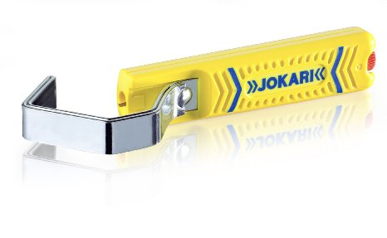
Name the tool
Cable “ Jokari” Knife– What is it used for?
They are designed to be used for a stripping wire.
What is it made from?
The blade is usually made (HCS) hardened and tempered. The handles are made from various insulating materials such as plastics.
Notes:
Knives and cutting tools
Knives and cutting tools should be kept sharp.
Always cut away from yourself, hands behind the cutting edge.
Store with the sharp edges protected

