Slide 1
Phase 1 Mechanical ROA
Module Title: Measurement Units Imperial & Metric
Module No: MS2
Presentation Title : Precision Measurement
Eddie Cody 15/5/2012 Phase 1 ROA Mechanical

Slide 2
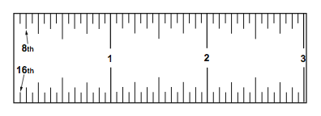
PRECISION MEASUREMENT
A. STEEL RULES
Also known as scales.
Range in length from 1 - to - 48 inches.
Most common is spring tempered 6-inch.
1. Fractional-Inch Rule
Divided in fractions of an inch. Such as 1/2, 1/4, 1/8, 1/16 or smaller.
Bottom number indicates number of spaces within an inch.
Fractional-Inch rule in 8ths and 16ths.

Slide 3
2. Review of Reducing Fractions
Reducing does not change the value of a fraction.
Divide numerator (top number) and denominator (bottom number)
by same number.
Reduce 2/8
2 = 1
8 2 = 4
2/8 = 1/4
Reduce 16/32
16 2 = 8
32 2 = 16
b. 8 2 = 4
16 2 = 8
c. 4 2 = 2
8 2 = 4
d. 2 2 = 1
4 2 = 2
16/32 = 1/2

Slide 4
Reducing Fractions Exercise
Solve these problems. Show all work.
a. In 1 1 ⁄2 there are ______________ 16ths.
b. In 1 ⁄2 there are _______________ 16ths.
c. In 3 ⁄4 there are _____________ 8ths.
d. In 1 4 ⁄16 there are _______________ 8ths.
e. In 24 ⁄ 32 there are _______________ 4ths.
f. In 2 1 ⁄2 there are _______________ 16ths.
g. 12 ⁄16 reduced to its lowest terms is _______________.
h. 28 ⁄ 32 reduced to its lowest terms is _______________.
i. 48 ⁄ 64 reduced to its lowest terms is _______________.
j. 96 ⁄64 reduced to its lowest terms is _______________.
k. 19 ⁄32 reduced to its lowest terms is _______________.
l. In 1 40 ⁄64 there are _______________ 16ths.
m. In 1 ⁄8 there are _______________ 64ths.
n. In 1 5 ⁄16 there are _______________ 32nds.
o. In 3 ⁄4 there are __________________ 16ths.
p. 15 ⁄8 reduced to its lowest terms is __________.
24
8
6
10
3
40
3/4
7/8
3/4
1-1/2
19/32
26
8
42
12
1-7/8
CHECK YOUR ANSWERS !

Slide 5
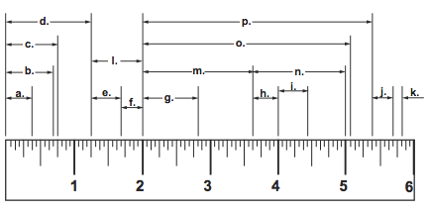
Rule Reading Exercise
3/8
7/16
7/16
1-5/8
a. __________ e. __________ i. __________ m. __________
b. __________ f. __________ j. __________ n. __________
c. __________ g. __________ k. __________ o. __________
d. __________ h. __________ l. __________ p. __________
11/16
5/16
5/16
1-3/8
3/4
13/16
1/8
3- 1/16
1-1/4
3/8
3/4
3 - 3/8
CHECK YOUR ANSWERS !

Slide 6
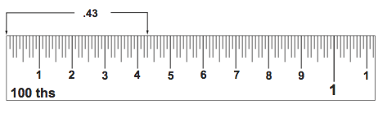
3. Decimal-Inch Rule
Measures closer than fractional-inch rule.
“100” at end of rule means 1 inch divided into 100 parts.
Each division = 1/100 of an inch.
Can be divided into 50ths and 10ths.
.10
.20
.30
.40

Slide 7
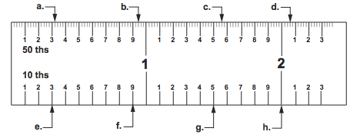
Reading the Decimal-Inch Rule Exercise
Complete the readings called for by placing your answers in the spaces provided.
a. __________ d. __________ g.__________
b. __________ e. __________ h. __________
c. __________ f. __________
.32
2.06
1.5
.94
.3
2.0
1.56
.9
CHECK YOUR ANSWERS !

Slide 8
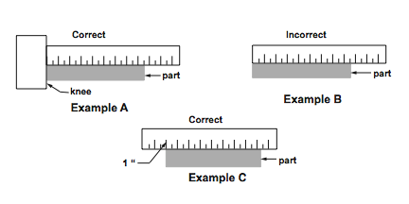
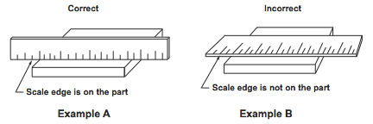
B. USING STEEL RULES
Don’t use end as reference point, except with “knee”..
If no “knee”, use 1 inch mark as reference.
Use scale
edge.

Slide 9
1. Care of The Rule
Don’t use as screwdriver.
Keep away from moving machinery.
Don’t lay other tools on the rule (destroys markings).
Wipe often with oily cloth (prevents rust).
Clean with fine steel wool.
Store rule by itself.
Don’t damage ends or edges.
Use correct rule for job.
Coat rule with wax or rust preventative for long storage time.

Slide 10
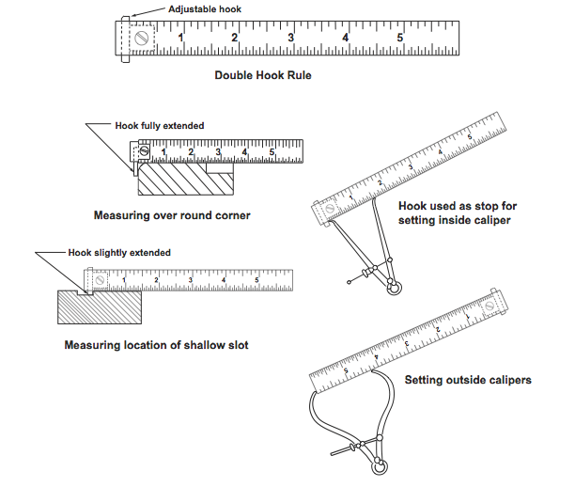
B. HOOKED RULES
Common Uses

Slide 11
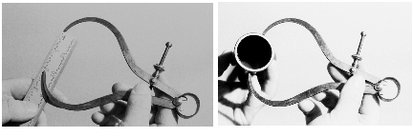
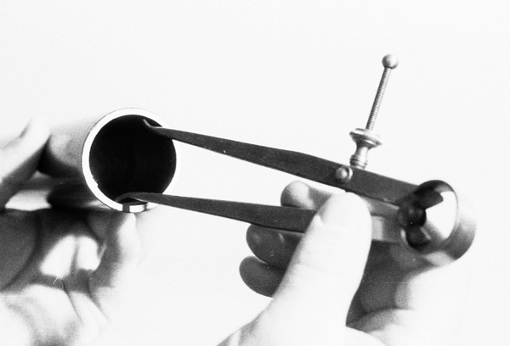
D. HELPER MEASURING TOOLS
Generally a spring caliper.
Has no scale - cannot be used by itself.
Common examples are “Inside and Outside” calipers.
“Outside”
“Inside”

Slide 12
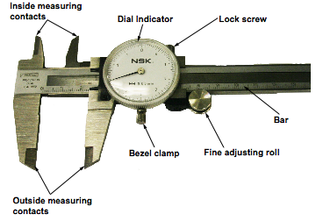
E. ADJUSTABLE JAW CALIPERS
Moveable jaws.
Takes measurement directly from part.
1. Dial Calipers
Dial indicator mounted on moveable jaw.

Slide 13
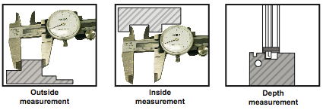
Common Uses of Dial Calipers

Slide 14
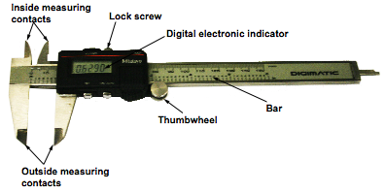
2. Digital Calipers
Latest advancement.
Measurement converted to digital readout.
Similar to conventional calipers.
Scale can be calibrated in both inches and centimeters.
More rugged.
More accurate.
Better repeatability.
Easier to handle & read.
Follow guidelines for proper use.

Slide 15
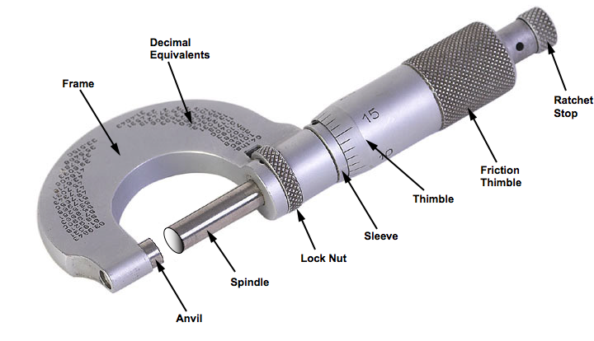
F. DIAL MICROMETERS
1. Outside Micrometers
Measures accurately to (.001).
Vernier micrometers measure to (.0001).

Slide 16
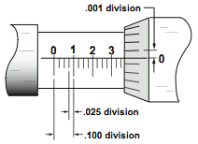
2. Standard Micrometers
Spindle rotates in fixed nut - (40 threads per inch).
One complete turn of spindle = 1/40 (.025) inches.
Micrometer Graduations

Slide 17
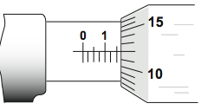
Micrometer Reading
Line “1” visible, plus two other lines:
“1” = .100
+ 2 @ .025 = .050
.150
2. Index line coincides with 12 on thimble:
12 x .001 = .012
.100 – Line marked “1”
.050 – 2 extra vertical lines
.012 – Thimble reading
.162 – Total reading

Slide 18
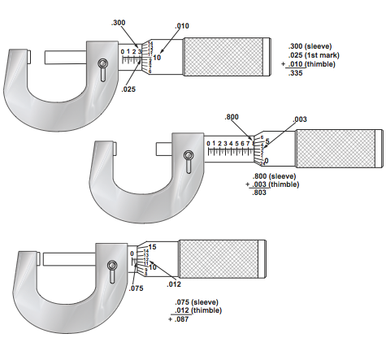
How Micrometers are Read

Slide 19
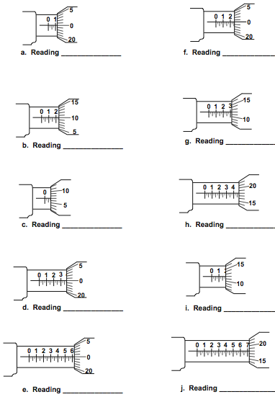
Micrometer Reading Exercise
.125
.250
.235
.312
.082
.468
.375
.187
.625
.718
CHECK YOUR ANSWERS !

Slide 20
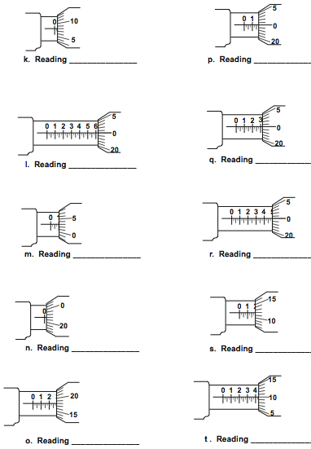
Micrometer Reading Exercise
.033
.175
.625
.325
.103
.500
.022
.187
.293
.435
CHECK YOUR ANSWERS !

Slide 21
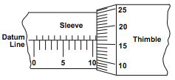
3. Metric Micrometers
Measure in hundredths of a millimeter (0.01 mm)
One complete turn of thimble = 1/2 mm.
Sleeve marked in “millimeters” below the line.
Marked in half-millimeters above line.
Thimble marked in 50 divisions.
- Each division = 1/50 of a 1/2 millimeter or 1/100 (.01)mm.
Step 1. Note whole millimeter mark on sleeve.
Step 2. Note whether a half-mm mark is showing between whole
millimeter mark and thimble.
Step 3. Read thimble for hundredths reading.
Step 4. Add readings.

Slide 22
Metric Micrometer Reading
Whole millimeter marks 10 x 1 mm = 10.00 mm
Half millimeter marks 1 x .50 mm = .50 mm
Thimble Reading 16 x .01 mm = .16 mm
Reading 10.66 mm

Slide 23
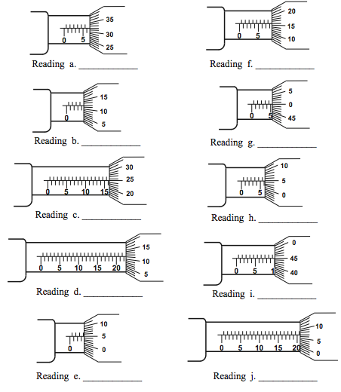
Metric Micrometer Reading Exercise
5.82 mm
8.16 mm
4.12 mm
5.50 mm
16.25 mm
6.05 mm
22.11 mm
9.95 mm
3.55 mm
20.57 mm
CHECK YOUR ANSWERS !

Slide 24
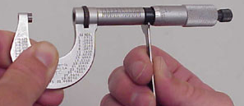
4. Micrometer Adjustments
Removing Play
- Back off the thimble.
- Insert a C-spanner into slot or hole of adjusting nut.
- Turn adjusting nut clockwise until play between threads
is eliminated.

Slide 25
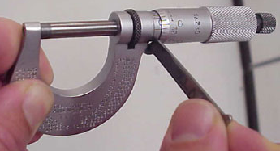
4. Micrometer Adjustments
Adjusting Accuracy
- Clean measuring faces and check for damage.
- Closes faces.
- Turn sleeve until index line on sleeve matches zero (0)
line on thimble.
- Recheck accuracy by opening and closing faces. Rating
should be zero (0).

Slide 26
5. Care of the Micrometer
Close faces carefully to avoid damage.
Keep micrometer clean. Wipe with oily cloth. Oil threads.
Not too much pressure.
Clean face of anvil and spindle before use.
Check for accuracy. Close faces - should read zero (0).
Don’t lay unit where it could fall.
Don’t twirl micrometer to open or close a great distance.
Clean and oil for long term storage. Place in box.

Slide 27
6. Inside Micrometers
For internal measurements larger than 1-1/2 inch
Consists of:
- Micrometer head - Range of 1/2 to 1 inch.
- Extension rods- different lengths inserted in head.
- 1/2 inch spacing collar.
Review and follow steps for using inside micrometer.

Slide 28
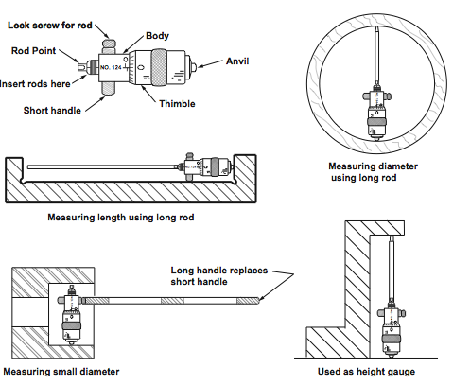
Uses of Inside Micrometers

Slide 29
G. DIGITAL MICROMETERS
Modern Version - Results Displayed Electronically
Delicate instrument - handle with care.
1. How to Read Digital Micrometers
Before taking reading, do the following:
- Turn display on.
- Press button to activate desired scale.
- Slowly close micrometer until ratchet engages.
- Zero micrometer by pressing Origin or Set button.
For thickness reading:
- Open micrometer.
- Insert sample.
- Slowly close micrometer until ratchet engages.
- Read thickness on digital display.

Slide 30
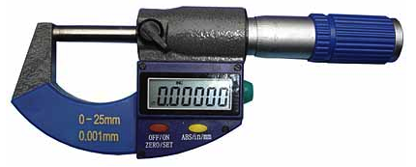
2. Proper Care of Digital Micrometers
When finished, open slightly.
Never store with spindle closed
Turn instrument off and store in protective case.

Slide 31
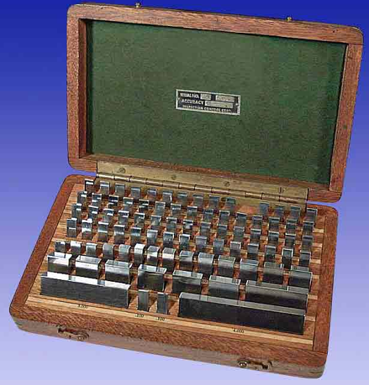
H. GAUGE BLOCKS
Rectangular blocks - hardened and ground alloy steel.
Measuring surfaces lapped and polished - accurate to within
a few millionths of an inch.
Size of block stamped one surface.

Slide 32
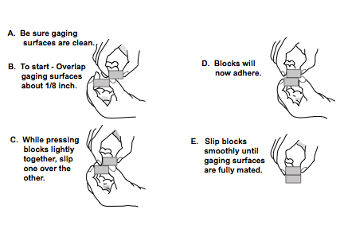
Wringing Gage Blocks Together

Slide 33
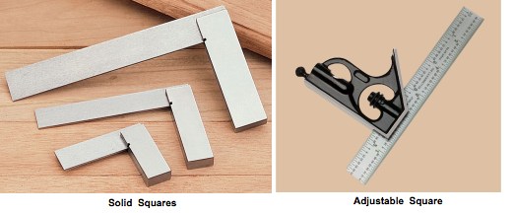
I. SQUARES
Used for laying out, checking, and setting up work.
Beam and blade form a right angle.
Good quality squares are hardened.
1. Solid and Adjustable Squares.
Not accurate enough for precision work or inspection.

Slide 34
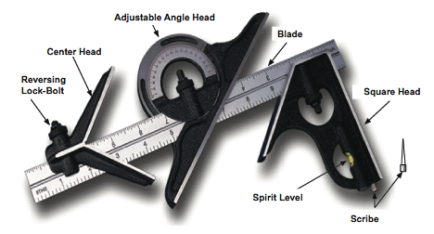
2. Combination Squares.
Checking inside and outside squareness.
Drawing lines parallel to edges of work piece.
Measuring depth.
Finding centers of round work pieces.
Checking 45⁰ angles.

Slide 35
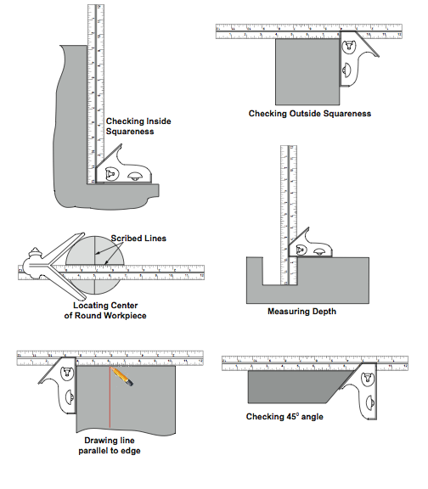
Uses of Combination Squares.

Slide 36
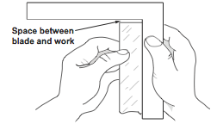
3. Using Solid Steel Squares.
Remove all burrs from work surface. Wipe clean.
Wipe square clean.
Face source of light.
Hold work with one hand. Grasp square with other.
Place inside of square against finished surface.

Slide 37
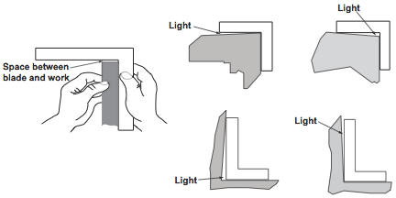
Lower blade to surface of work.
All light should be excluded.

Slide 38
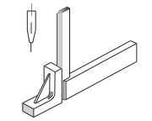
4. Beveled Edge Squares.
Used for inspection.
Edges are beveled and hardened.
Better contact with surface. More accurate.

Slide 39
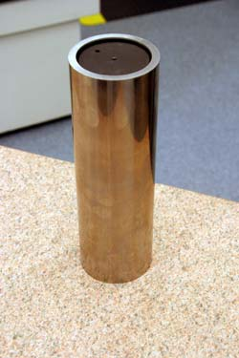
5. Cylindrical Squares.
Made in 4”, 6” and 12” lengths.
Used as master squares to check other squares.
Thick-walled, alloy steel cylinder (hardened, ground, and lapped).
STEPS:
Place in contact with work.
Turn until no light is seen between.
Uppermost curved line shows squareness.
Eddie Cody 15/5/12

