Slide 1
SCREW THREADS AND LOCKING DEVICES
This module is designed to develop your awareness and competence in thread forms and locking devices in accordance with your current training objectives set out in your ROA (record of achievement).
At the end of this input, the trainee will have an understanding of fixings, fasteners and any item with a thread and be able to identify it and satisfactorily complete a test of understanding as verification.

Slide 2
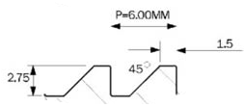
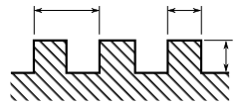
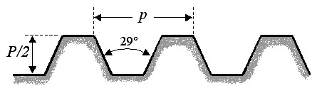
SCREW THREADS AND LOCKING DEVICES
There are many standards for screw threads used on bolts and fastenings. They all have a specific formation and each is very different to the other..
PITCH
PITCH/2
butress
acme
SQUARE

Slide 3
SCREW THREADS
There are several standards (British Standards) of thread available, on site you will usually see only three of these in use.
Unified Thread Form BS1580
angle = 60º
Whitworth Thread Form BS 84
angle = 55º
Metric Thread Form BS 3643
angle = 60º

Slide 4
SCREW THREADS
There are several standards (British Standards) of thread available, on site you will usually see only three of these in use.
Unified Thread Form BS1580
Imperial
Whitworth Thread Form BS 84
BSW, BSF, UNC, UNF
Metric BS 3643
metric

Slide 5
SCREW THREADS
There are several standards (British Standards) of thread available, on site you will usually see only three of these in use.
Unified Thread Form BS1580
60º
Whitworth Thread Form BS 84
55º
Metric BS 3643
60º
British Association - BA
47.5º

Slide 6
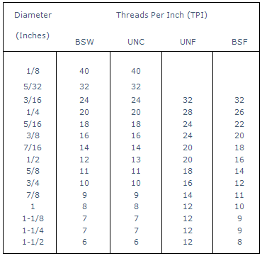
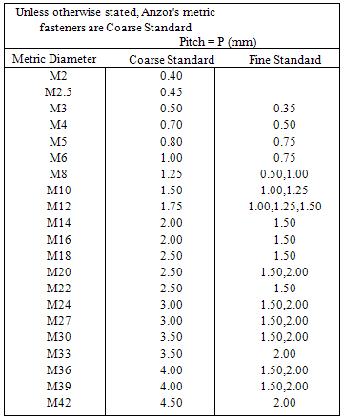
SCREW THREAD TABLES
Imperial
metric

Slide 7

SCREW THREAD MISMATCH

Slide 8

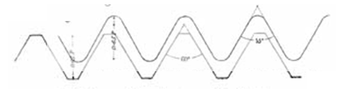
SCREW THREAD MISMATCH
Correct thread
Mismatched thread
½” Whitworth+ ½” UNC

Slide 9
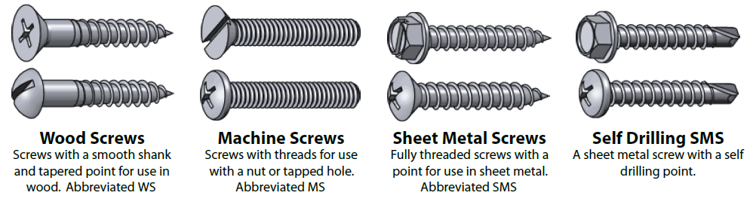
FASTENERS AND LOCKING DEVICES - SCREWS
WOOD SCREWS
MACHINE SCREWS
SHEET METAL SCREWS
SELF DRILLING SCREWS

Slide 10
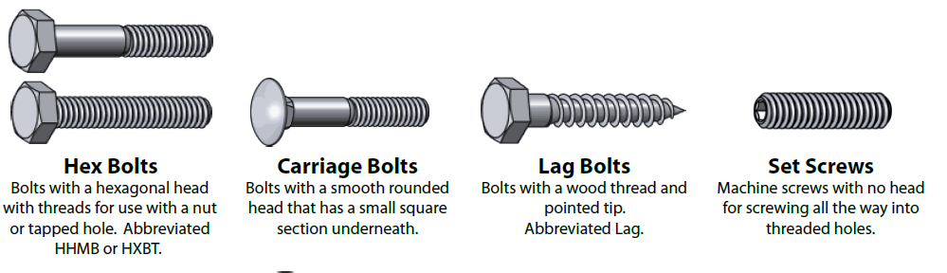
FASTENERS AND LOCKING DEVICES – NUTS & BOLTS
HEXAGONAL BOLTS
CARRIAGE BOLTS
LAG BOLTS
SET SCREW

Slide 11
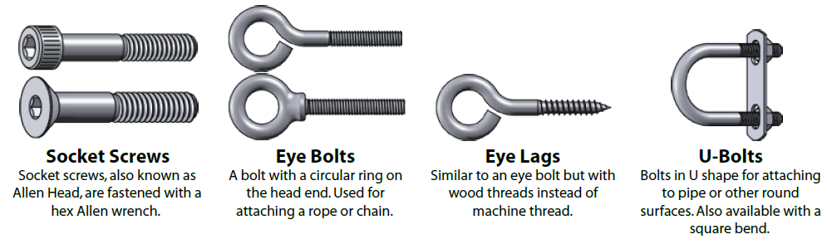
ADDITIONAL TYPES OF FIXING
SOCKET SCREW
EYE BOLT
EYE LAG
U - BOLT

Slide 12
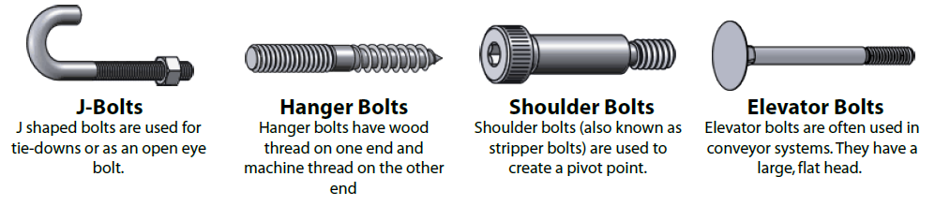
ADDITIONAL TYPES OF FIXING
J - BOLTS
HANGER BOLTS
SHOULDER BOLT
ELEVATOR BOLT

Slide 13
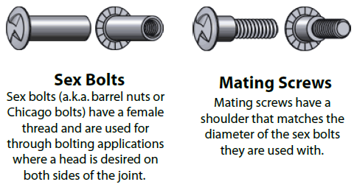
ADDITIONAL TYPES OF FIXING

Slide 14
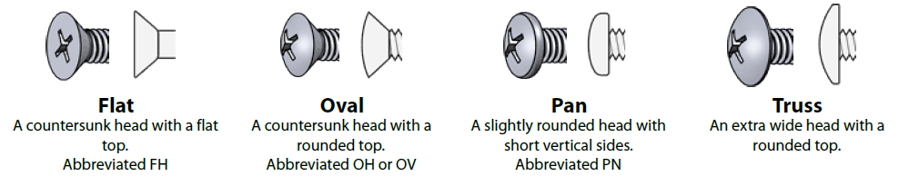
HEAD STYLES AND DRIVES
FLAT
OVAL
PAN
TRUSS

Slide 15
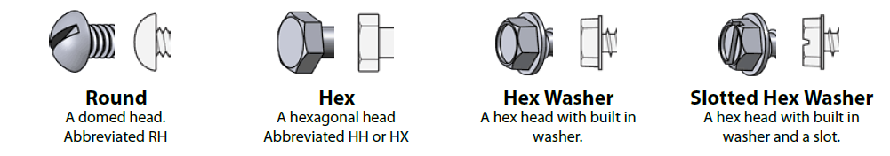
HEAD STYLES AND DRIVES
ROUND
HEX
HEX WASHER
SLOTTED HEX WASHER

Slide 16
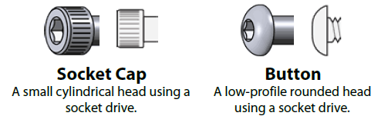
HEAD STYLES AND DRIVES
SOCKET CAP
BUTTON

Slide 17
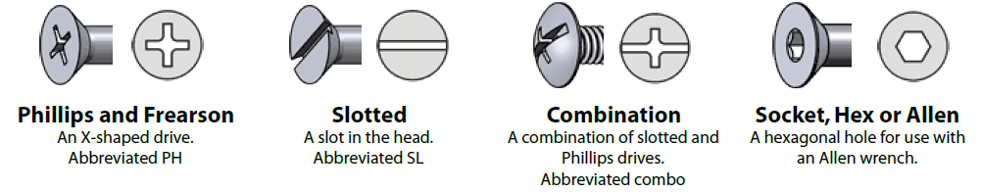
HEAD STYLES AND DRIVES
PHILLIPS / FREARSON
SLOTTED
COMBINATION
SOCKET/ HEX/ ALLEN

Slide 18
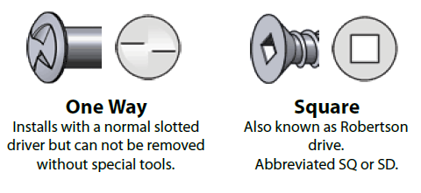
HEAD STYLES AND DRIVES
ONE WAY
SQUARE

Slide 19















HEX
A six sided nut. Also referred to as a finished hex nut.
NYLON INSERT
A nut with a nylon insert
to prevent backing off.
Also referred to as a Nylock
LOCK / JAM
A hex nut with a reduced height.
NYLON INSERT LOCK / JAM
A Nylock nut with a reduced height..
NUTS
WING
A nut with 'wings' for hand tightening
CAP
A nut with a domed top over the end of the fastener.
ACORN
Acorn nuts are a high crown type of cap nut, used for appearance.
FLANGE
A nut with a built in washer like flange.
TEE
A nut designed to be driven into wood to create a threaded hole.
SQUARE
A four sided nut.
PREVAILING TORQUE LOCK
A non-reversible lock nut used for high temperature applications
K-LOCK / KEP
A nut with an attached free-spinning external tooth lockwasher.
COUPLING
Coupling nuts are long nuts used to connect pieces of threaded rod or other male threaded fasteners..
SLOTTED
Slotted nuts are used in conjunction with a cotter pin on drilled shank fasteners to prevent loosening.
CASTLE
Castle nuts are similar to slotted nuts but with the slots in a rounded section above the main nut.

Slide 20
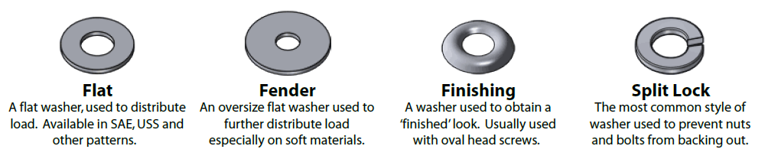
WASHER TYPES
FLAT
FENDER
FINISHING/CUP
SPLIT LOCK
WASHERS ARE ALL FRICTION LOCKING DEVICES!

Slide 21
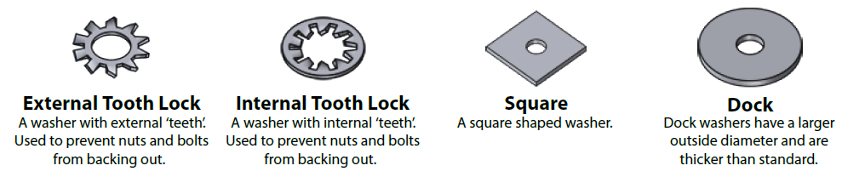
WASHER TYPES
EXTERNAL TOOTH LOCK
INTERNAL TOOTH LOCK
SQUARE
DOCK
WASHERS ARE ALL FRICTION LOCKING DEVICES!

Slide 22
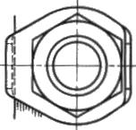
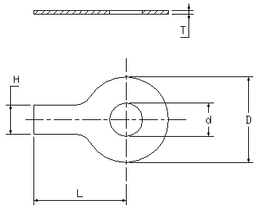
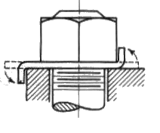
USING A TAB WASHER
WASHER BEGINS LIFE FLAT AND IS BENT INTO POSITION

Slide 23
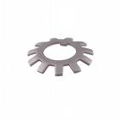
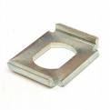



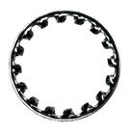
TAB WASHER FORMS
TAB WASHERS ARE ALL POSITIVE LOCKING DEVICES!

Slide 24
THREE STEPS TO THREAD IDENTIFICATION
STEP 01
MEASURE THE
PITCH / T.P.I.
METRIC THREAD
NONE METRIC THREAD

Slide 25
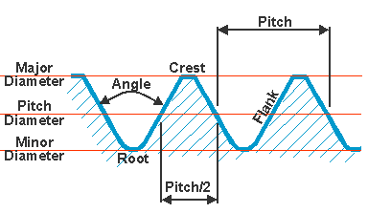
MEASURING THE PITCH
The pitch is the distance between thread peaks, or a similar position from one
thread to the adjacent thread.
EFFECTIVE DIAMETER

Slide 26
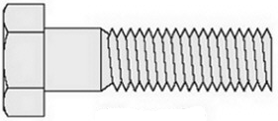
MEASURING THE PITCH
2 mm

Slide 27
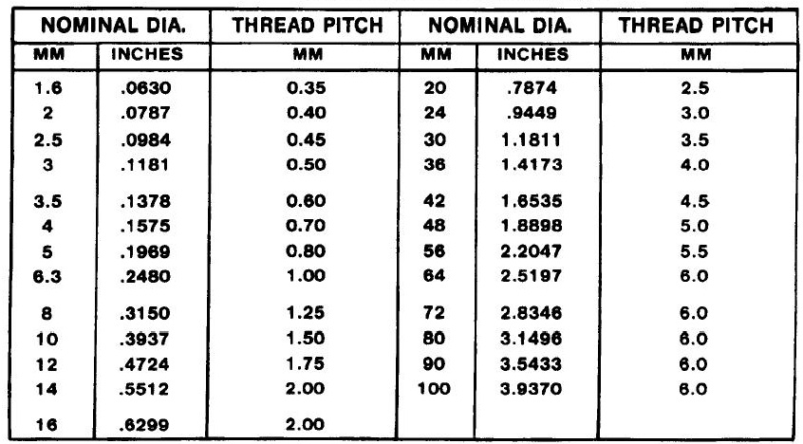
MEASURING THE PITCH

Slide 28
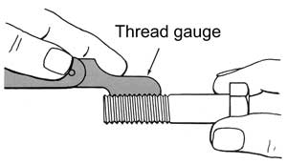
Measuring the TPI
Place the thread gauge onto the threads so it is flat, no light showing underneath.

Slide 29
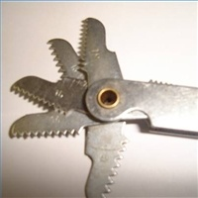
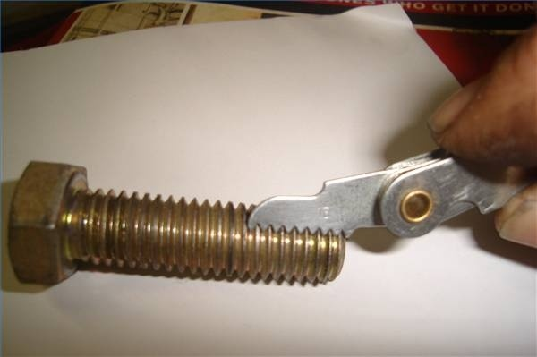
Measuring the TPI

Slide 30
Refer the TPI to a thread chart
Diameter (Inches) | Threads Per Inch (TPI)
 | BSW | UNC | UNF | BSF
1/8 | 40 | 40
5/32 | 32 | 32
3/16 | 24 | 24 | 32 | 32
1/4 | 20 | 20 | 28 | 26
5/16 | 18 | 18 | 24 | 22
3/8 | 16 | 16 | 24 | 20
7/16 | 14 | 14 | 20 | 18
1/2 | 12 | 13 | 20 | 16
5/8 | 11 | 11 | 18 | 14
3/4 | 10 | 10 | 16 | 12
7/8 | 9 | 9 | 14 | 11
1 | 8 | 8 | 12 | 10
1-1/8 | 7 | 7 | 12 | 9
1-1/4 | 7 | 7 | 12 | 9
1-1/2 | 6 | 6 | 12 | 8

Slide 31
THREE STEPS TO THREAD IDENTIFICATION
THREE STEPS TO THREAD IDENTIFICATION
STEP 02
MEASURE THE
DIAMETER –
To next full size up!

Slide 32
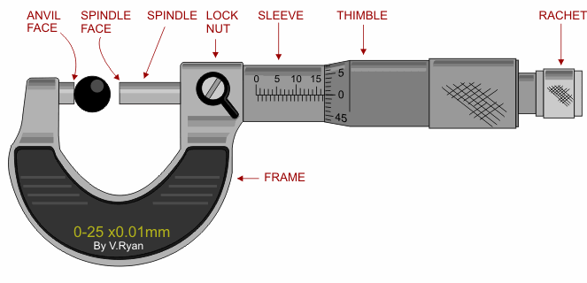
Measure the diameter
Use a micrometer........

Slide 33
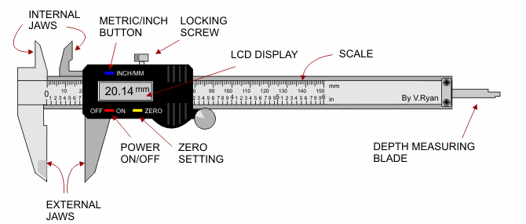
Measure the diameter
Or use a vernier, so long as you understand how to read the measurement and you select the correct micrometer or vernier scale – mm / inches!

Slide 34

Measure the diameter
General
There are several different locations on a fastener where one can measure the diameter.
The most commonly used diameters are:
Thread Diameter (T). Also called major diameter.
Shank Diameter (S). Also called the grip length.
Root Diameter (R). Also called minor diameter.

Slide 35
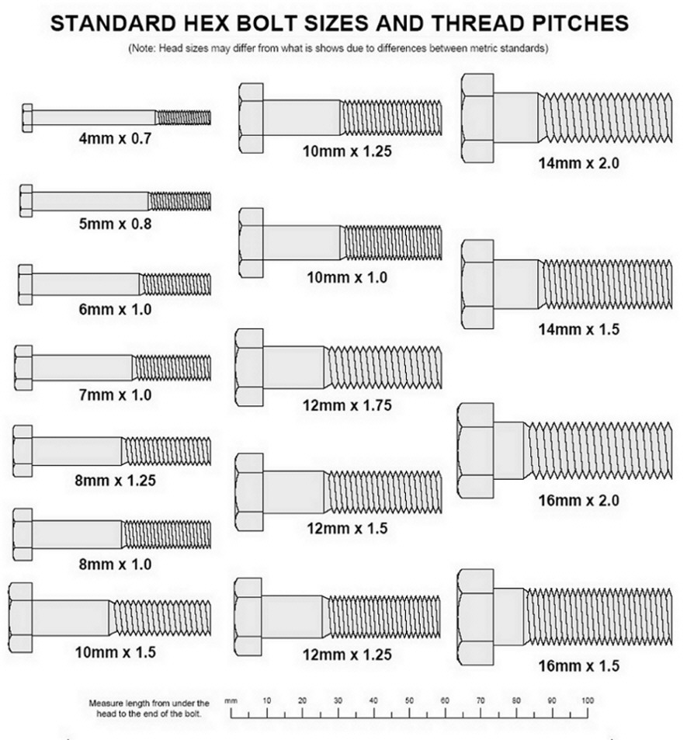

Slide 36
THREE STEPS TO THREAD IDENTIFICATION
STEP 03
NOTE ANY
IDENTIFYING MARKS

Slide 37

IDENTIFYING MARKS - BOLTS
Three touching circles
CIRCULAR RECESSED
BOLTS
IMPERIAL / UNIFIED THREAD

Slide 38
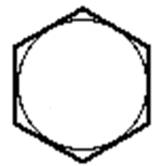
IDENTIFYING MARKS - NUTS
FLAT HEAD BOLTS
– NO RECESS
THE LETTER “M” IS
EMBOSSED ONTO
THE SURFACE
METRIC THREAD

Slide 39

IDENTIFYING MARKS - NUTS
CIRCULAR RECESSED
NUTS
PRECISION –
On the none bearing face
IMPERIAL / UNIFIED THREAD

Slide 40

IDENTIFYING MARKS - NUTS
CIRCULAR RECESSED
NUTS
PRESSED–
On the none bearing face
IMPERIAL / UNIFIED THREAD

Slide 41
IDENTIFYING MARKS - NUTS
Three touching rings for unified thread

Slide 42
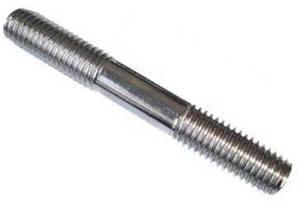

IDENTIFYING MARKS - STUDS
A “VEE” AND A LINE BELOW for unified thread

Slide 43
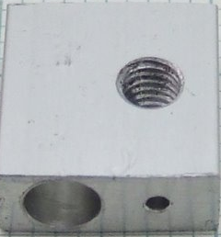
IDENTIFYING MARKS – STUD HOLES
Three touching rings for unified thread,
stamped into the surface

Slide 44
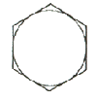
Identification Markings
Material Notes
Low or Medium Carbon Steel
Medium Carbon Steel
Low Carbon
Low Carbon Martensite
Weathering Steel
Alloy Steel
Medium Carbon Alloy
Treatment -
a - cold drawn
b - quenched and tempered
Specs | Nominal Size (inch) | Proof Load Stress (ksi) | Tensile Strength (min ksi) | Material Notes
SAE Grade 1 | 1/4 to 1 1/2 | 33 | 60 | 1
SAE Grade 2 | 1/4 thru 3/4 | 55 | 74
 | over 3/4 thru 1-1/2 | 33 | 60
ASTM A307 | 1/4 to 1 1/2 | 33 | 60 | 3
SAE Grade 4 | 1/4 to 1 1/2 | 65 | 115 | 2,a

Slide 45
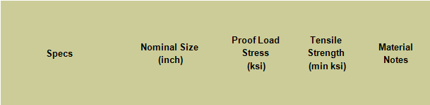
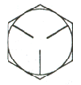
Identification Markings
Material Notes
Low or Medium Carbon Steel
Medium Carbon Steel
Low Carbon
Low Carbon Martensite
Weathering Steel
Alloy Steel
Medium Carbon Alloy
Treatment -
a - cold drawn
b - quenched and tempered
SAE - Grade 5 | 1/4 thru 1 | 85 | 120 | 2, b
ASTM A449 - Type 1 | 1 1/8 thru 1-1/2 | 74 | 105
 | 1 3/4 thru 3 | 55 | 90

Slide 46
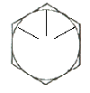
Identification Markings
Material Notes
Low or Medium Carbon Steel
Medium Carbon Steel
Low Carbon
Low Carbon Martensite
Weathering Steel
Alloy Steel
Medium Carbon Alloy
Treatment -
a - cold drawn
b - quenched and tempered
SAE - Grade 5.2 | 1/4 thru 1 | 85 | 120 | 4, b

Slide 47
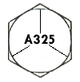
Identification Markings
Material Notes
Low or Medium Carbon Steel
Medium Carbon Steel
Low Carbon
Low Carbon Martensite
Weathering Steel
Alloy Steel
Medium Carbon Alloy
Treatment -
a - cold drawn
b - quenched and tempered
ASTM A325 - Type 1 | 1/2 thru 1 | 85 | 120 | 2, b
 | 1 1/8 to 1-1/2 | 74 | 105

Slide 48
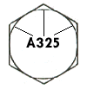
Identification Markings
Material Notes
Low or Medium Carbon Steel
Medium Carbon Steel
Low Carbon
Low Carbon Martensite
Weathering Steel
Alloy Steel
Medium Carbon Alloy
Treatment -
a - cold drawn
b - quenched and tempered
ASTM A325 - Type 2 | 1/2 thru 1 | 85 | 120 | 4,b
 | 1 1/8 to 1-1/2 | 74 | 105

Slide 49
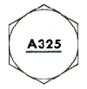
Identification Markings
Material Notes
Low or Medium Carbon Steel
Medium Carbon Steel
Low Carbon
Low Carbon Martensite
Weathering Steel
Alloy Steel
Medium Carbon Alloy
Treatment -
a - cold drawn
b - quenched and tempered
ASTM A325 - Type 3 | 1/2 thru 1 | 85 | 120 | 5,b
 | 1 1/8 to 1-1/2 | 74 | 105

Slide 50
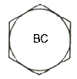
Identification Markings
Material Notes
Low or Medium Carbon Steel
Medium Carbon Steel
Low Carbon
Low Carbon Martensite
Weathering Steel
Alloy Steel
Medium Carbon Alloy
Treatment -
a - cold drawn
b - quenched and tempered
ASTM A354 - Grade BC | 1/4 thru 2-1/2 | 105 | 125 | 5,b
 | 2-3/4 thru 4 | 95 | 115

Slide 51
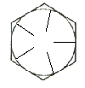
Identification Markings
Material Notes
Low or Medium Carbon Steel
Medium Carbon Steel
Low Carbon
Low Carbon Martensite
Weathering Steel
Alloy Steel
Medium Carbon Alloy
Treatment -
a - cold drawn
b - quenched and tempered
SAE Grade 7 | 1/4 to 1 1/2 | 105 | 133 | 7,b

Slide 52
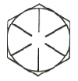
Identification Markings
Material Notes
Low or Medium Carbon Steel
Medium Carbon Steel
Low Carbon
Low Carbon Martensite
Weathering Steel
Alloy Steel
Medium Carbon Alloy
Treatment -
a - cold drawn
b - quenched and tempered
SAE - Grade 8 | 1/4 thru 1-1/2 | 120 | 150 | 7,b
ASTM A354 - Grade BD | 1/4 thru 1-1/2 | 120 | 150 | 6,b

Slide 53
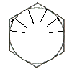
Identification Markings
Material Notes
Low or Medium Carbon Steel
Medium Carbon Steel
Low Carbon
Low Carbon Martensite
Weathering Steel
Alloy Steel
Medium Carbon Alloy
Treatment -
a - cold drawn
b - quenched and tempered
SAE - Grade 8.2 | 1/4 thru 1 | 120 | 150 | 4,b

Slide 54
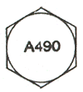
Identification Markings
Material Notes
Low or Medium Carbon Steel
Medium Carbon Steel
Low Carbon
Low Carbon Martensite
Weathering Steel
Alloy Steel
Medium Carbon Alloy
Treatment -
a - cold drawn
b - quenched and tempered
ASTM A490 - Type 1 | ½ to1-1/2 | 120 | 150 | 6,b

Slide 55
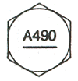
Identification Markings
Material Notes
Low or Medium Carbon Steel
Medium Carbon Steel
Low Carbon
Low Carbon Martensite
Weathering Steel
Alloy Steel
Medium Carbon Alloy
Treatment -
a - cold drawn
b - quenched and tempered
ASTM A490 - Type 3 | 1/2 thru 1-1/2 | 120 | 150 | 5,b

Slide 56
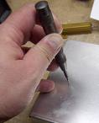
TAPPING A NEW HOLE
Step 1
Mark the location for the threaded hole with the ruler and scribe.
With the center punch and hammer, center mark the hole location.

Slide 57

TAPPING A NEW HOLE
Step 2
Refer to the drill and tap chart to determine the correct size of the drill bit required for the tap. If the hole is larger than 1/2 an inch, you will need to drill a pilot hole before you can drill the final hole size. Do not use a pilot hole that is larger than 40 percent of the diameter of the final hole size. A larger pilot hole will cause the final drill bit to bind and break, resulting in a poor final hole quality or injury to the person drilling the hole.

Slide 58

DRILL TO TAPPING CHART

Slide 59

TAPPING A NEW HOLE
Step 3
Insert the drill bit into the drill. Apply cutting fluid to the center mark that you placed on the metal and onto the drill bit. Drill the hole through the metal, using steady pressure. Apply additional cutting fluid as necessary to keep the drill bit cool. If you are drilling into stainless steel, pump the trigger to keep the drill bit moving slow. Increased drilling speeds will result in your drill bit heating up and losing its cutting edge. With stainless steel, slower is always better.

Slide 60

TAPPING A NEW HOLE
Step 4
Clean the shavings from around the drilled area with a clean rag. Insert the proper tap into the tee handle. A drill can be used to run the tap through the hole, but it is not recommended as even slight pressure other than straight down will break the fragile carbide tap.

Slide 61

TAPPING A NEW HOLE
Step 5
Liberally coat the tap with cutting and tapping fluid. With the tap aligned straight with the hole, turn the tee handle clockwise to start tapping the hole. If you are tapping for left-handed threads, you need to turn the tee handle counter-clockwise for the tap to start in the hole.

Slide 62
TAPPING A NEW HOLE
Step 6
Eliminate tap binding by turning the tee handle backwards 1/4 of a turn after each revolution of the tee handle. The 1/4 turn back will remove filing build-up from the front edge of the tap. Apply tapping fluid to the tap before continuing the tap into the hole.

Slide 63
TAPPING A NEW HOLE
Step 7
Reverse the tap to remove it from the threaded hole. Remove the burr from the hole. Test the threads with the correct size bolt to ensure that the bolt threads correctly.

Slide 64

TAPPING A NEW HOLE
The correct order of using the tap and wrench to cut a new thread is :-
S = STARTING tap
I = INTERMEDIATE tap
F = FINISHING tap

Slide 65
TAPPING A NEW HOLE
The correct order of using the tap and wrench to cut a new thread is :-
T I P
T = Taper tap
I = INTERMEDIATE tap
P = PLUGGING tap

Slide 66

INSERTING A STUD
All studs have an unthreaded portion between the two threaded ends.
Do NOT install studs using a pipe wrench on the unthreaded portion of the stud. Aside from possible damage to the threads, the marks or notches (Fig. 1) made by the pipe wrench create stress riser points in the stud.

Slide 67

INSERTING A STUD
The accepted method for stud installation is as follows: (1) First thread Lock/Jam Nut into stud. (2) Place flat washer on top of Jam Nut. (3) Thread Full Nut onto stud over washer. (Assembly shown in Fig. 2) After assembly, stud may be driven into tapped hole In the casting using either impact wrench or hand wrench. The washer prevents turning of the nuts and reduces thread stresses.

Slide 68

INSERTING A STUD
When installing new studs, care must be taken to assure that the stud Is not over-inserted. NEVER!! insert a stud into a tapped hole to the extent that it bottoms-out. If the stud is bottomed, the thread stresses are mislocated and the probability of stud failure is greatly increased.

Slide 69

TAPPED HOLE OR STRAIGHT THROUGH

Slide 70
ANTI-FRICTION COATING
AF coatings are dry lubricants consisting of suspensions of solid lubricants, such as graphite, PTFE or molybdenum disulphide of small particle size in a binder. Such coatings can be applied to fastener threads to replace metallic coatings such as zinc and cadmium and offer maintenance free permanent lubrication. By careful selection of the lubricants, AF coatings can be designed to meet specific applications. The coatings are permanently bonded to the metal surface and provide a lubricating film preventing direct metal to metal contact.

Slide 71

BOLT
A bolt is the term used for a threaded fastener, with a head, designed to be used in conjunction with a nut.

Slide 72

BOLT – ROOT DIAMETER
ACME THREAD

Slide 73
ANY QUESTIONS

